Slide 1
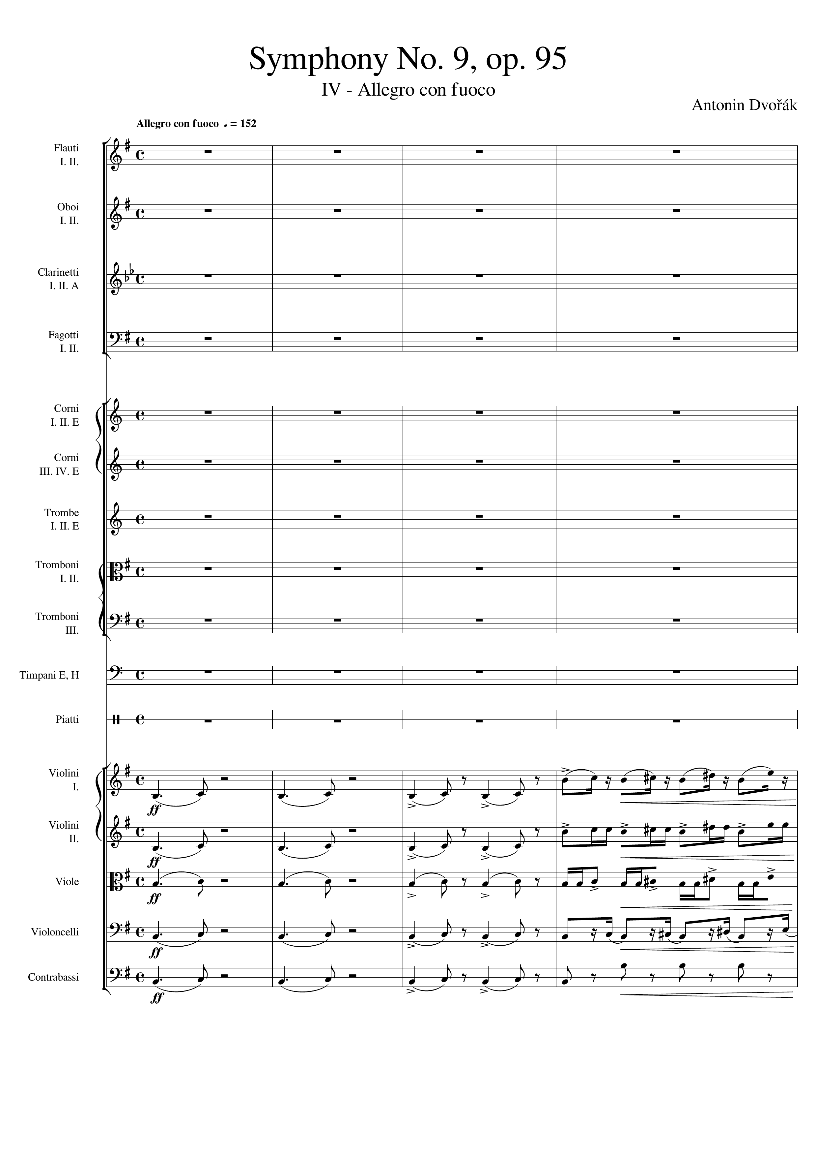
mel
mel
mel
mel+rhythm
mel
mel+rhythm
mel
mel+rhythm
mel
rhythm
Notes:
0-16
33:17

Slide 2
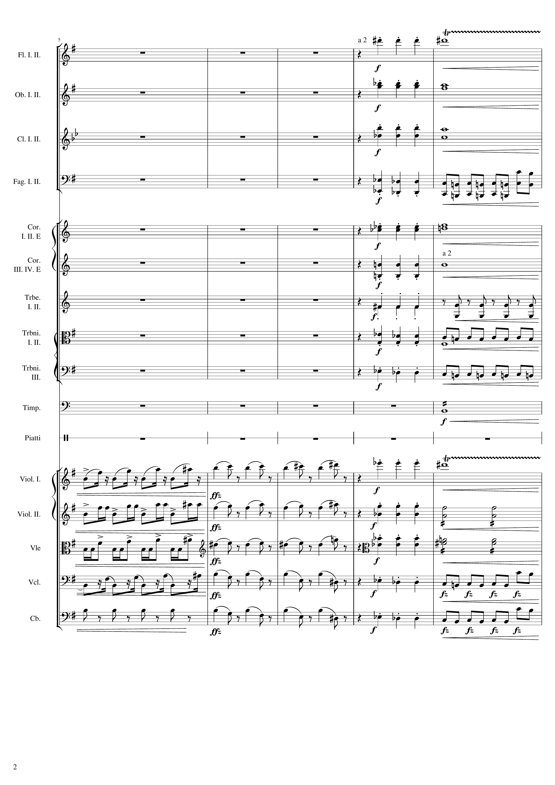
mel
rhythm+harm
harm
rhythm+harm
harm
rhythm+harm
rhythm
rhythm+harm
harm
rhythm+harm
harm
rhythm+harm
rhythm
rhythm+harm
rhythm
rhythm+harm
harm
rhythm+harm
rhythm
rhythm+harm
mel
mel
mel
mel+rhythm
mel+harm
rhythm+harm
rhythm+harm
mel+rhythm
mel+harm
rhythm+harm
rhythm+harm
mel+rhythm
mel+harm
rhythm+harm
rhythm
rhythm
mel+harm
rhythm+harm
rhythm
Notes:
16-36
33:23

Slide 3
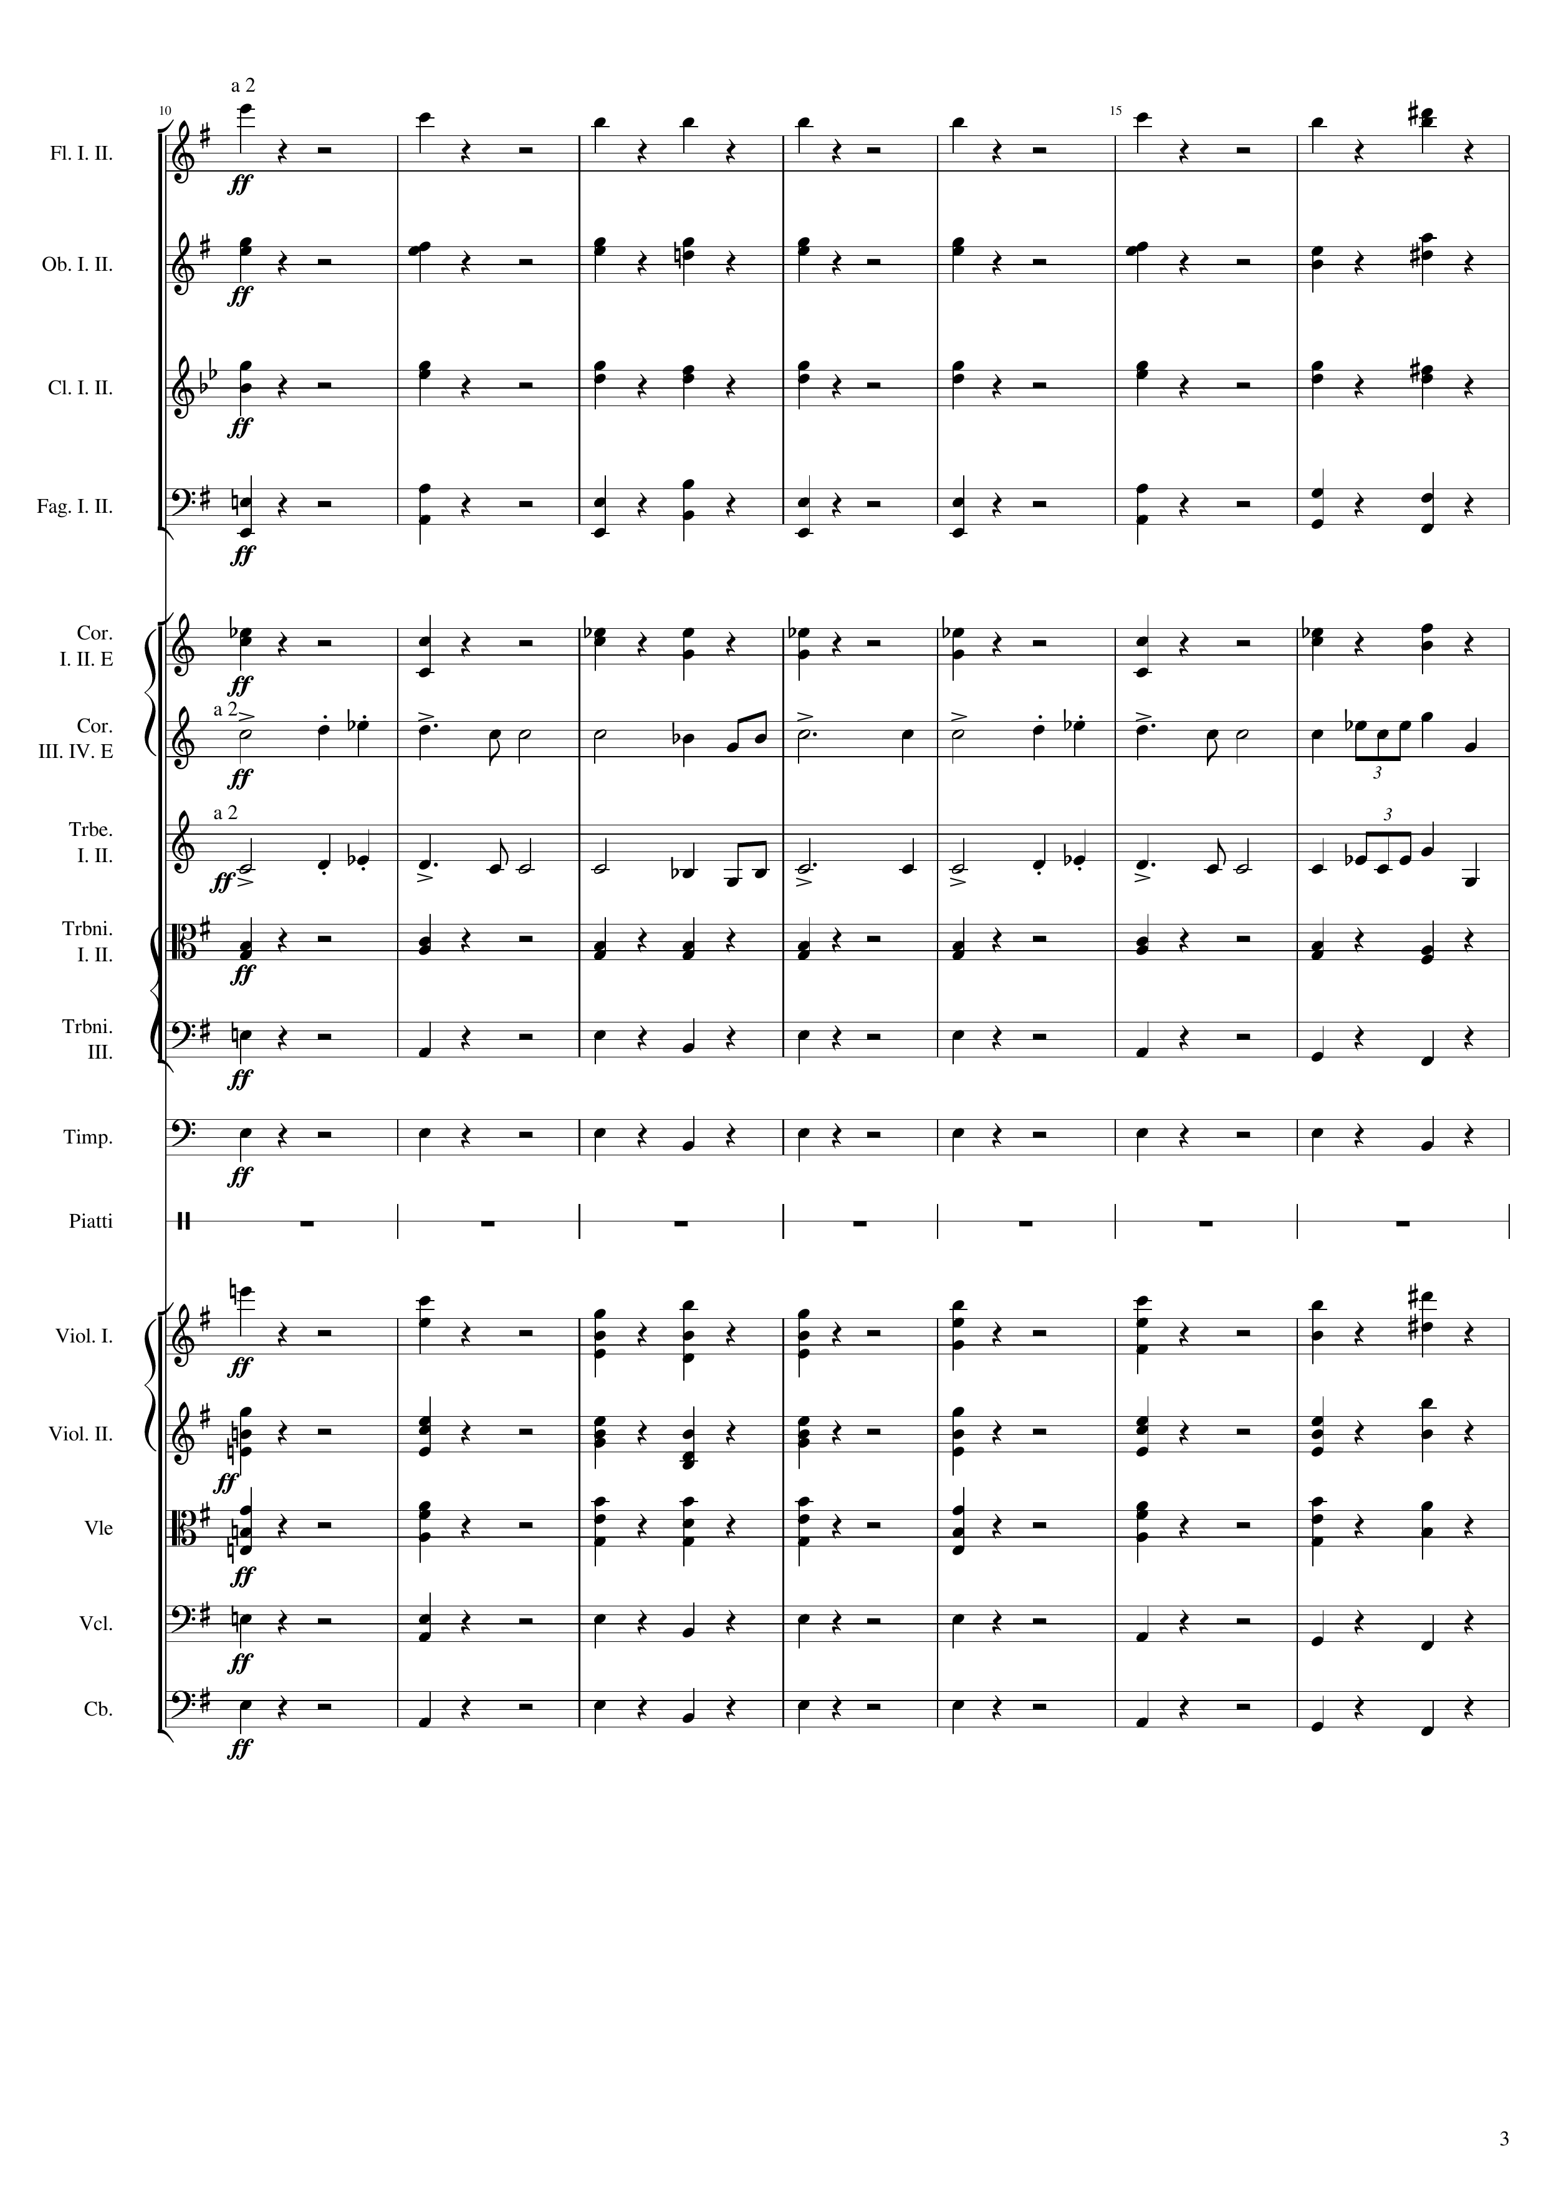
mel
rhythm+harm
rhythm+harm
rhythm+harm
rhythm+harm
rhythm+harm
mel
mel
rhythm+harm
rhythm+harm
rhythm+harm
mel
rhythm+harm
rhythm+harm
rhythm+harm
rhythm+harm
rhythm+harm
Notes:
36-64
33:32

Slide 4
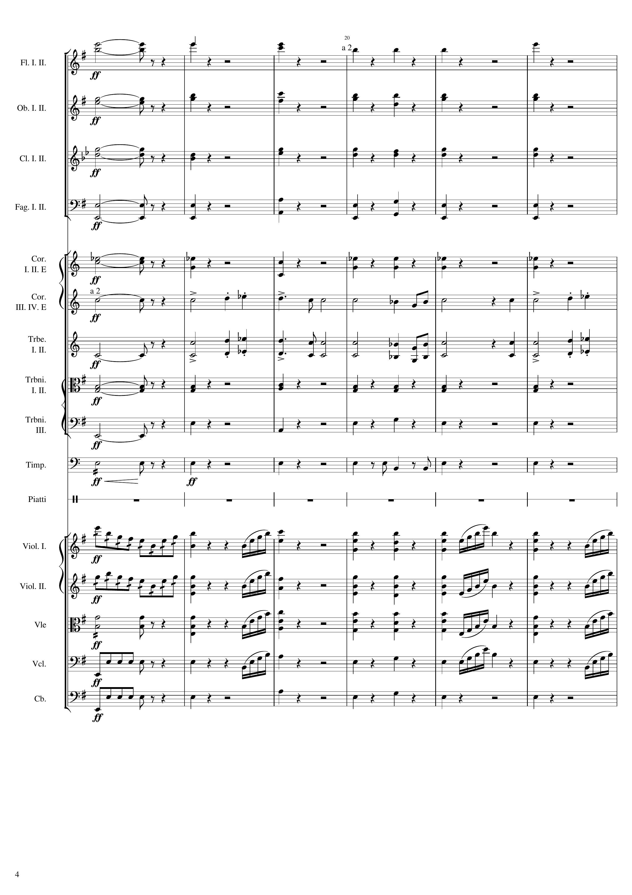
rhythm+harm
rhythm+harm
rhythm+harm
rhythm+harm
rhythm+harm
rhythm+harm
rhythm+harm
rhythm+harm
rhythm+harm
rhythm+harm
mel
mel
rhythm+harm
rhythm+harm
rhythm+harm
rhythm+harm
rhythm
rhythm+harm
mel+rhythm
rhythm+harm
mel+rhythm
rhythm+harm
rhythm
rhythm+harm
rhythm
rhythm+harm
rhythm
rhythm+harm
Notes:
64-88
33:45

Slide 5
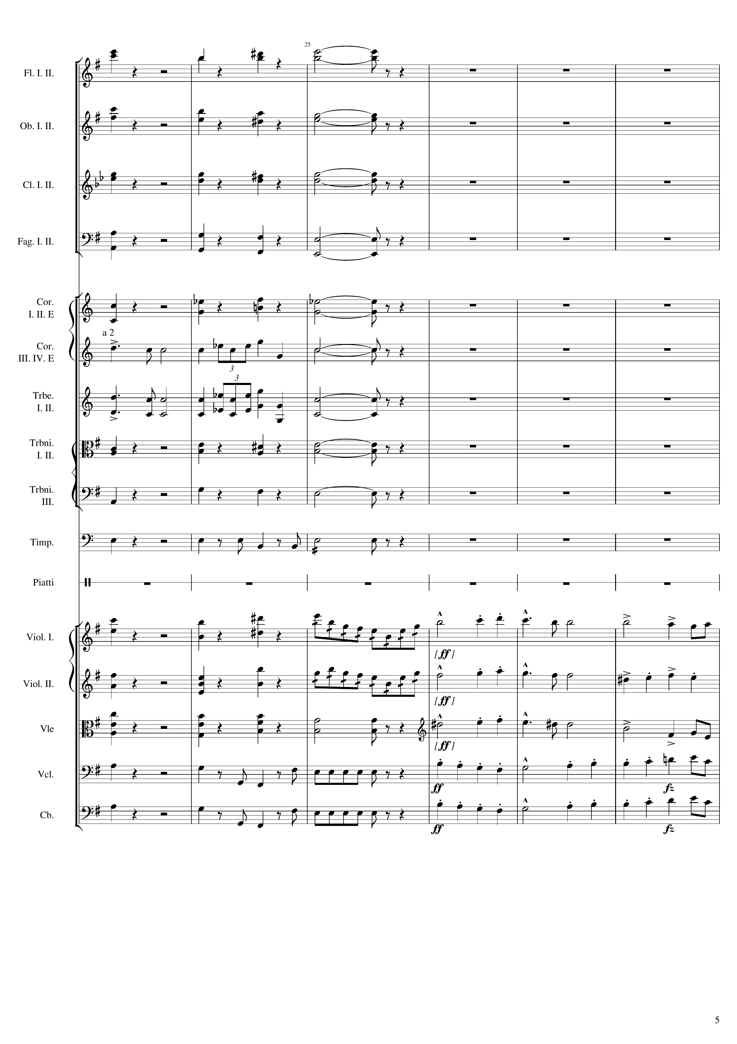
rhythm+harm
rhythm+harm
rhythm+harm
rhythm+harm
rhythm+harm
mel
mel
rhythm+harm
rhythm+harm
rhythm+harm
rhythm
rhythm+harm
mel+rhythm
mel
mel
rhythm+harm
mel+rhythm
mel
mel
rhythm+harm
mel
mel
rhythm+harm
rhythm
mel
rhythm+harm
rhythm
mel
Notes:
88-112
33:56

Slide 6
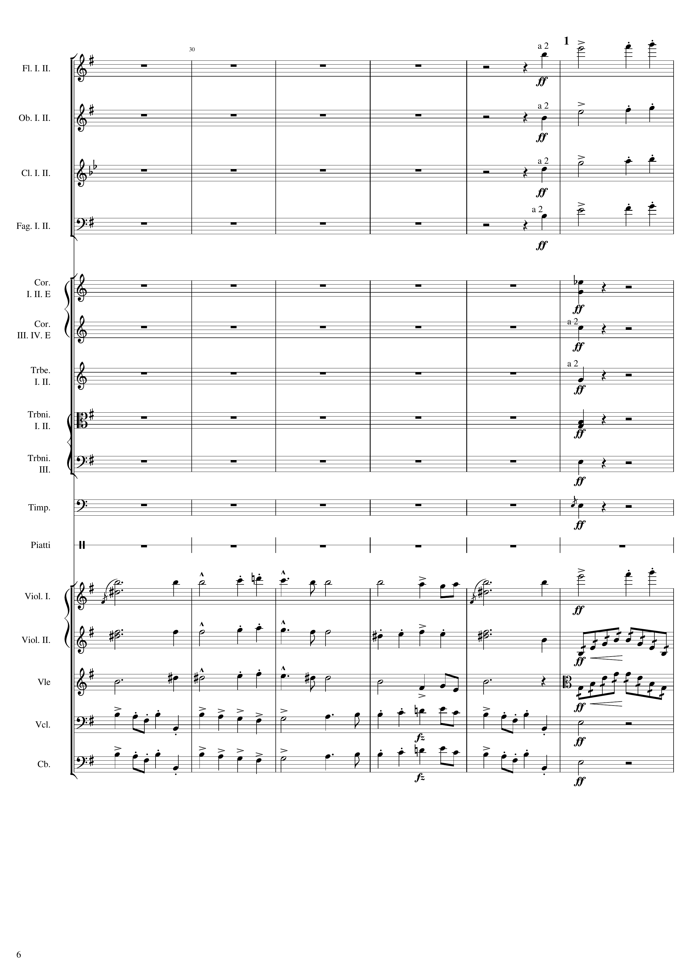
mel
mel
mel
mel
rhythm+harm
rhythm+harm
rhythm+harm
rhythm+harm
rhythm+harm
rhythm+harm
mel
mel
mel
mel
mel
rhythm
mel
mel
rhythm
mel
rhythm+harm
mel
rhythm+harm
Notes:
112-136
34:07

Slide 7
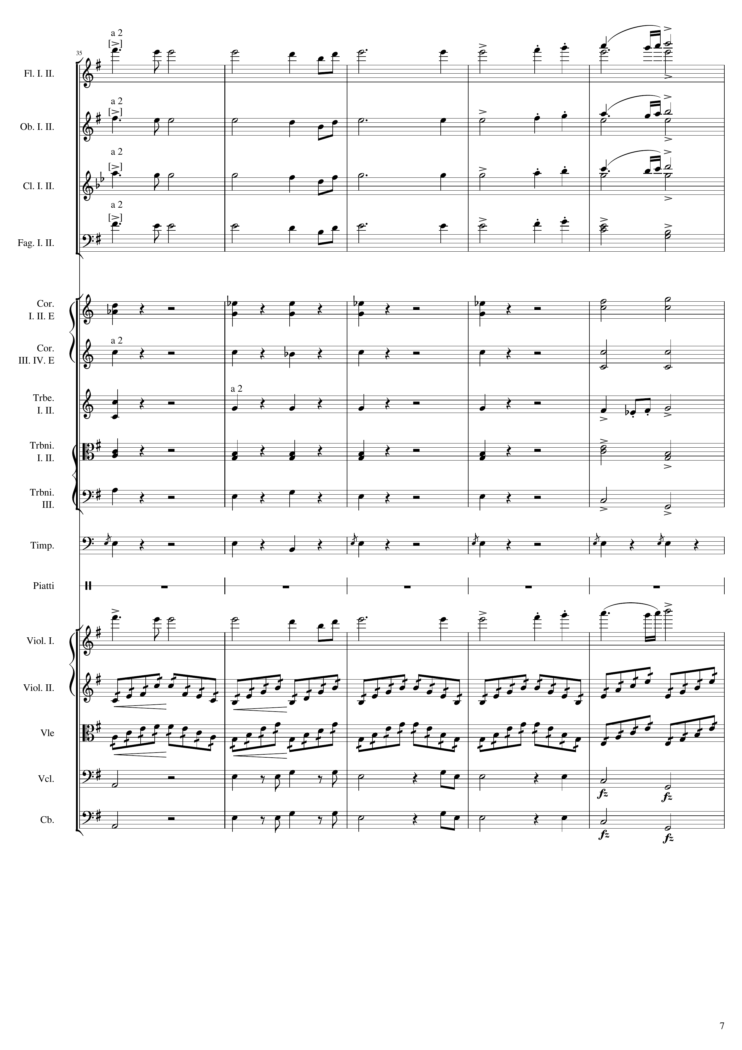
mel
mel
rhythm+harm
mel
mel
rhythm+harm
mel
mel
rhythm+harm
mel
rhythm+harm
rhythm+harm
rhythm+harm
rhythm+harm
mel
rhythm+harm
rhythm+harm
rhythm+harm
mel
rhythm
rhythm
rhythm+harm
rhythm+harm
Notes:
136-156
34:18

Slide 8
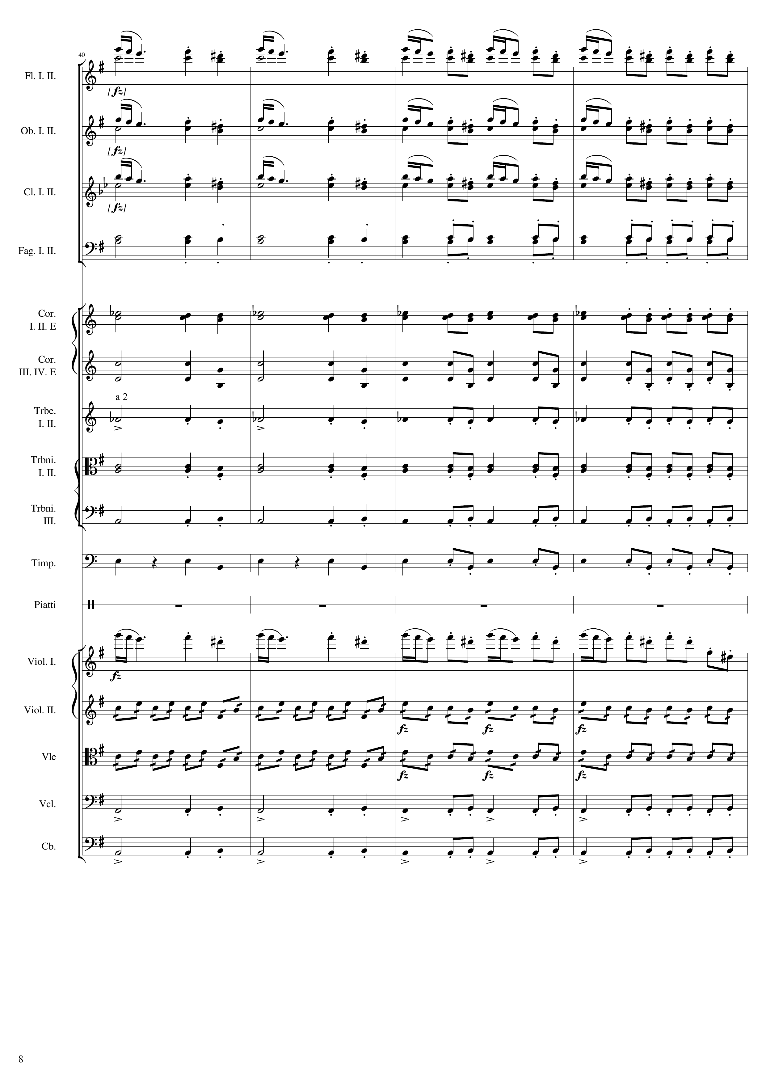
mel
rhythm+harm
rhythm
mel
rhythm+harm
rhythm
mel
rhythm+harm
rhythm
rhythm+harm
rhythm
rhythm+harm
rhythm
rhythm+harm
rhythm
rhythm+harm
rhythm
rhythm+harm
rhythm
rhythm+harm
rhythm
rhythm+harm
rhythm
mel
rhythm
rhythm
rhythm+harm
rhythm
rhythm+harm
rhythm
Notes:
156-172
34:27

Slide 9
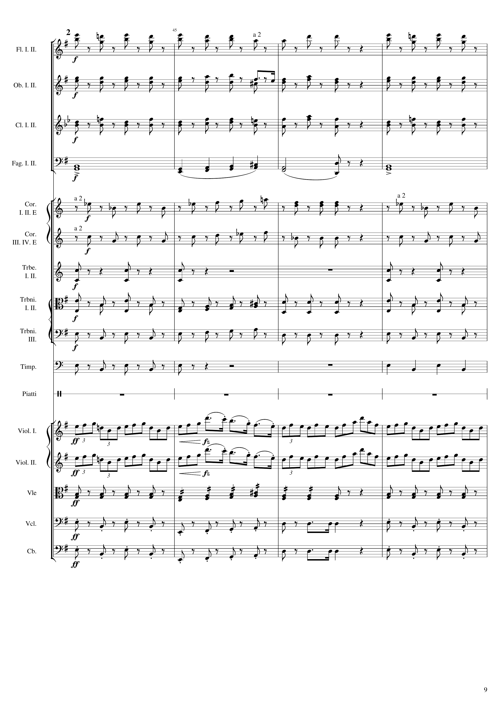
rhythm+harm
rhythm+harm
rhythm+harm
harm
rhythm+harm
rhythm+harm
rhythm+harm
rhythm+harm
rhythm+harm
rhythm+harm
mel
mel
rhythm+harm
rhythm+harm
rhythm+harm
Notes:
172-188
34:34

Slide 10
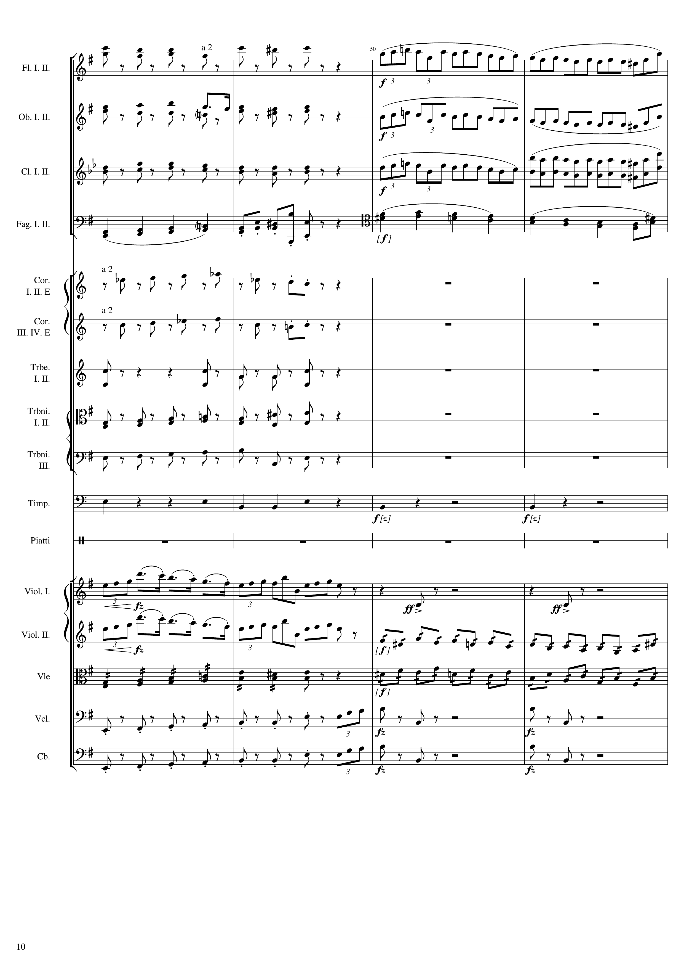
rhythm+harm
mel
rhythm+harm
mel
rhythm+harm
mel
harm
rhythm
mel+harm
rhythm+harm
rhythm+harm
rhythm+harm
rhythm+harm
rhythm+harm
rhythm+harm
rhythm
mel
rhythm
mel
rhythm
rhythm
rhythm
rhythm+harm
rhythm
rhythm+harm
rhythm
Notes:
188-204
34:41

Slide 11
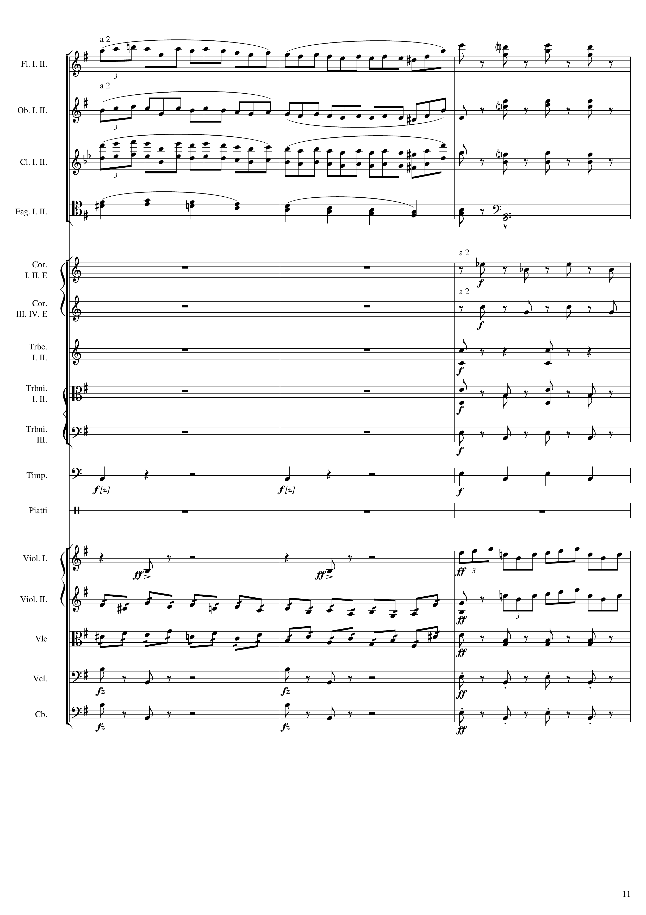
mel
rhythm+harm
mel
rhythm+harm
mel
rhythm+harm
mel+harm
harm
rhythm+harm
rhythm+harm
rhythm+harm
rhythm+harm
rhythm+harm
rhythm
rhythm+harm
rhythm
mel
rhythm
rhythm
mel
rhythm
rhythm
rhythm
rhythm+harm
rhythm
rhythm+harm
Notes:
204-216
34:48

Slide 12
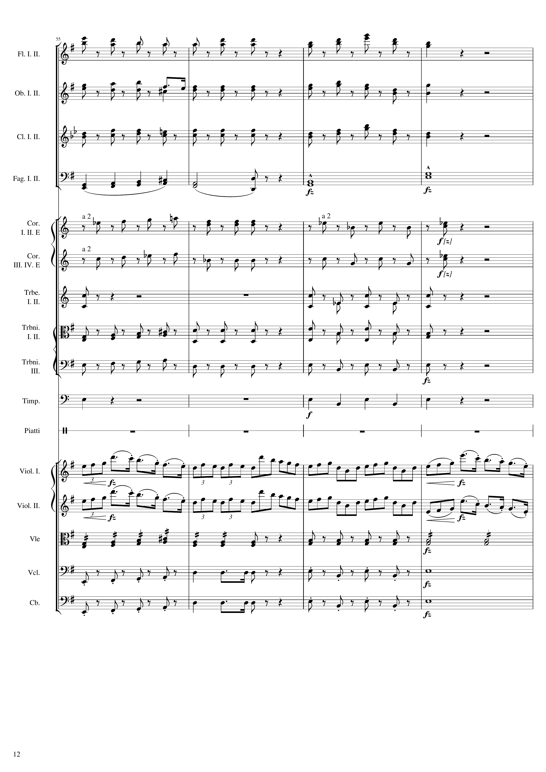
rhythm+harm
rhythm+harm
rhythm+harm
harm
rhythm+harm
rhythm+harm
rhythm+harm
rhythm+harm
rhythm+harm
rhythm+harm
rhythm+harm
mel
mel
rhythm
rhythm+harm
harm
rhythm+harm
harm
Notes:
216-232
34:53

Slide 13
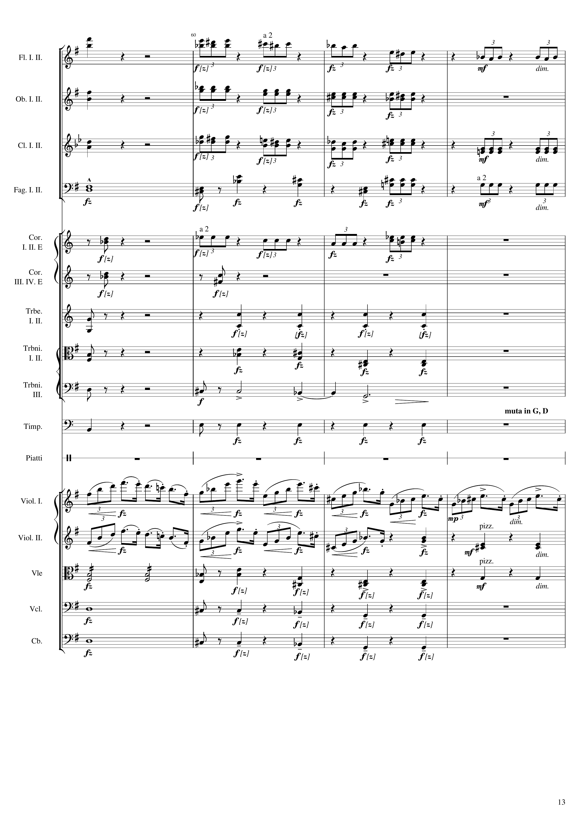
rhythm+harm
rhythm
rhythm+harm
rhythm
rhythm+harm
rhythm
harm
rhythm
rhythm+harm
rhythm
rhythm+harm
rhythm+harm
rhythm
rhythm+harm
rhythm
rhythm+harm
rhythm
rhythm+harm
rhythm
mel
mel
rhythm
rhythm
rhythm
rhythm
harm
rhythm
harm
rhythm
Notes:
232-248
35:00

Slide 14
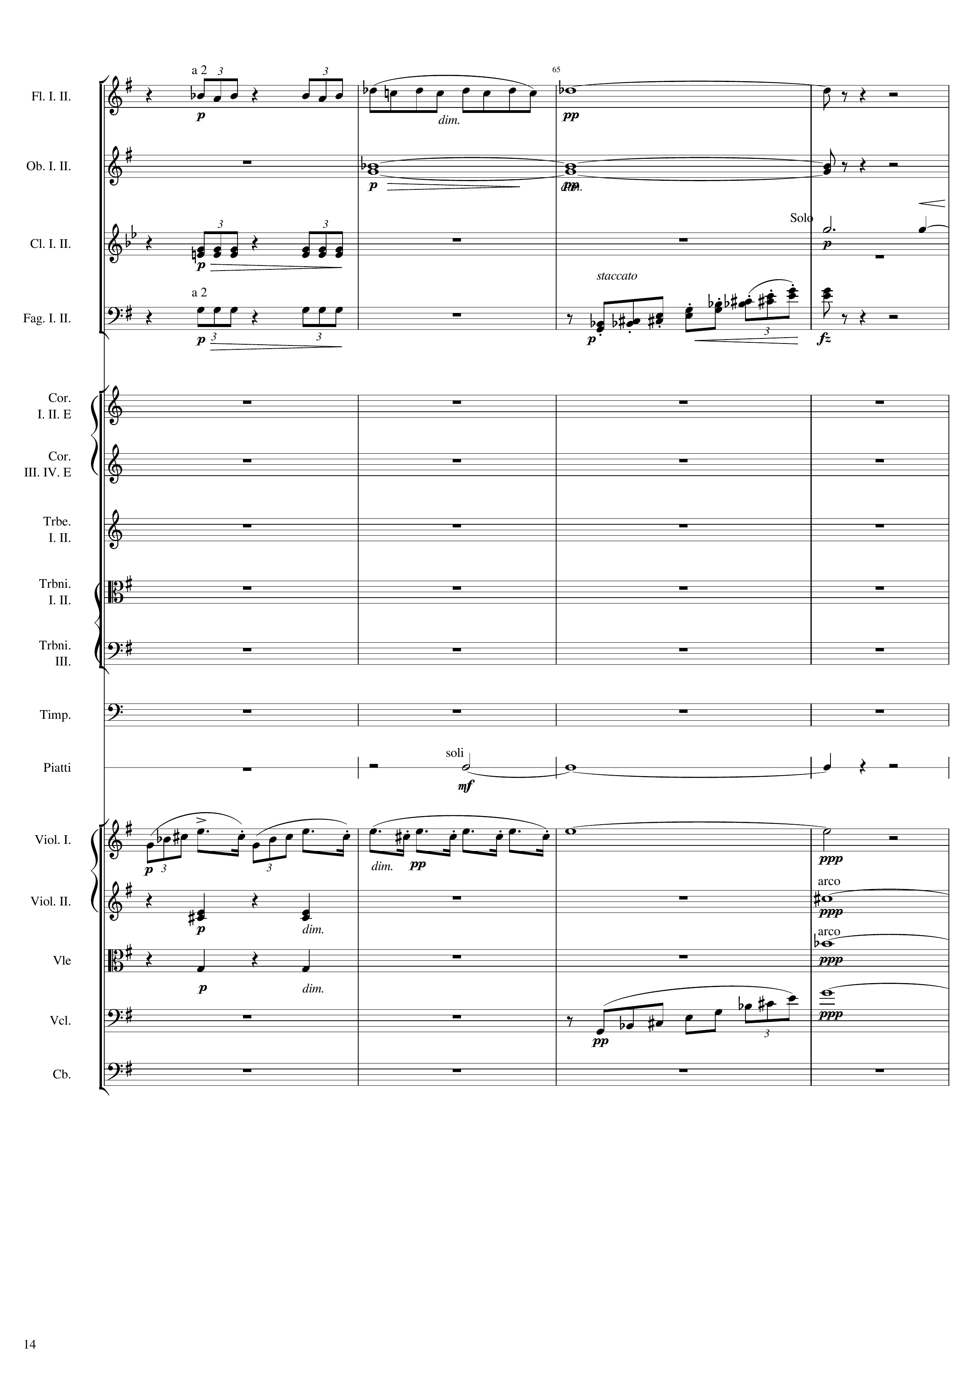
rhythm
rhythm
harm
harm
rhythm
mel
rhythm
rhythm+harm
rhythm
mel
rhythm
harm
rhythm
harm
rhythm+harm
harm
Notes:
248-264
35:07

Slide 15
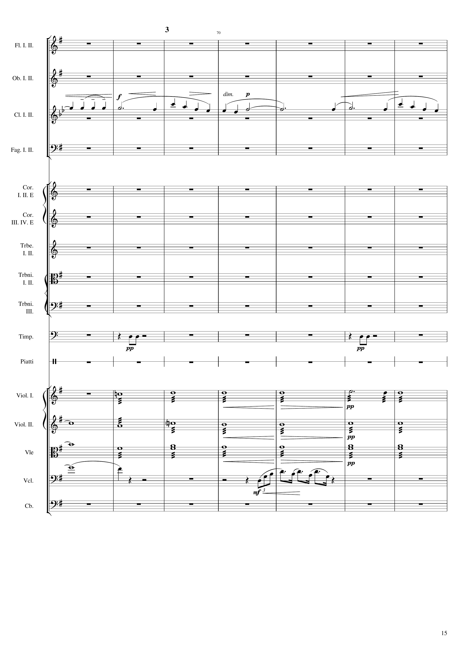
mel
rhythm
rhythm
harm
harm
harm
harm
mel
Notes:
264-292
35:14

Slide 16
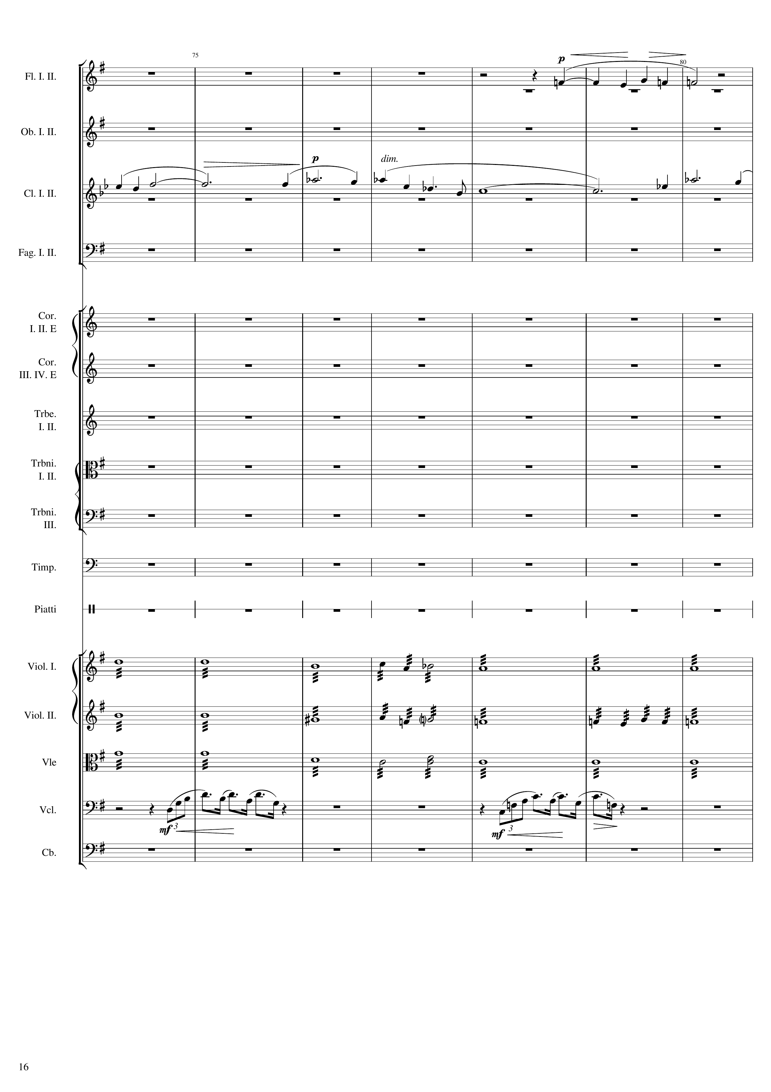
mel
mel
harm
harm
harm
mel
mel
Notes:
292-320
35:29

Slide 17
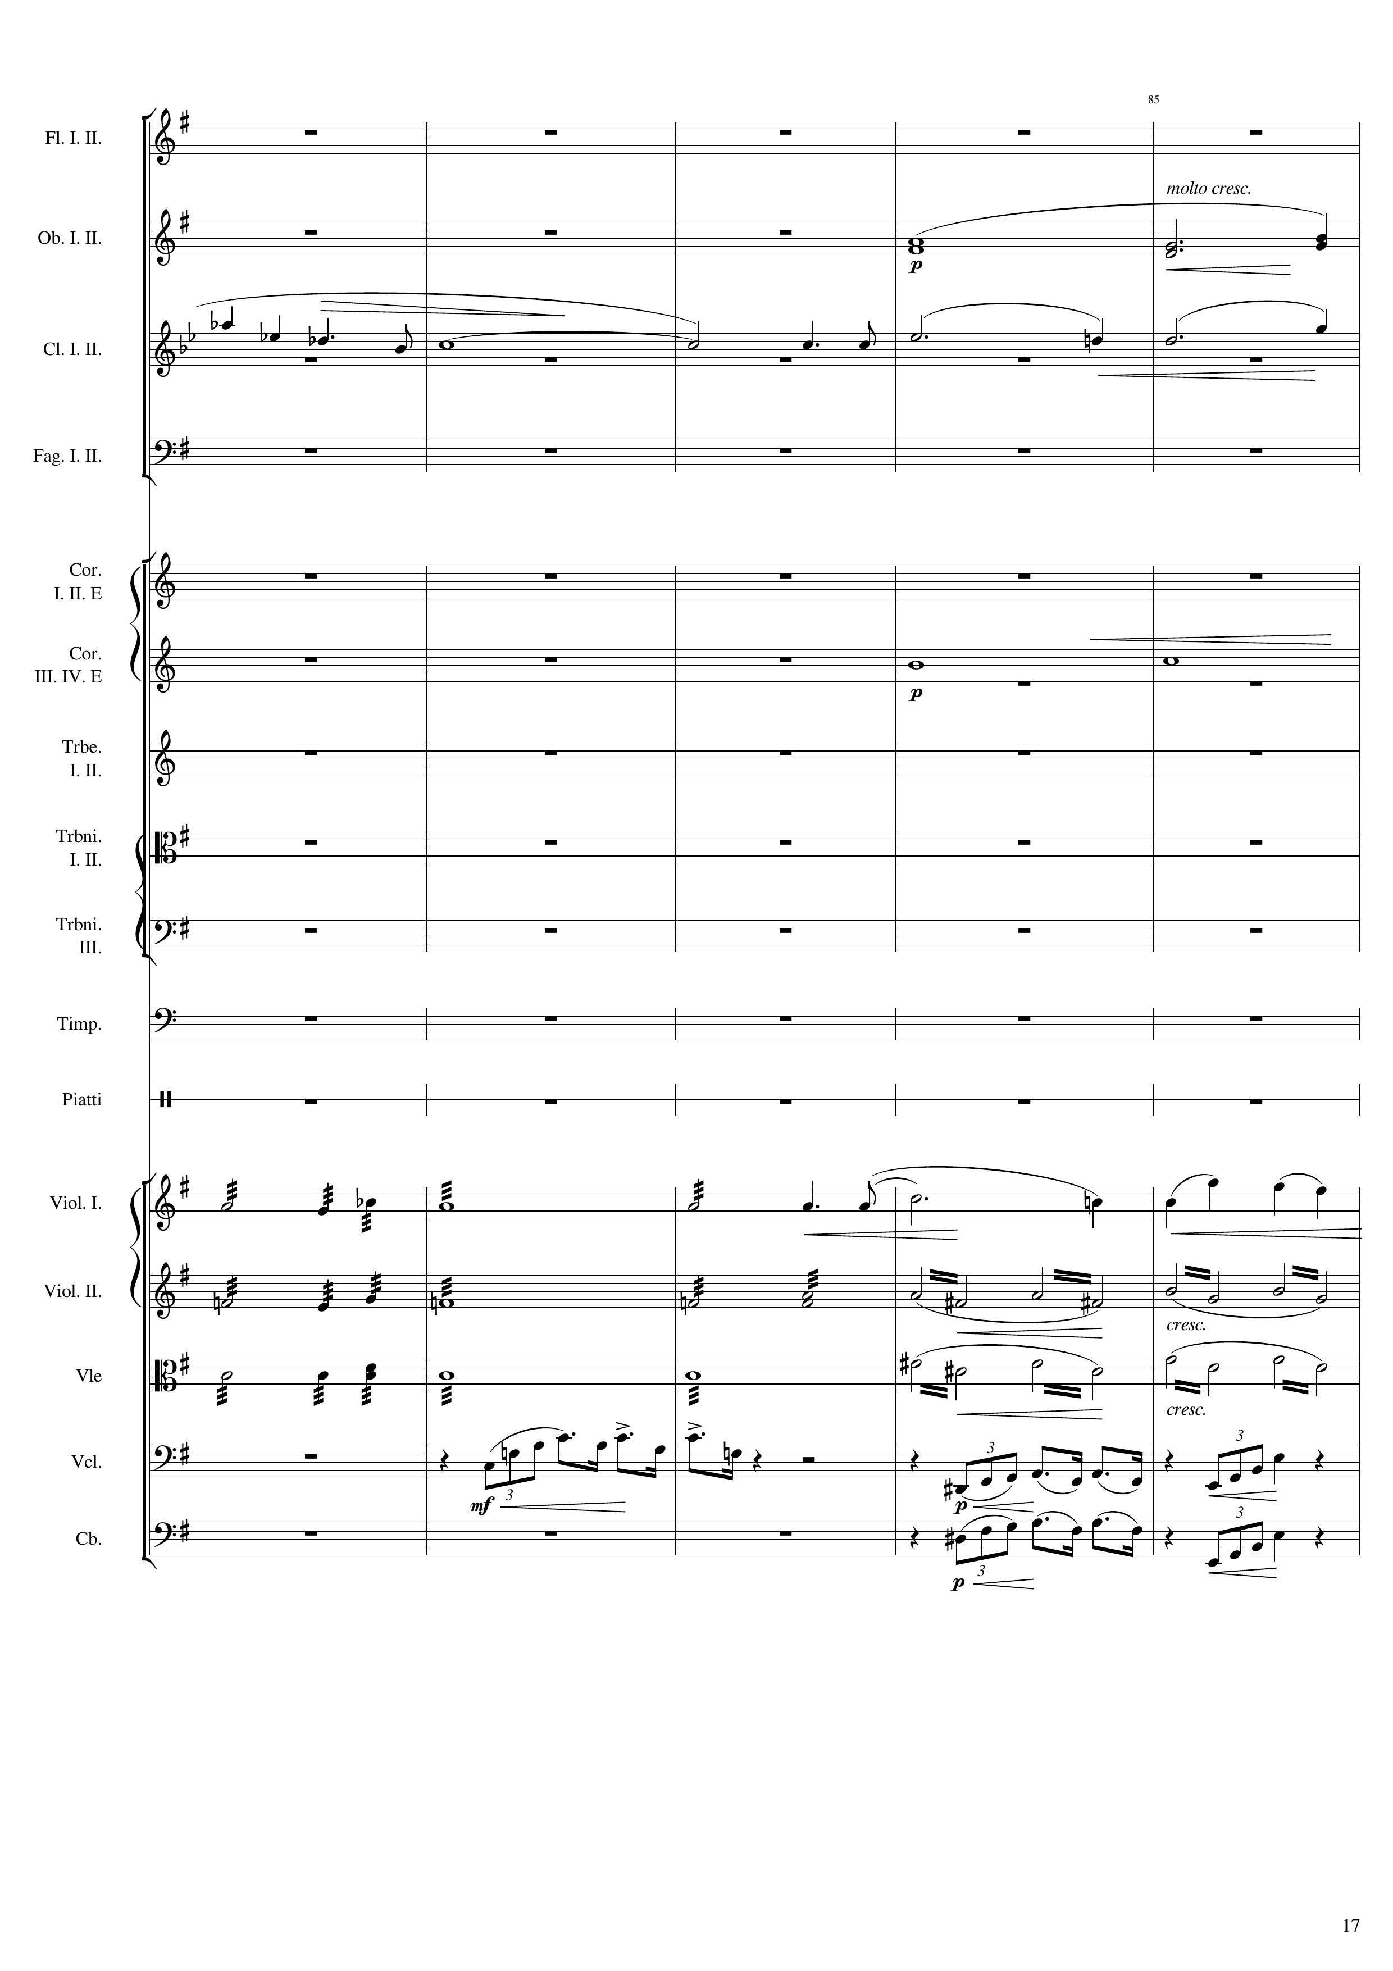
harm
mel
harm
harm
mel
harm
rhythm+harm
harm
rhythm+harm
mel
mel
mel
Notes:
320-340
35:43

Slide 18
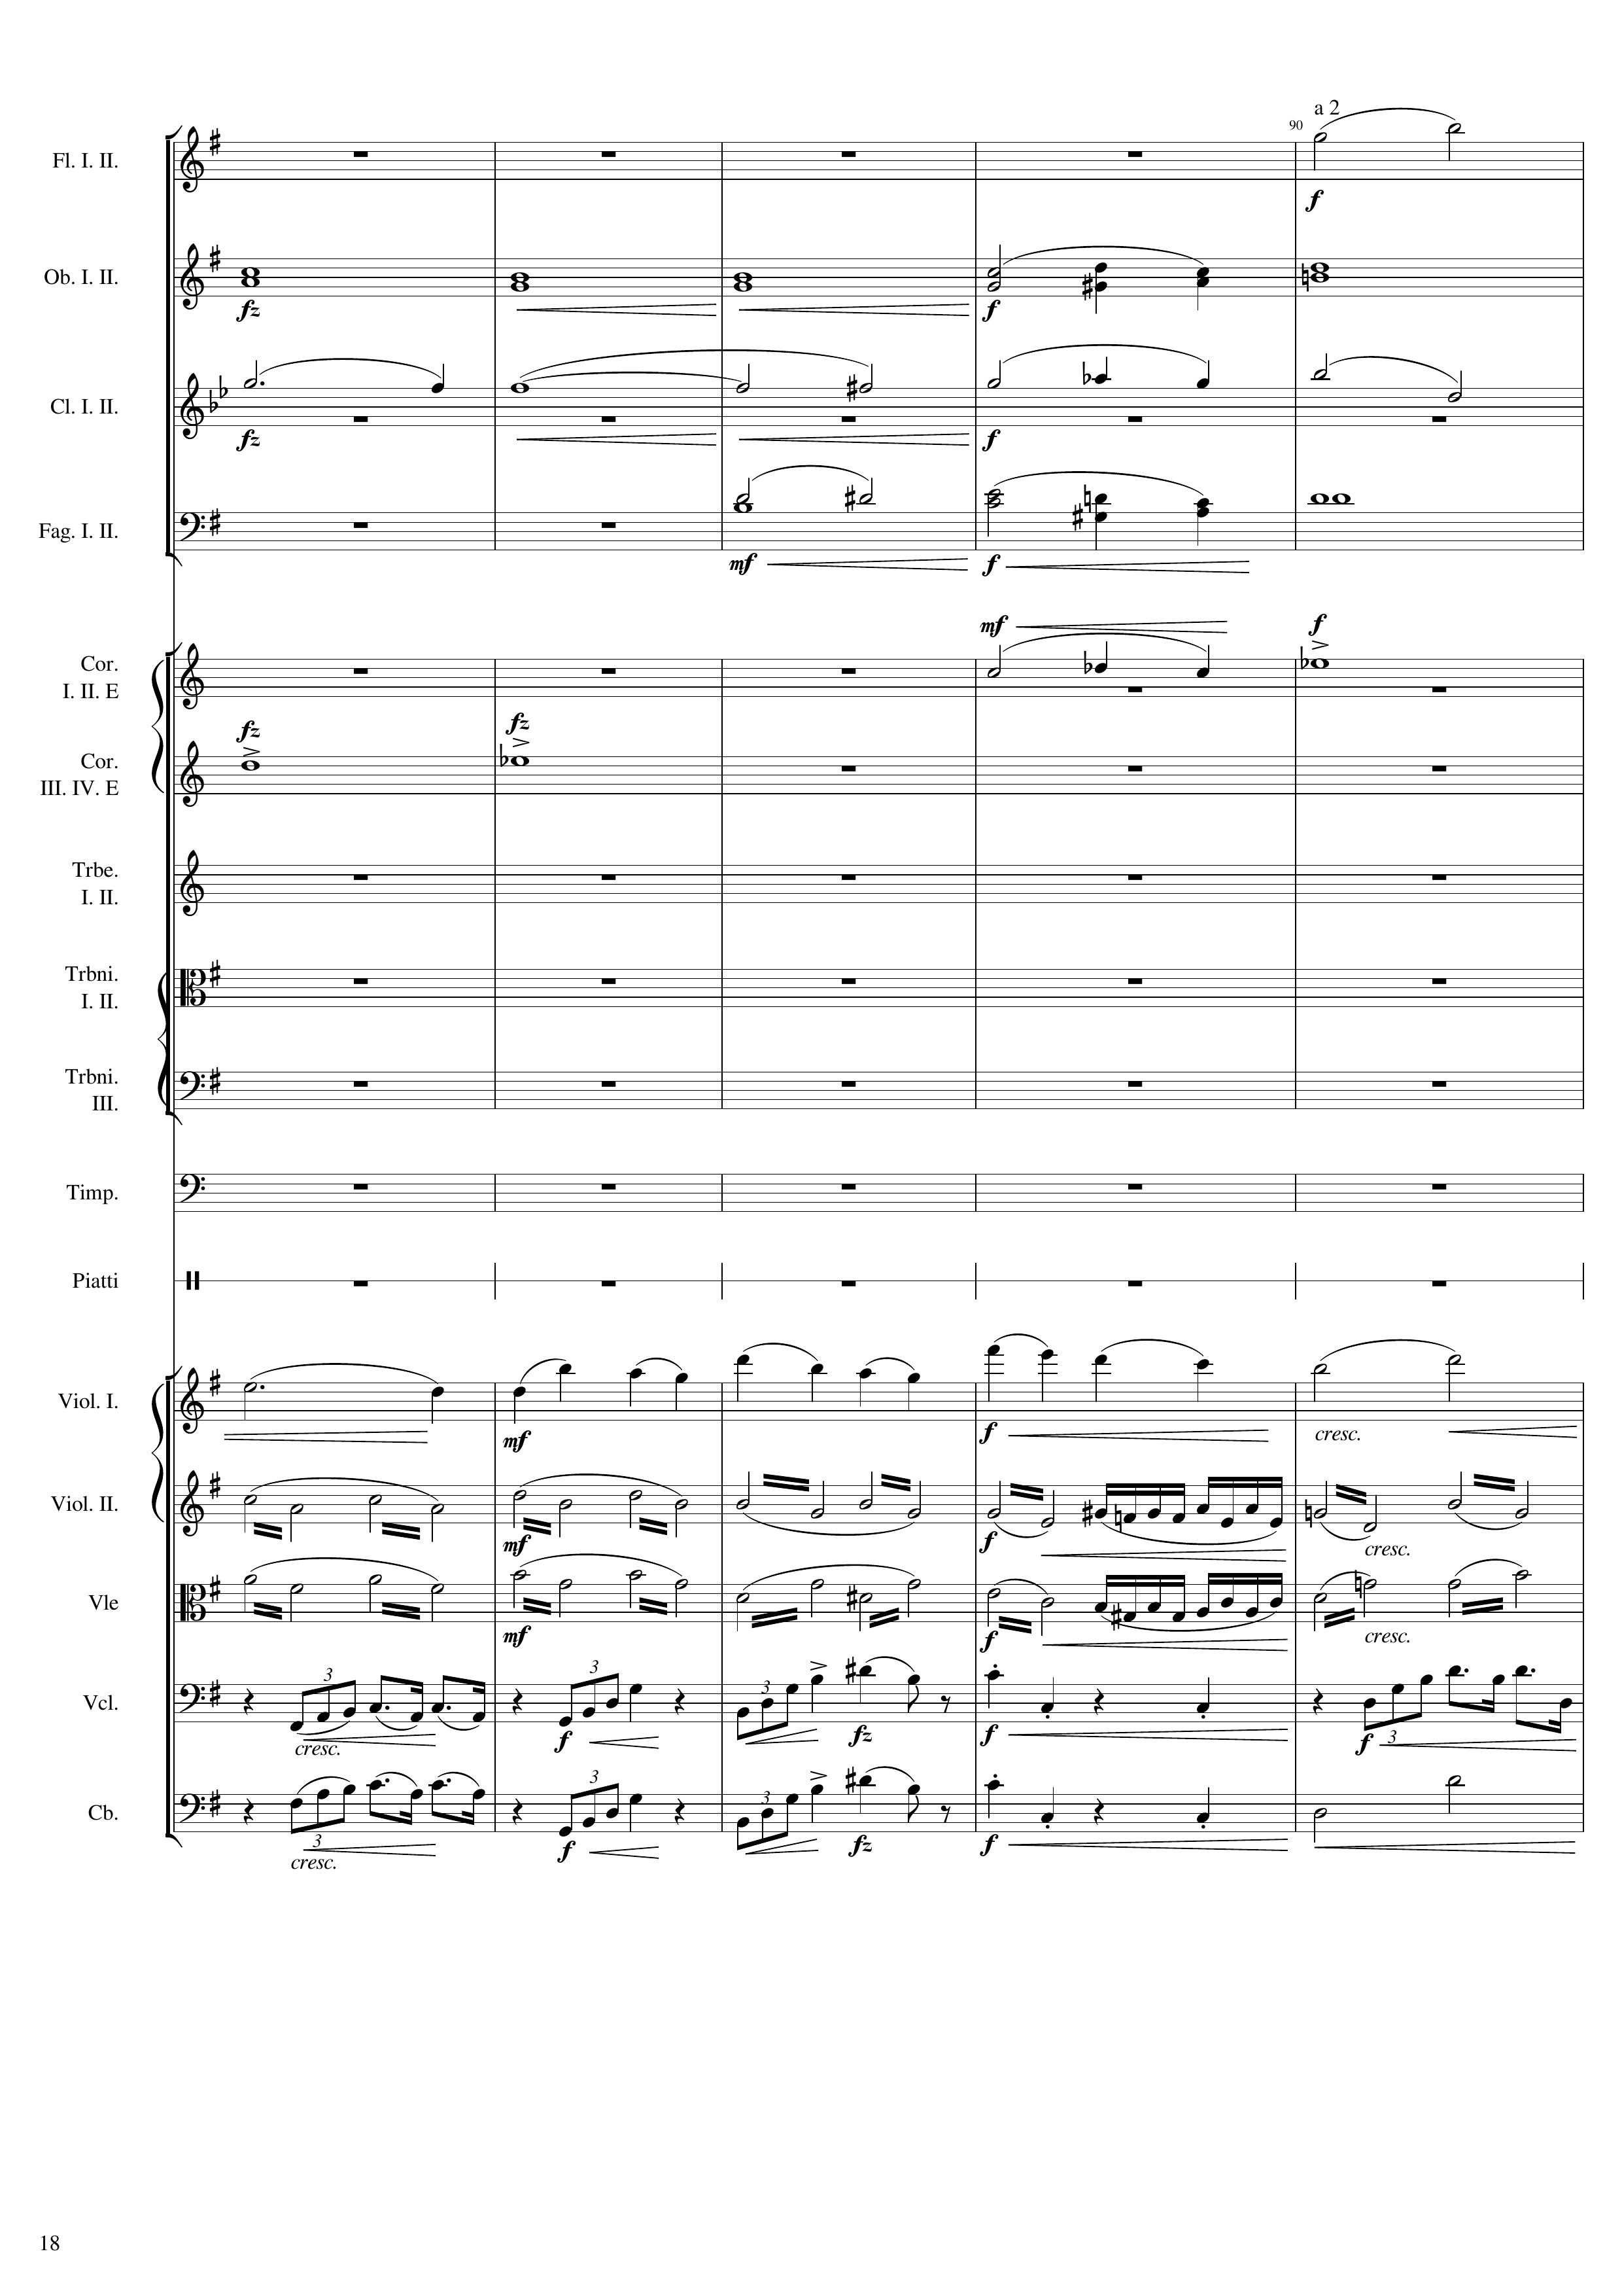
mel+harm
harm
mel
mel+harm
harm
harm
harm
mel
rhythm+harm
rhythm+harm
mel
mel
harm
Notes:
340-360
35:52

Slide 19
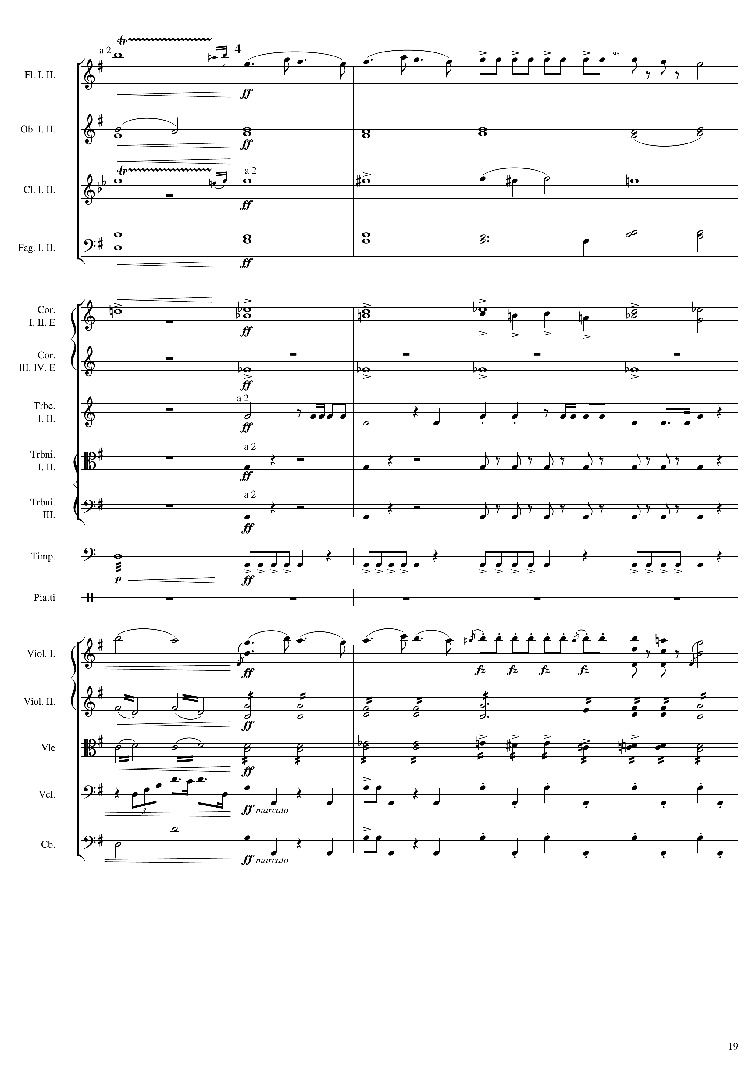
mel+harm
mel
harm
harm
mel+harm
harm
harm
harm
harm
harm
harm
harm
rhythm+harm
harm
rhythm
rhythm
rhythm
rhythm
rhythm
mel
mel
rhythm+harm
rhythm+harm
rhythm+harm
rhythm+harm
mel
rhythm
harm
rhythm
Notes:
360-380
36:02

Slide 20
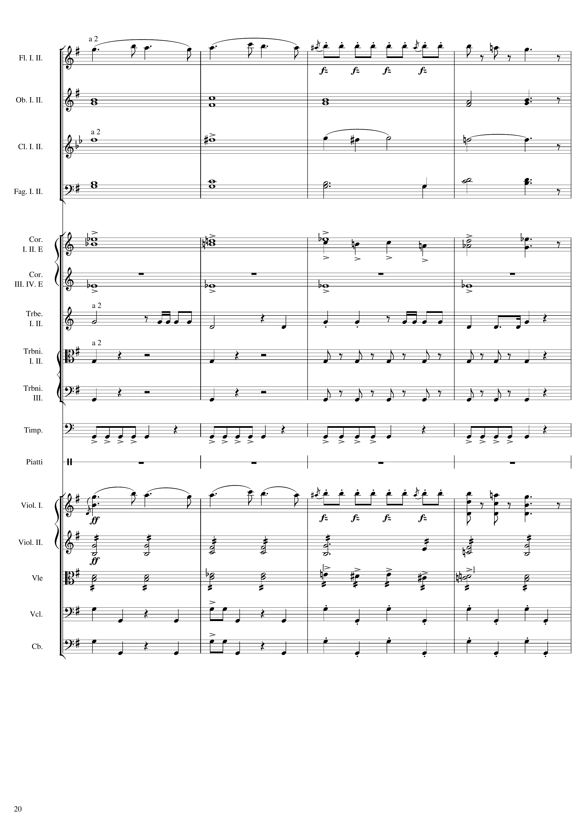
mel
harm
harm
harm
harm
harm
harm
rhythm+harm
harm
rhythm
rhythm
rhythm
rhythm
mel
rhythm+harm
rhythm+harm
rhythm
rhythm
Notes:
380-396
36:12

Slide 21
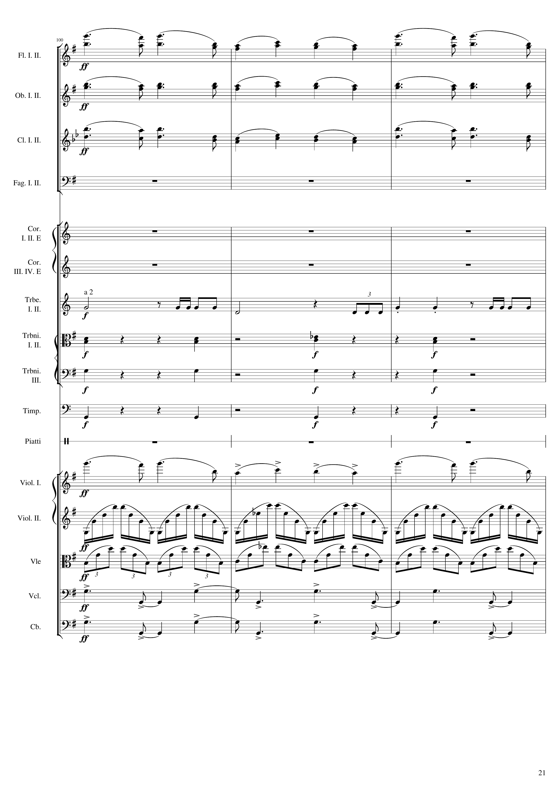
mel
mel
mel
rhythm
rhythm+harm
rhythm+harm
rhythm+harm
mel
rhythm
rhythm
rhythm
rhythm
Notes:
396-408
3:19

Slide 22
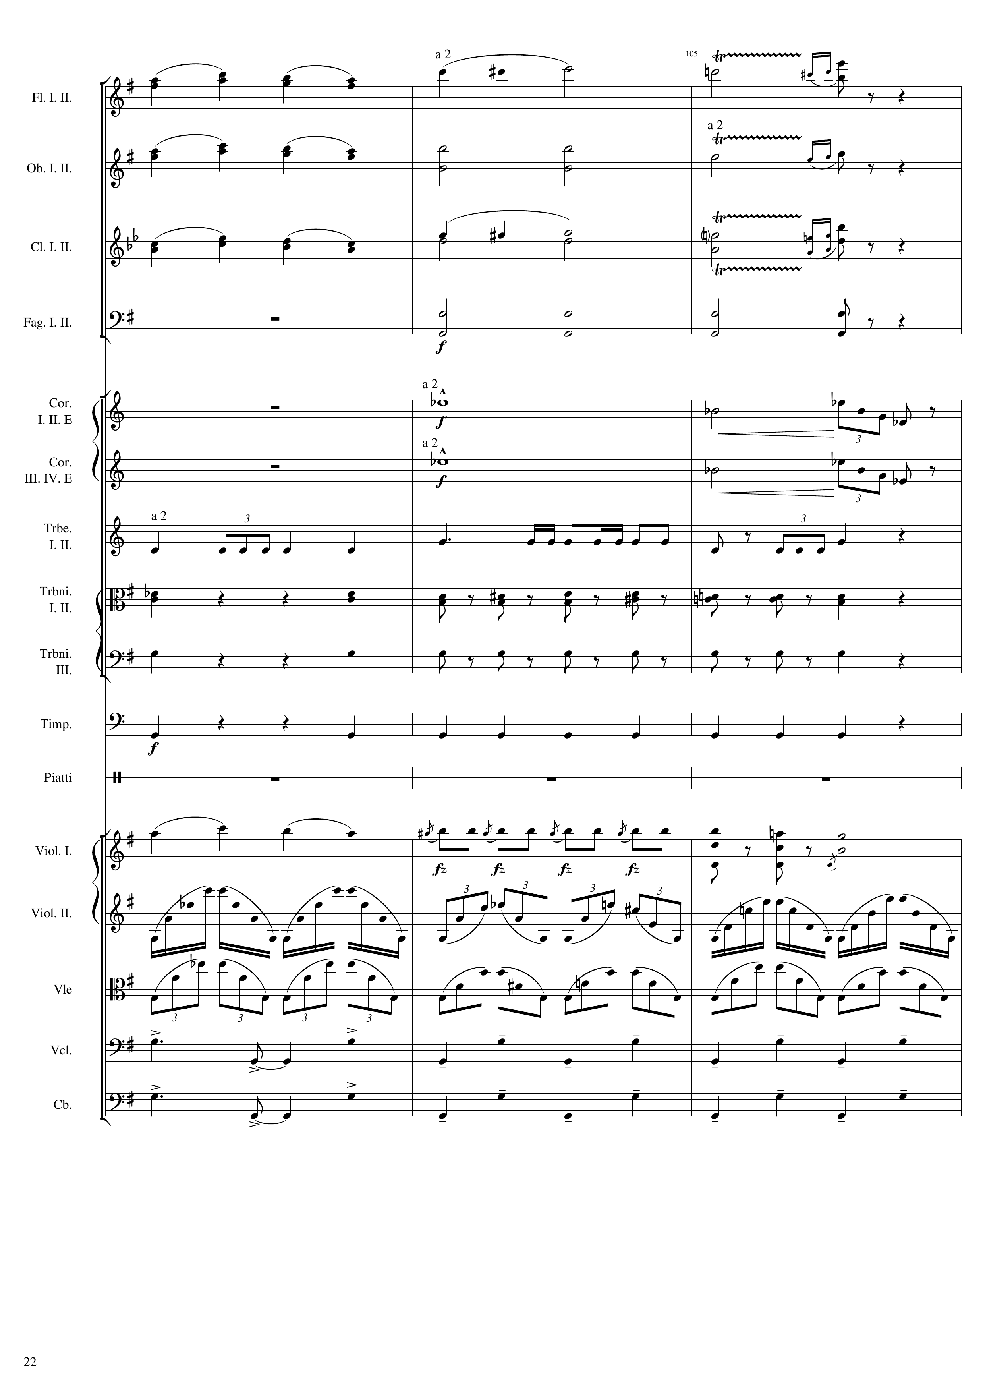
mel
mel
mel
harm
mel
mel
harm
harm
harm
rhythm
harm
rhythm
rhythm
rhythm+harm
mel+rhythm
rhythm+harm
rhythm
rhythm+harm
rhythm
mel
rhythm
rhythm
rhythm
rhythm
Notes:
408-420
36:25

Slide 23
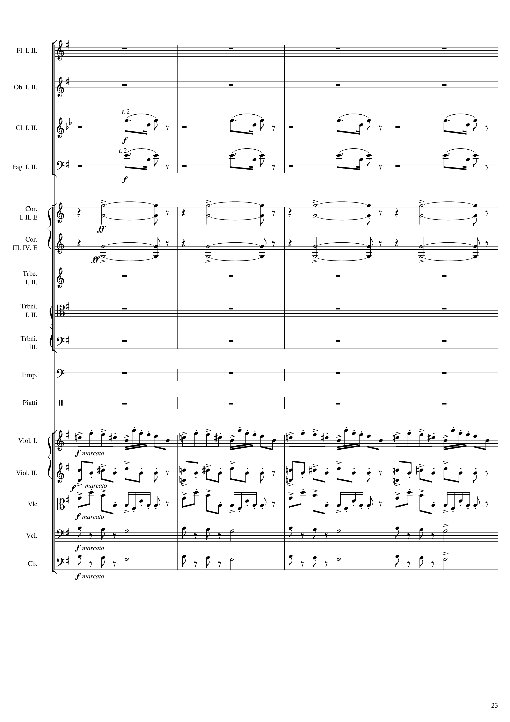
rhythm
rhythm
harm
harm
mel
mel+rhythm
mel
mel
mel
Notes:
420-436
36:31

Slide 24
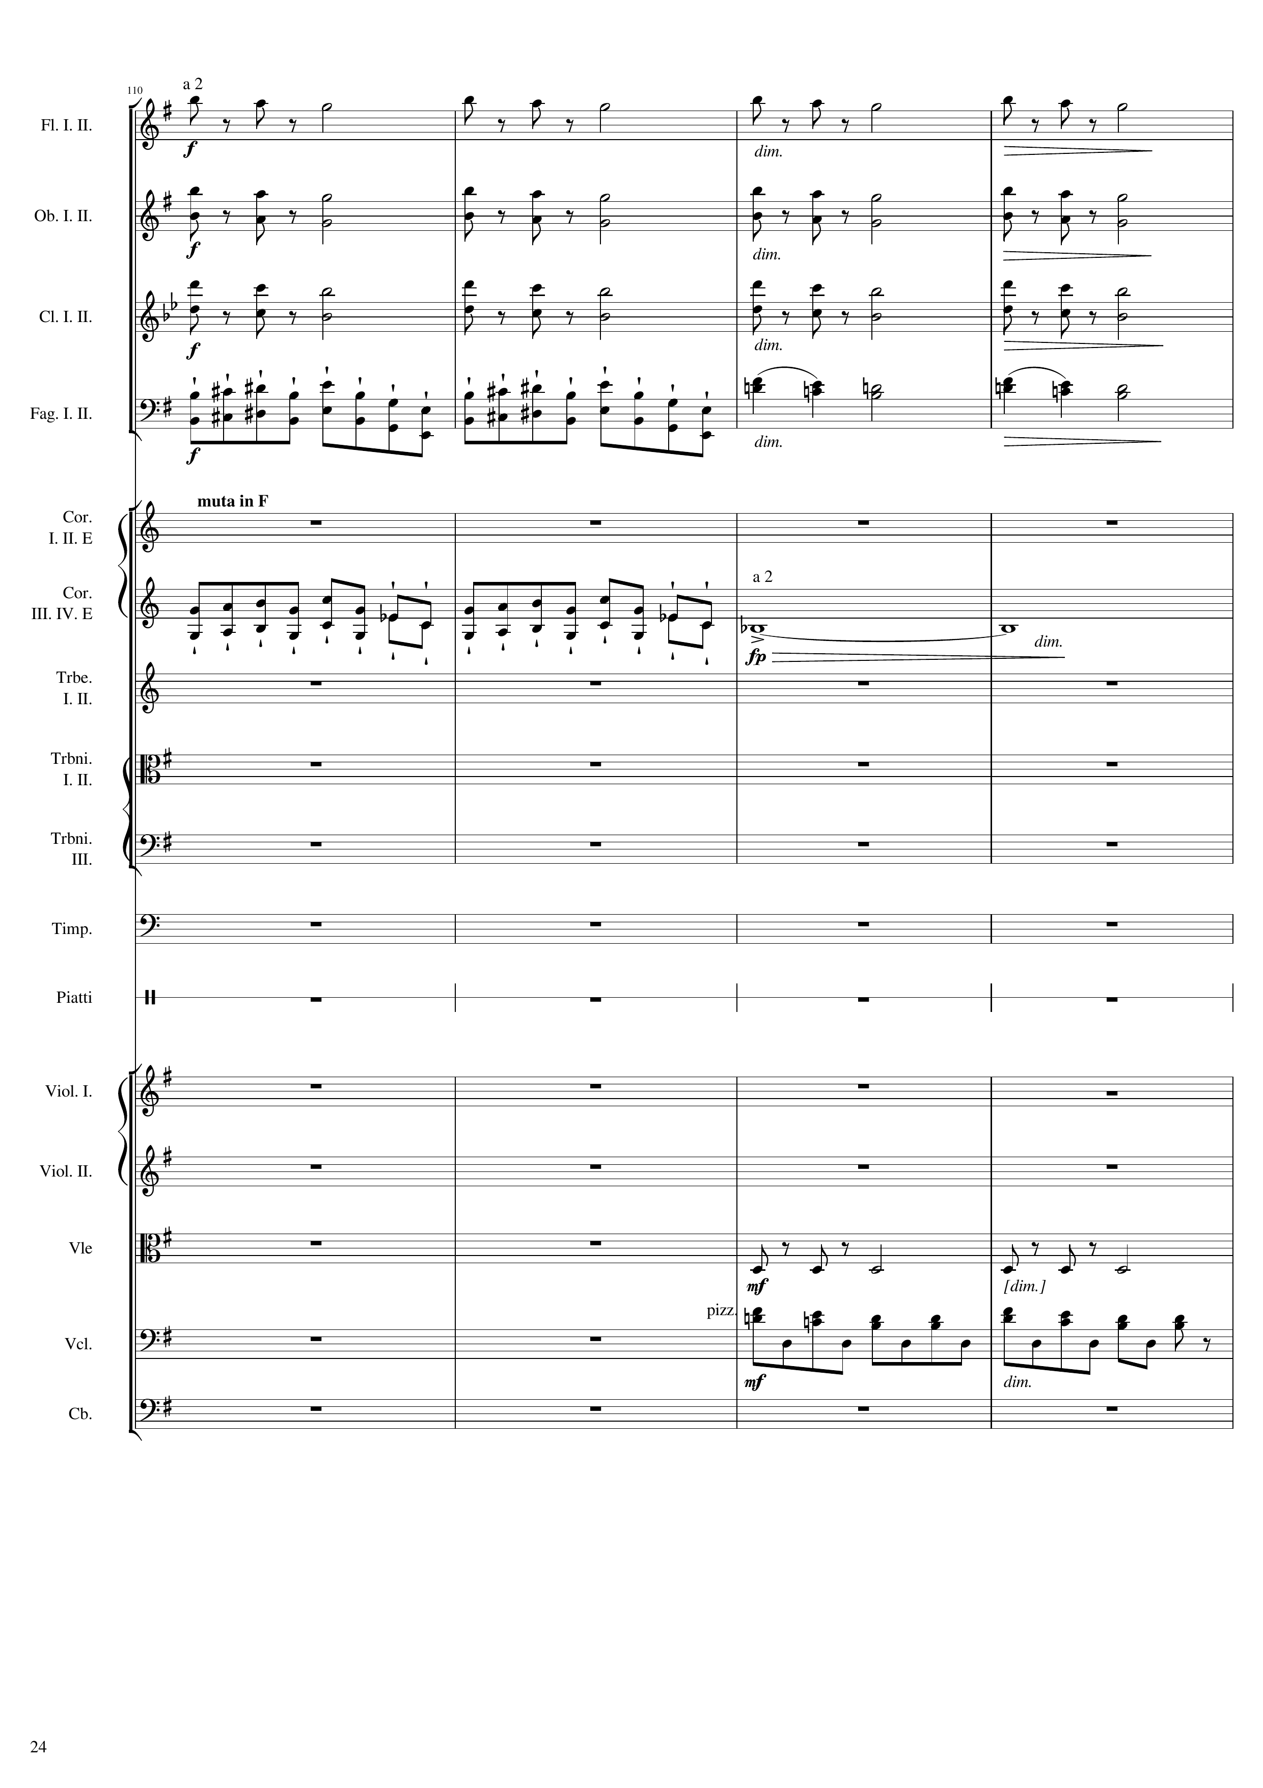
mel
mel
mel
rhythm
mel+harm
rhythm
harm
rhythm
mel+rhythm
Notes:
436-452
36:38

Slide 25
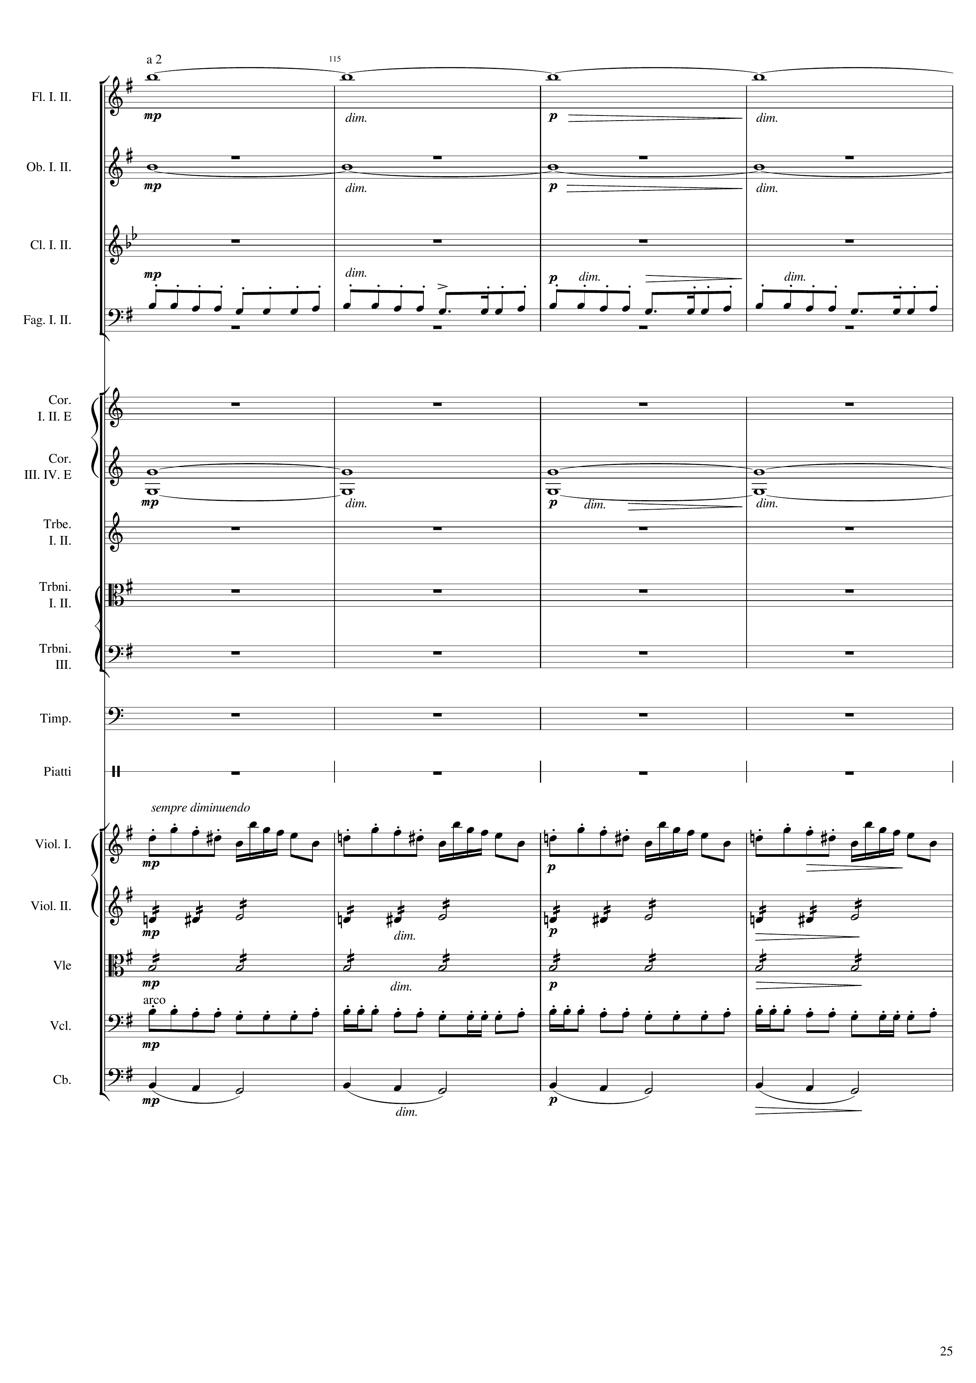
harm
harm
mel+rhythm
harm
mel
mel+harm
rhythm
mel+rhythm
mel
Notes:
452-468
36:46

Slide 26
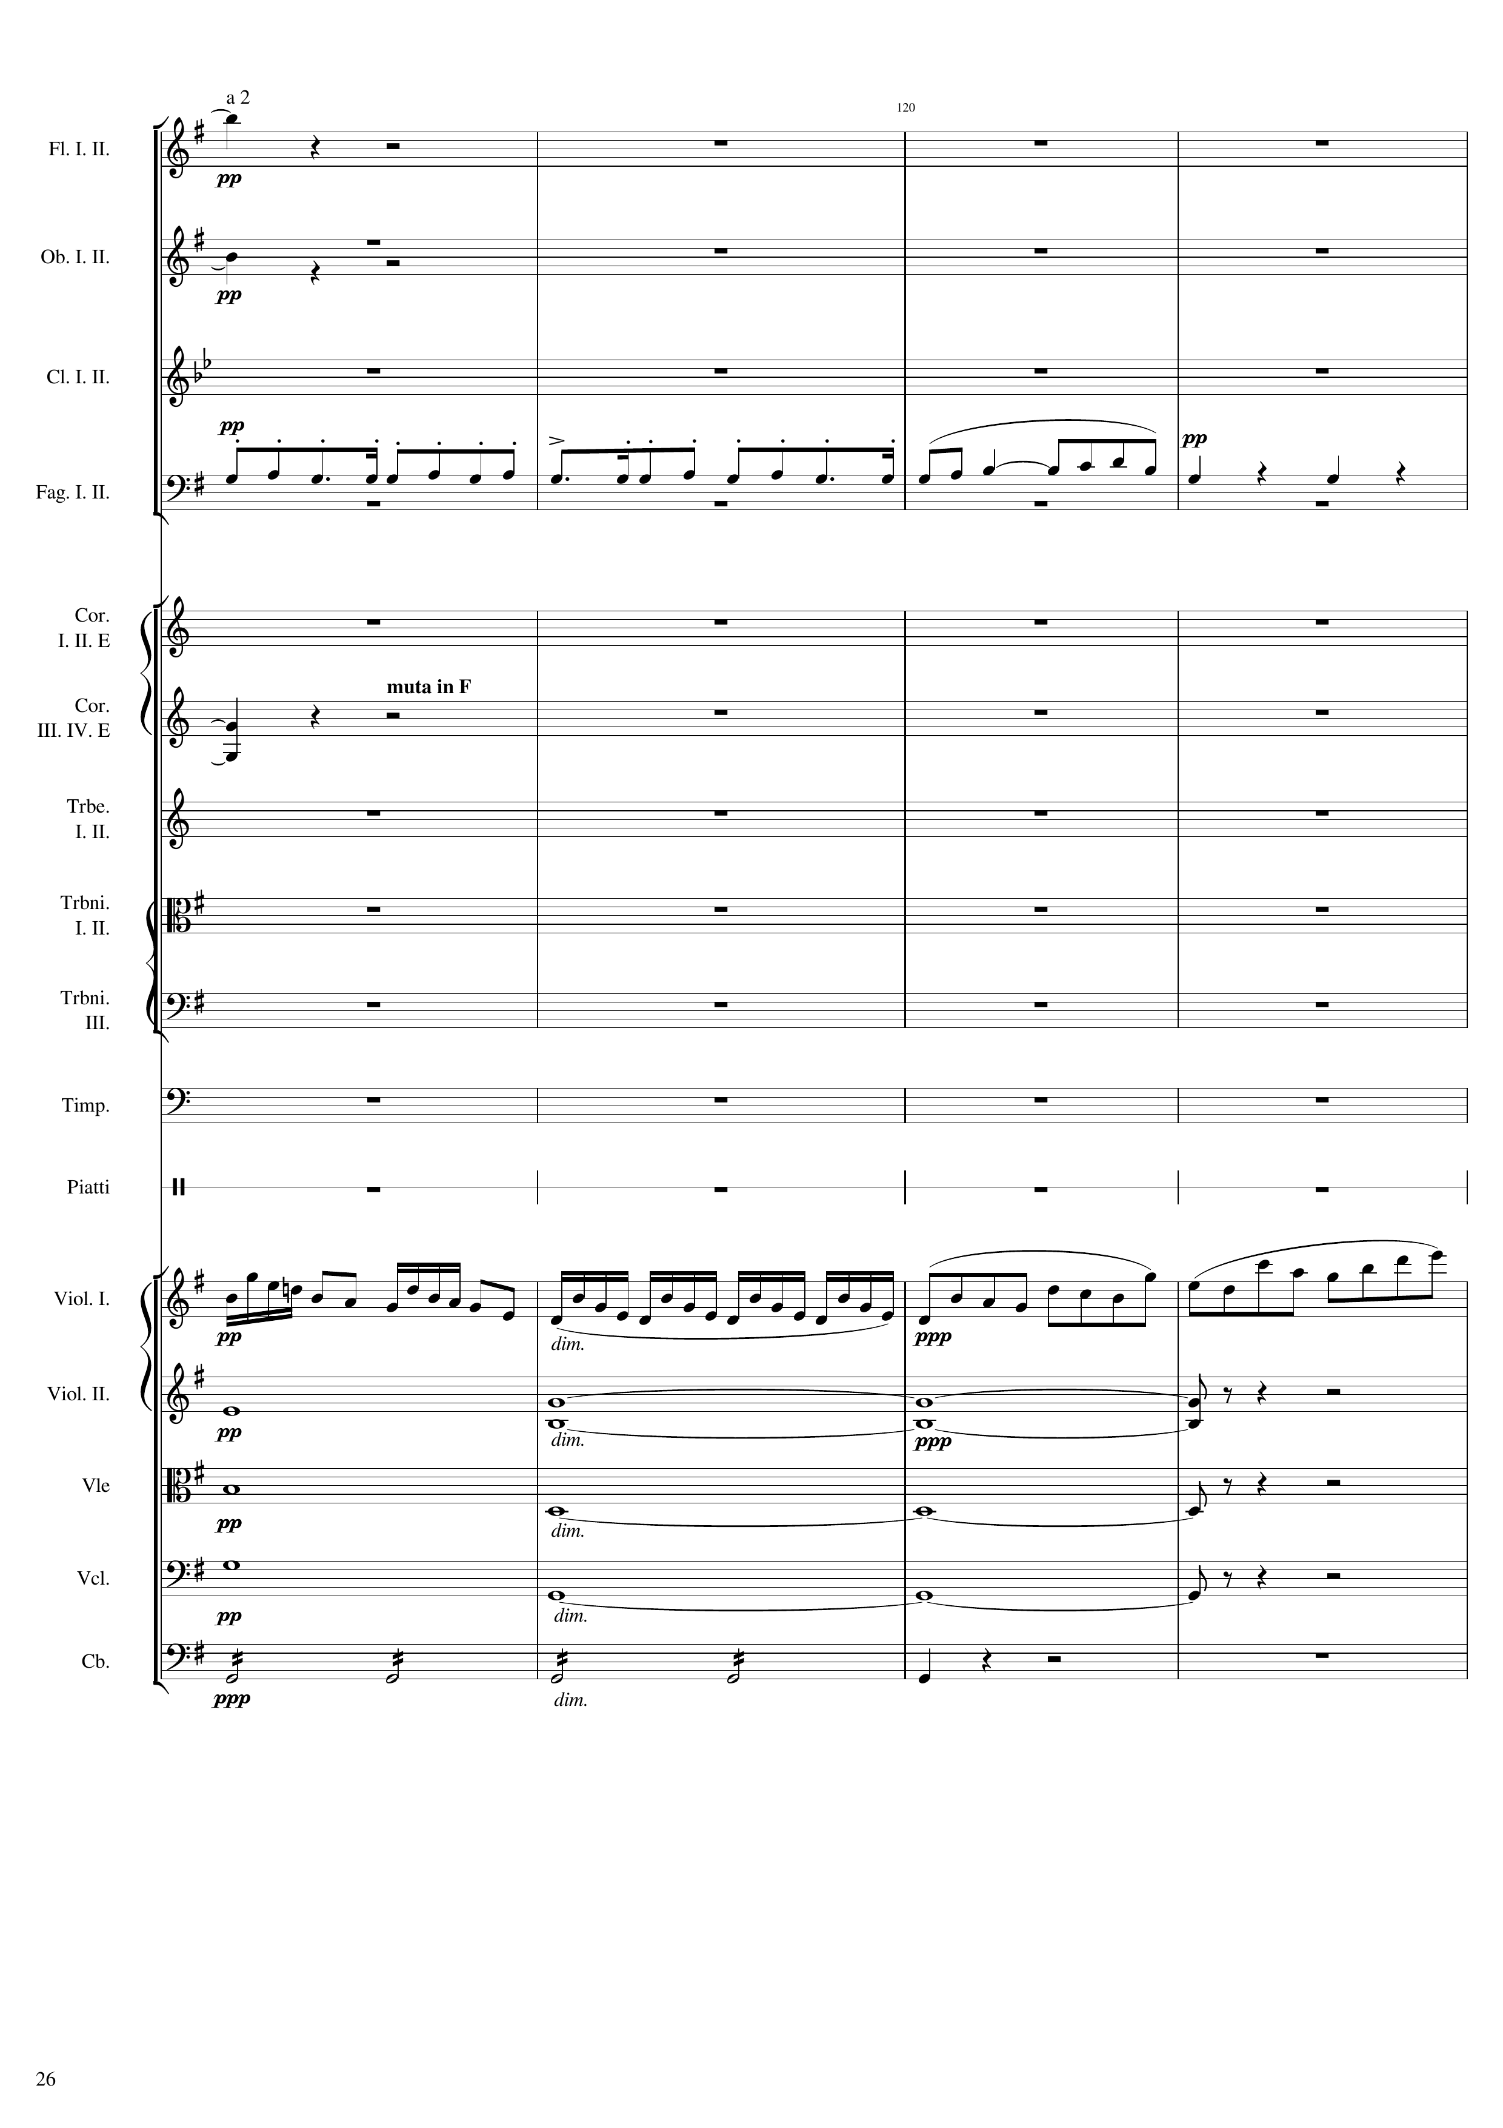
harm
harm
mel
rhythm
harm
mel
harm
harm
harm
harm
Notes:
468-484

Slide 27
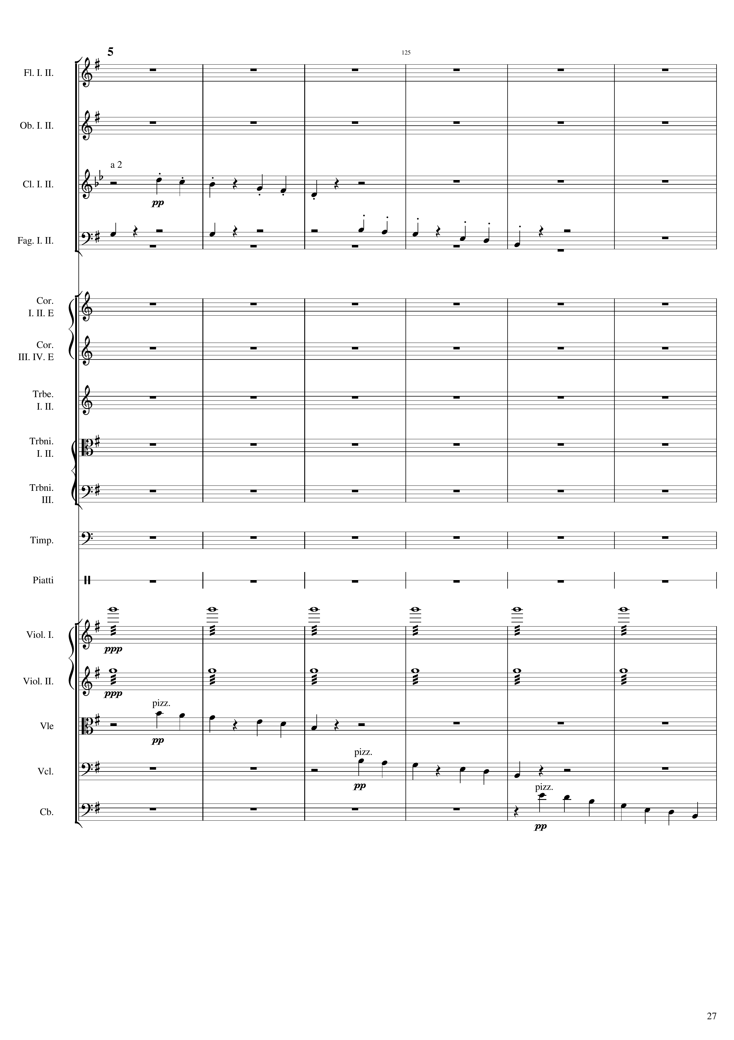
mel
rhythm
mel
harm
harm
mel
mel
mel
Notes:
484-508

Slide 28
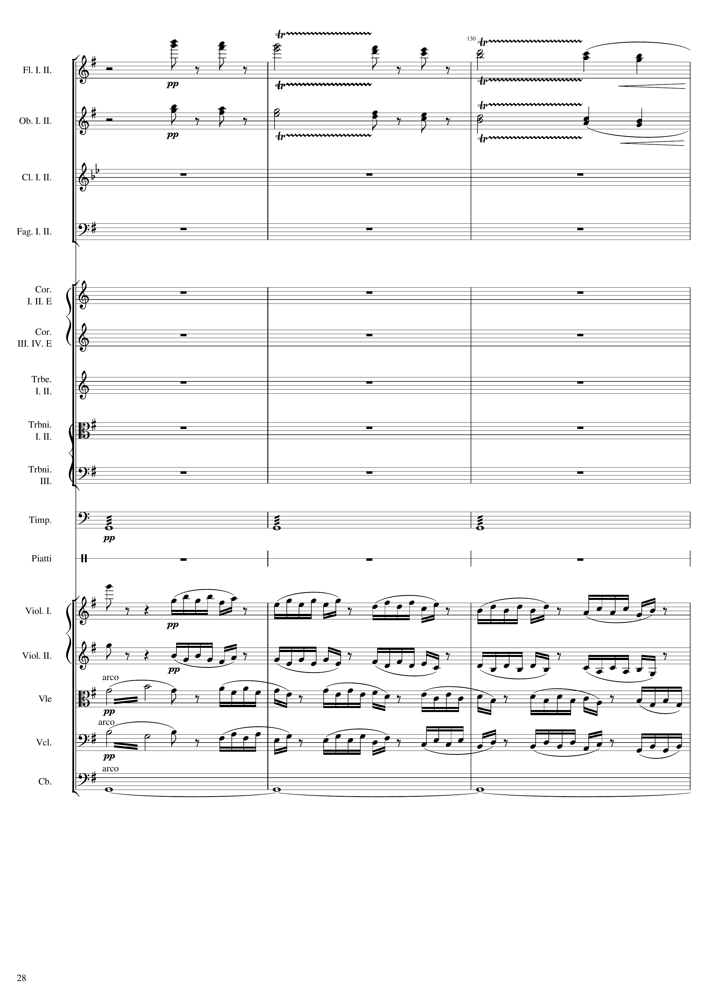
mel
mel
rhythm
harm
mel+rhythm
harm
mel+rhythm
mel+rhythm
mel+rhythm
harm
Notes:
508-520
37:12

Slide 29
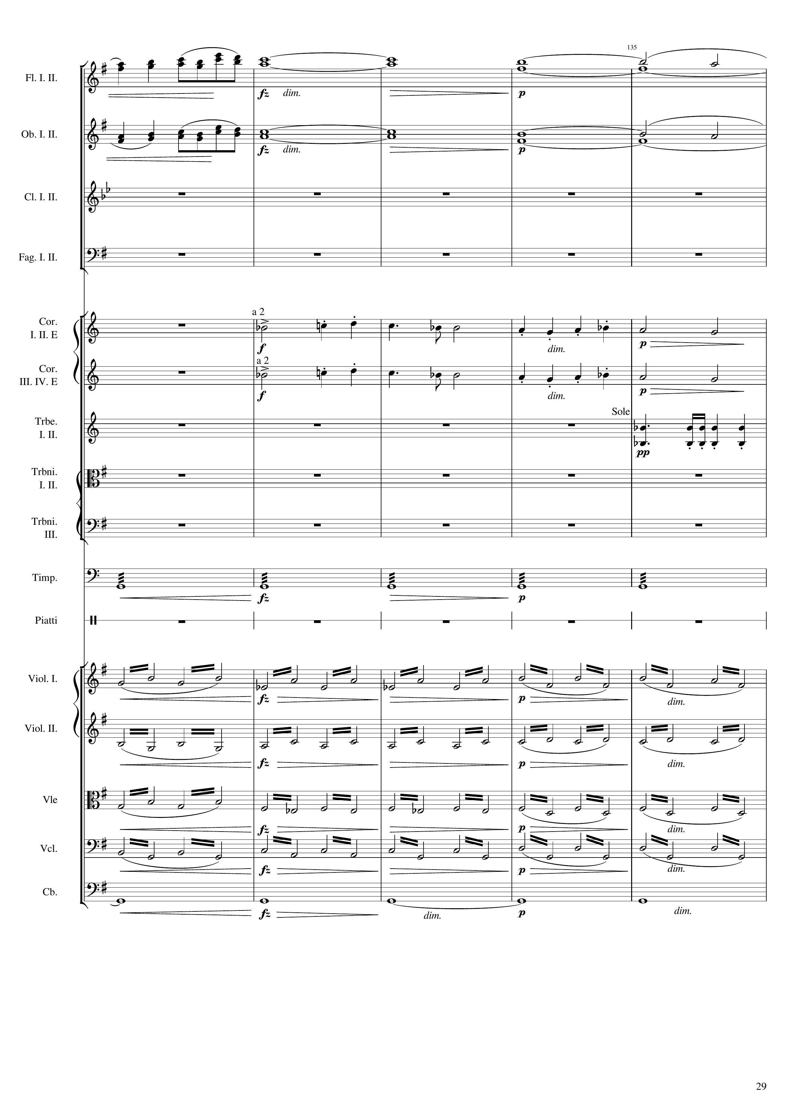
mel
harm
mel
harm
mel
mel
rhythm
rhythm
rhythm+harm
rhythm+harm
rhythm+harm
rhythm+harm
harm
Notes:
520-540
37:17

Slide 30
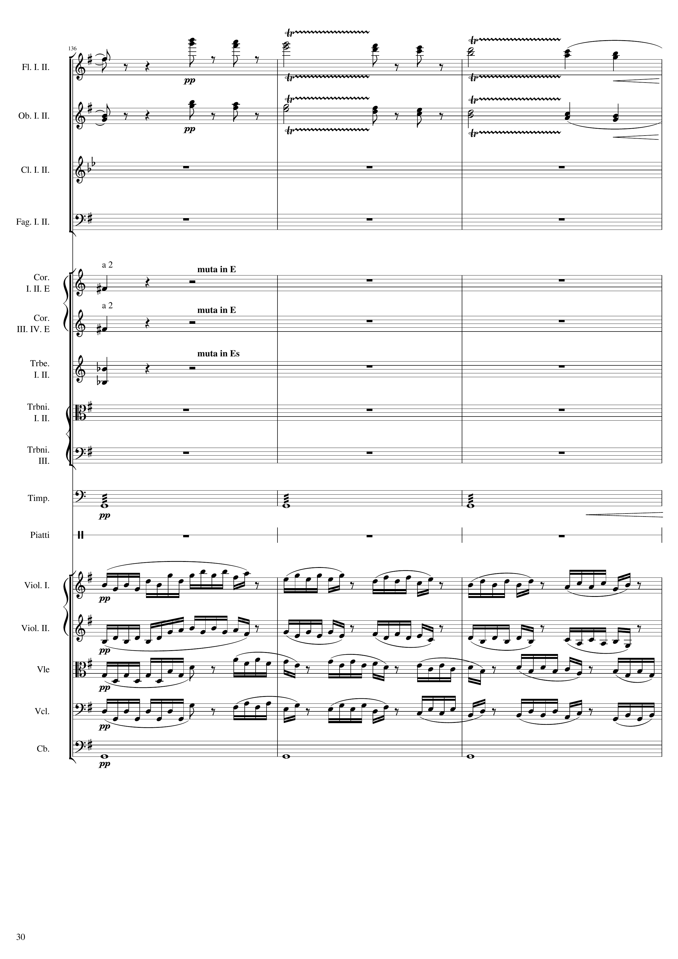
harm
mel
harm
mel
mel
mel
rhythm
rhythm
mel+rhythm
mel+rhythm
mel+rhythm
mel+rhythm
harm
Notes:
540-552
37:27

Slide 31
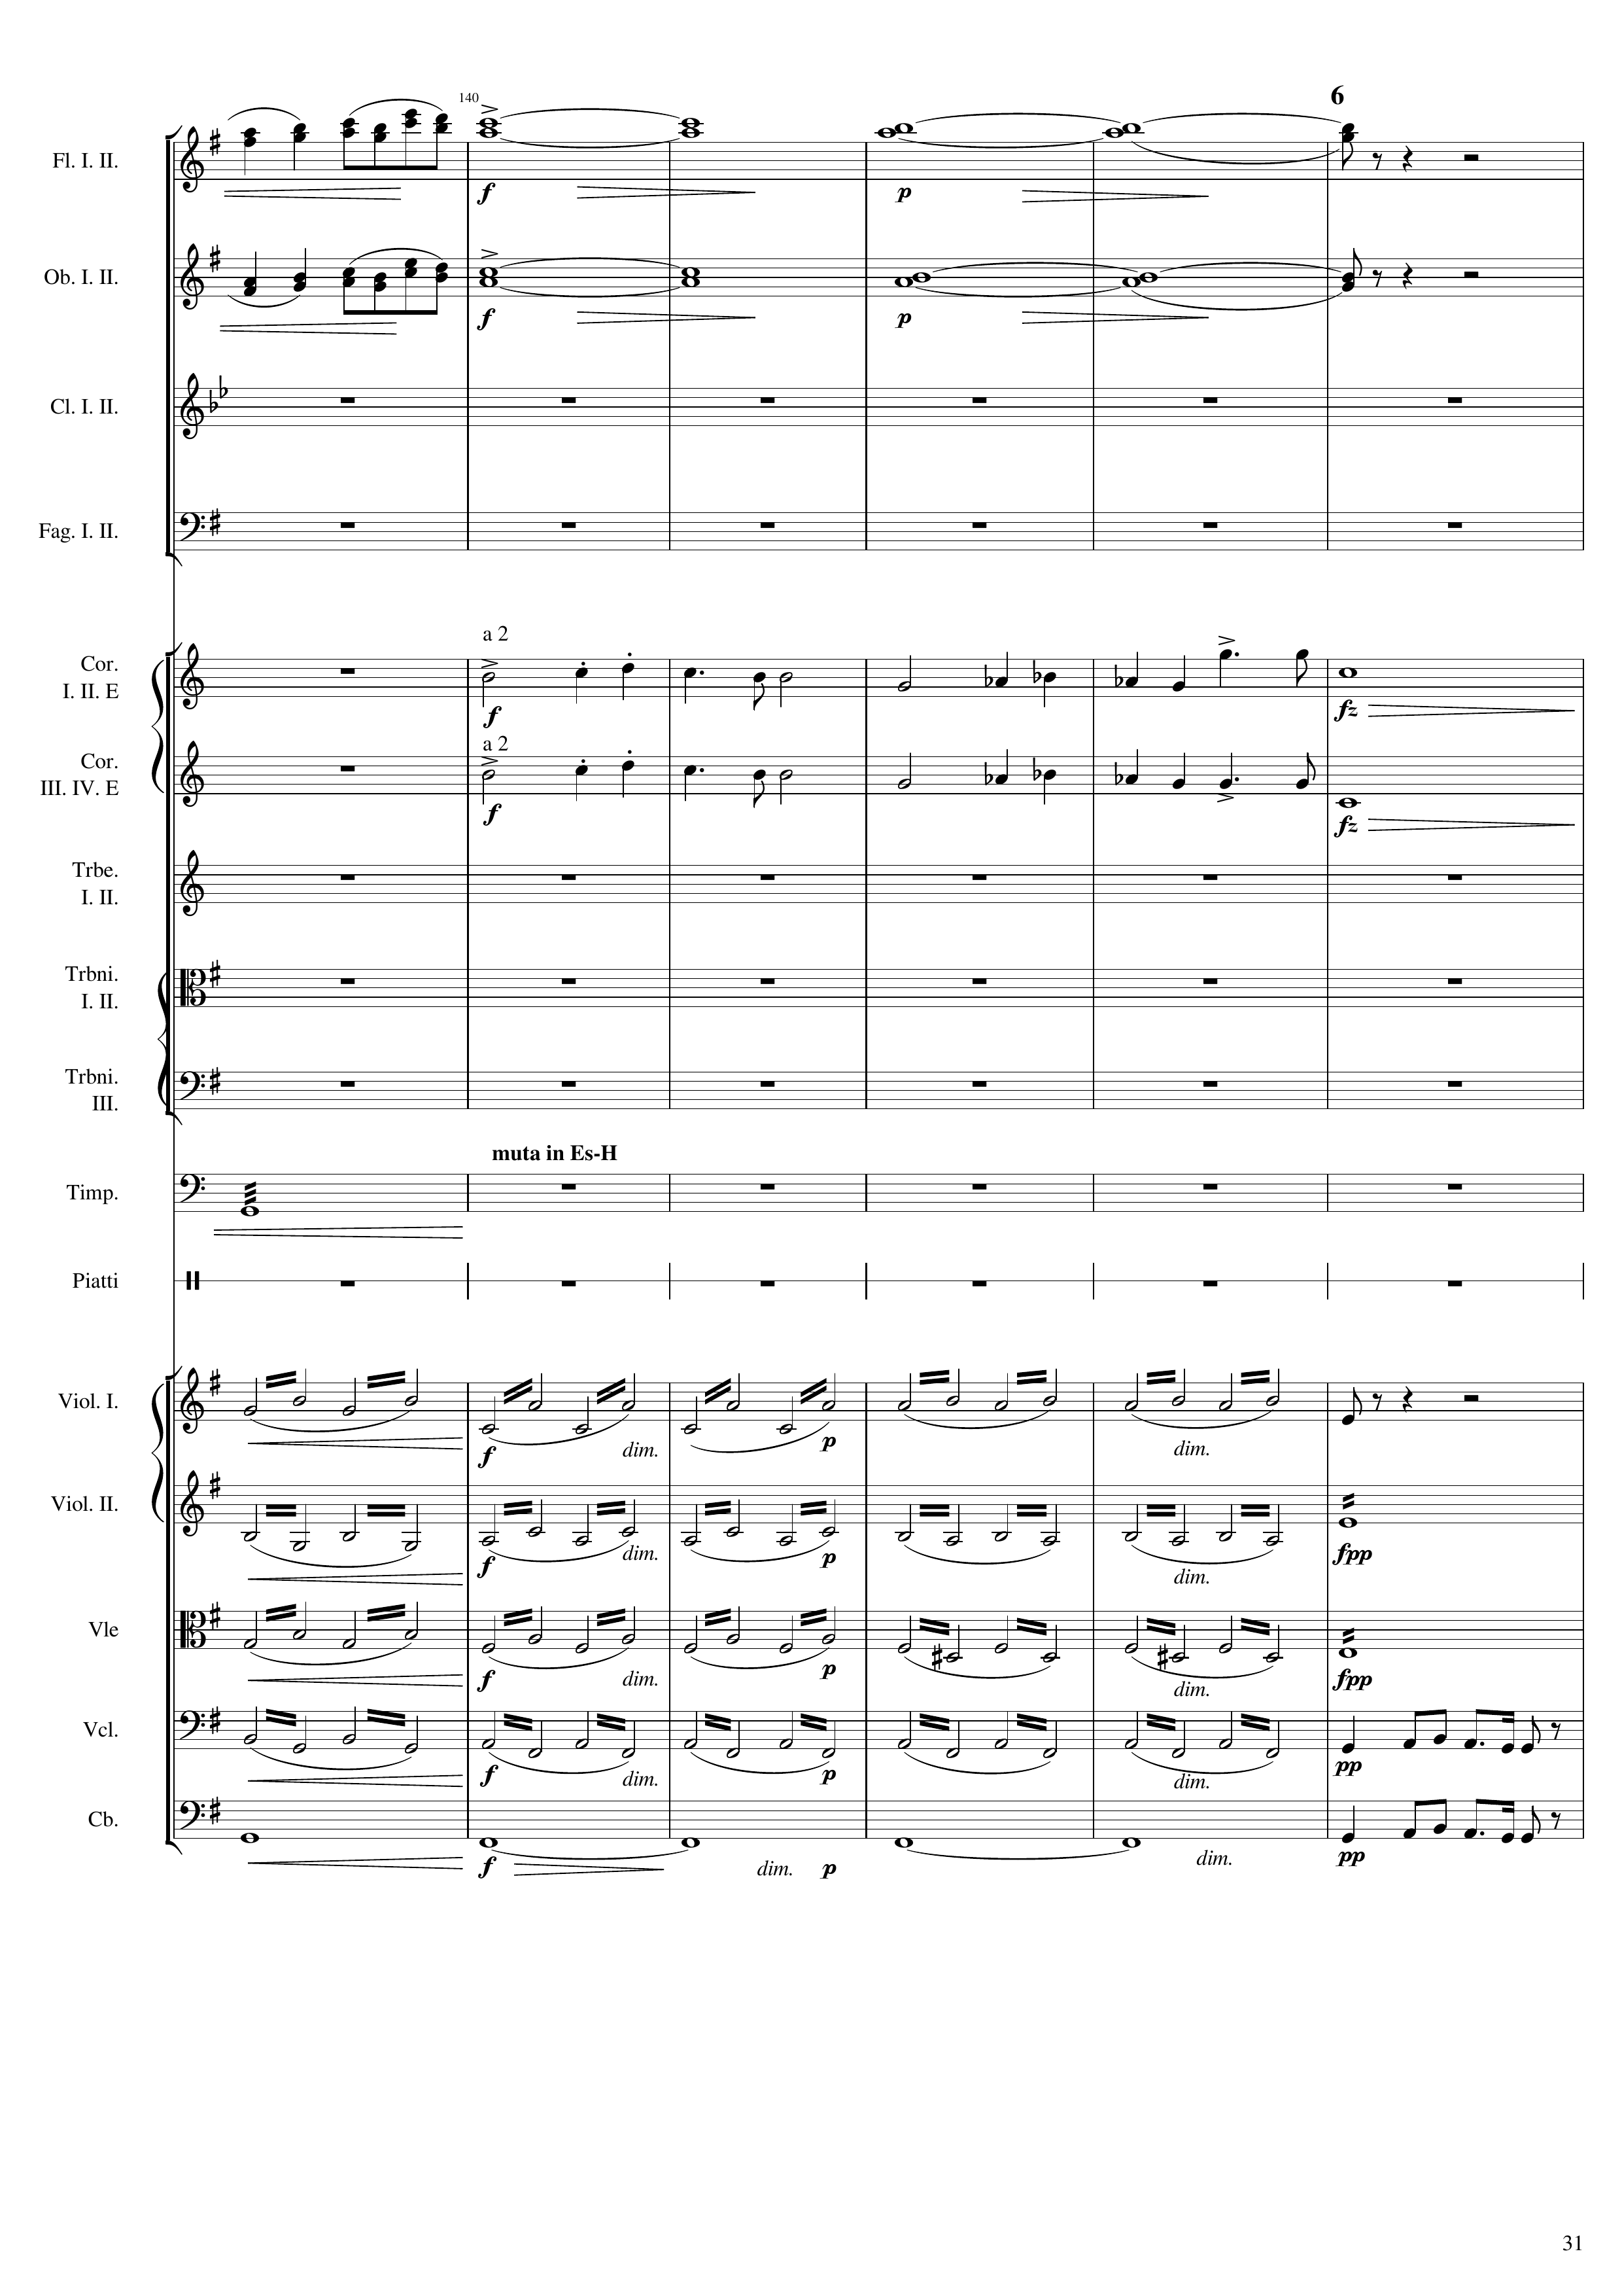
mel
harm
mel
harm
mel
harm
mel
harm
rhythm
rhythm+harm
rhythm+harm
rhythm
rhythm+harm
rhythm
rhythm+harm
mel
harm
mel
Notes:
552-576
37:32

Slide 32
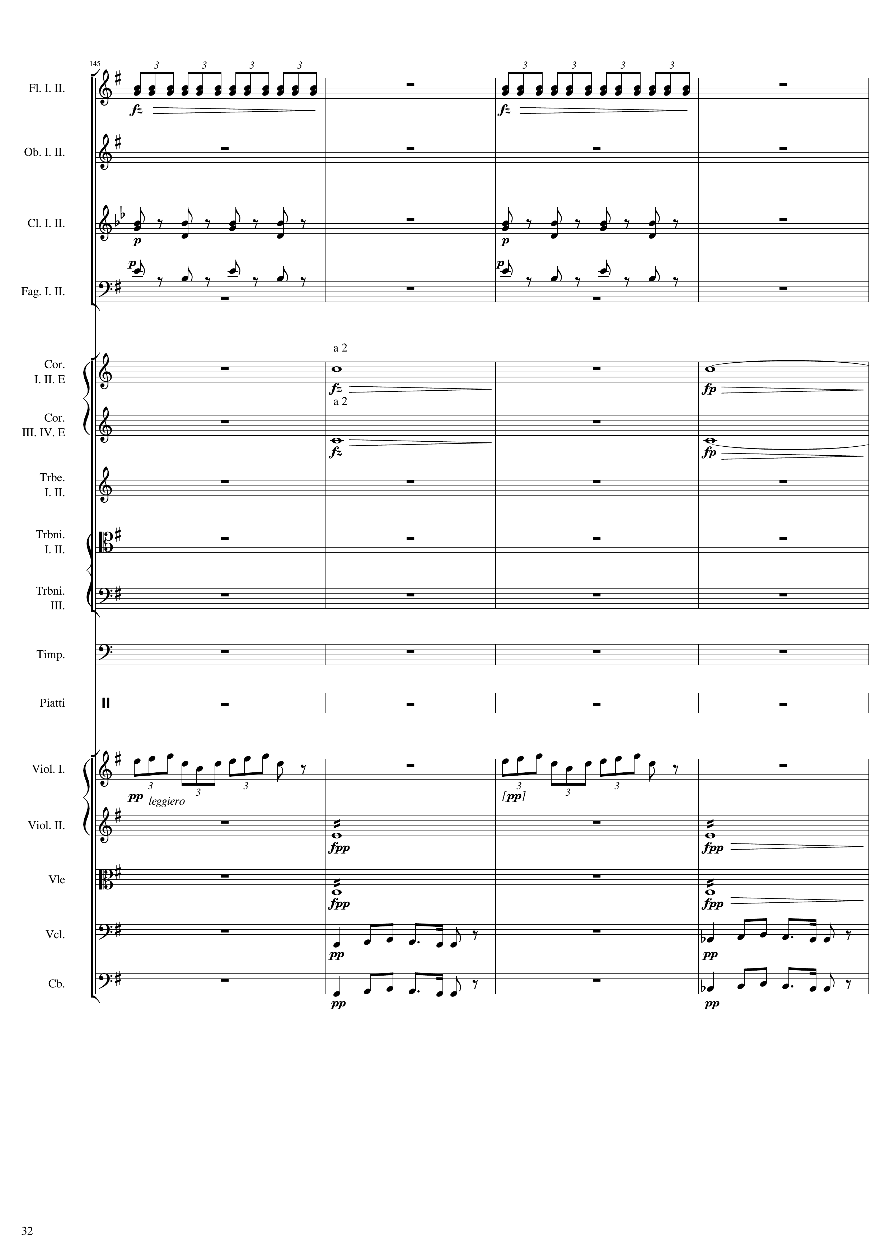
rhythm
rhythm
rhythm
rhythm
rhythm
rhythm
harm
harm
harm
harm
mel
mel
rhythm
rhythm
rhythm
rhythm
mel
mel
mel
mel
Notes:
576-592
37:44

Slide 33
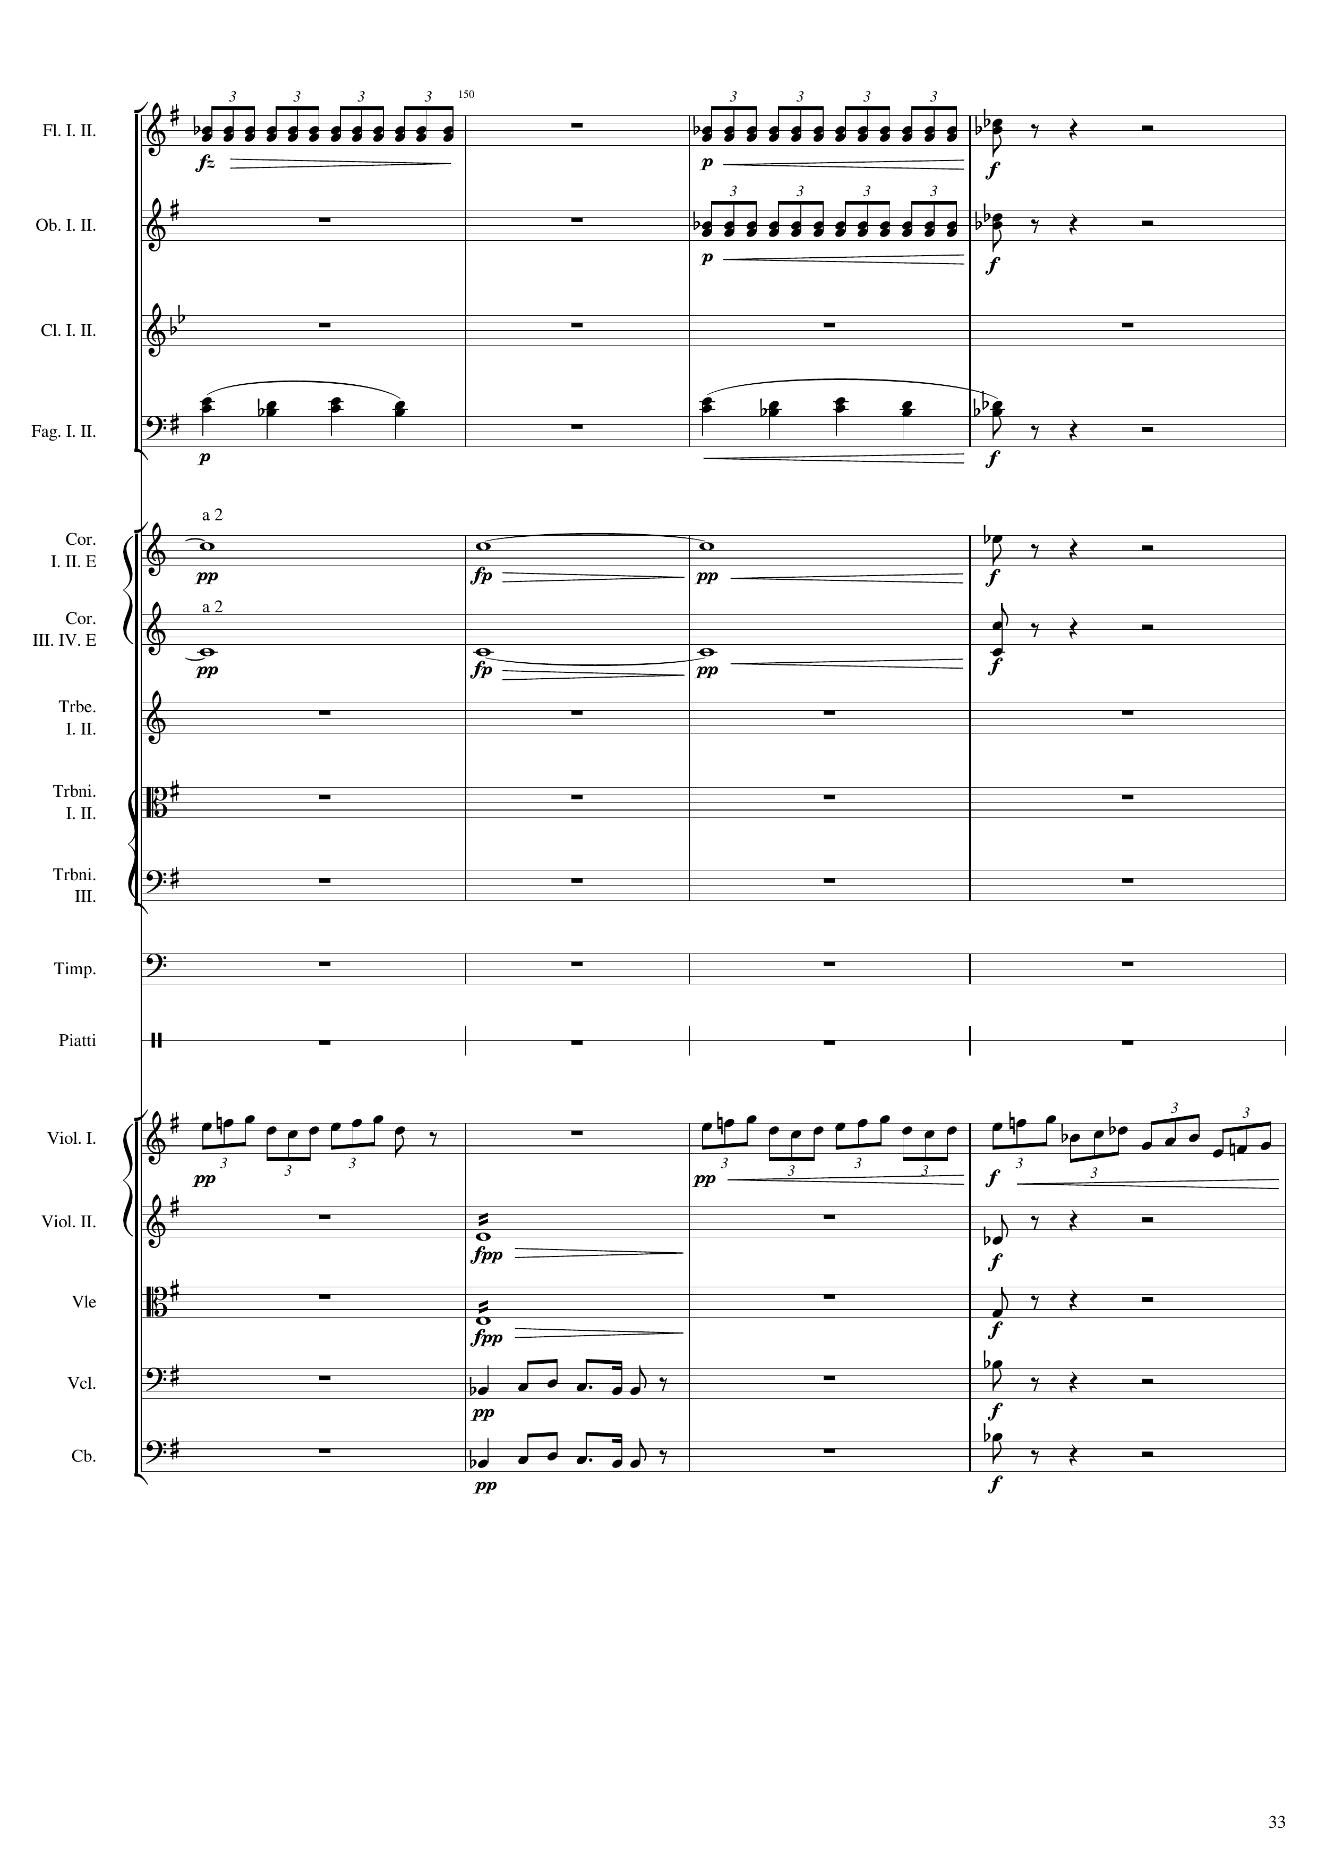
rhythm
rhythm
rhythm
mel+harm
mel+harm
harm
rhythm+harm
harm
rhythm+harm
mel
mel
rhythm
rhythm+harm
rhythm
rhythm+harm
mel
rhythm+harm
mel
rhythm+harm
Notes:
592-608
37:51

Slide 34
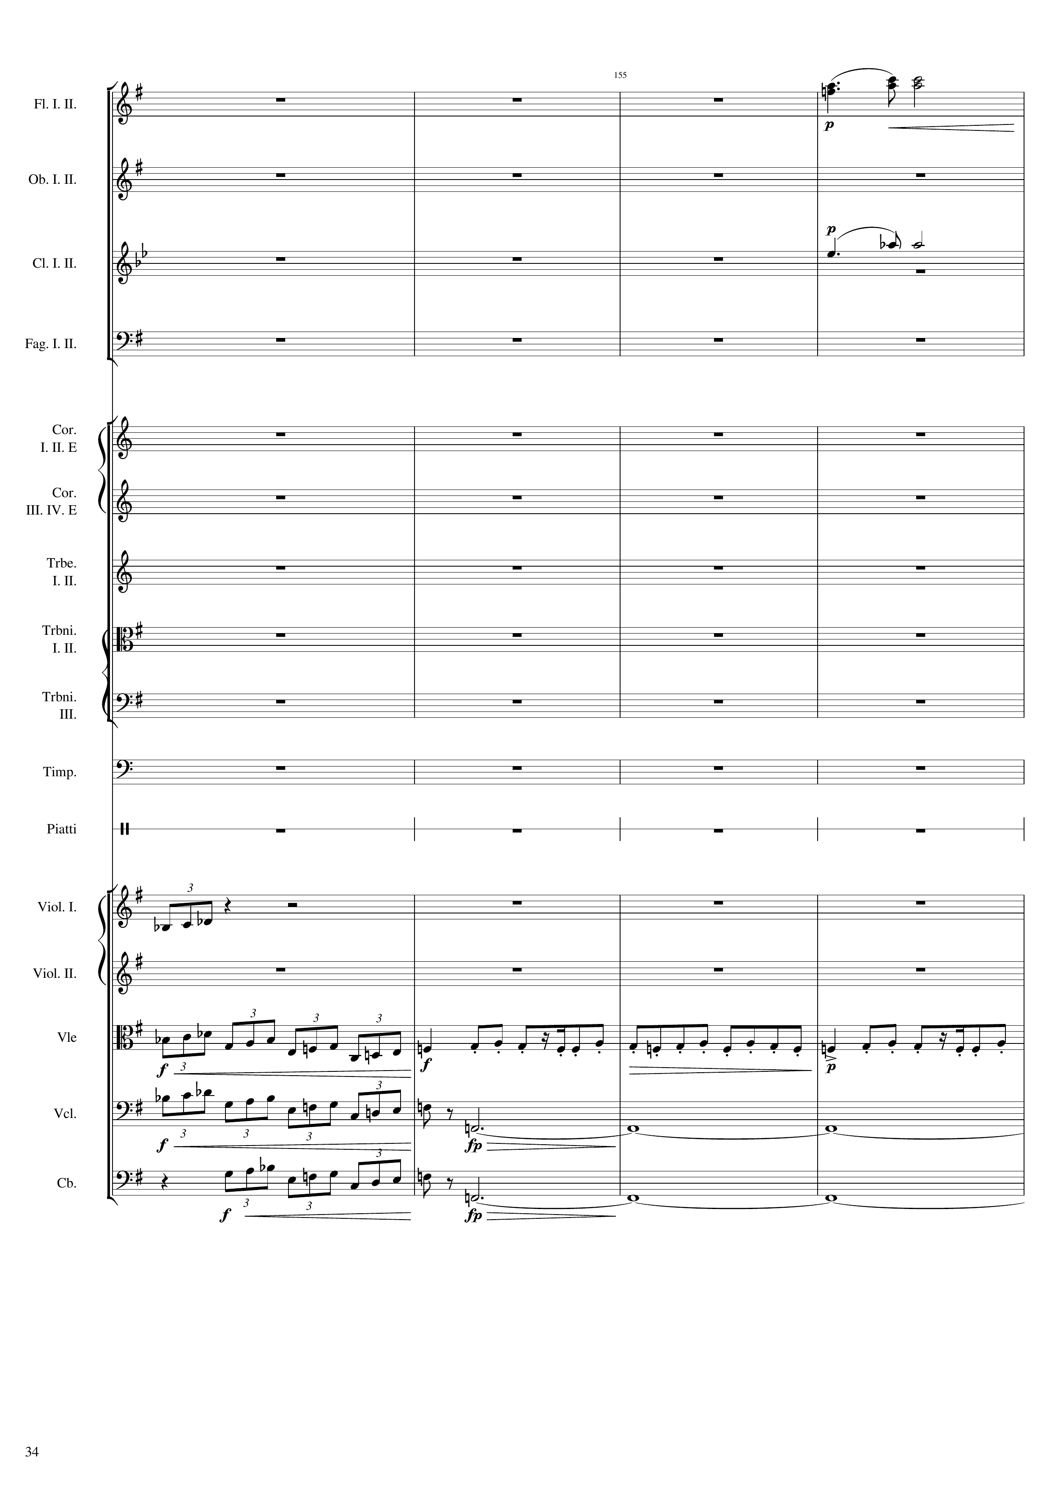
mel
mel
mel
mel
mel+rhythm
mel
harm
mel
harm
Notes:
608-624
37:58

Slide 35
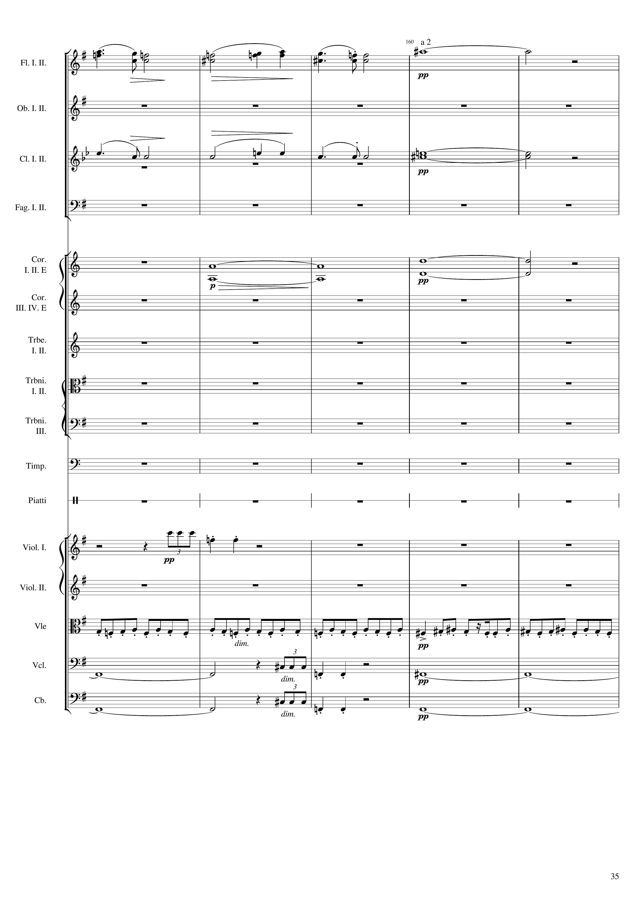
mel
harm
mel
harm
harm
rhythm
mel+rhythm
harm
rhythm
harm
harm
rhythm
harm
Notes:
624-644
38:05

Slide 36
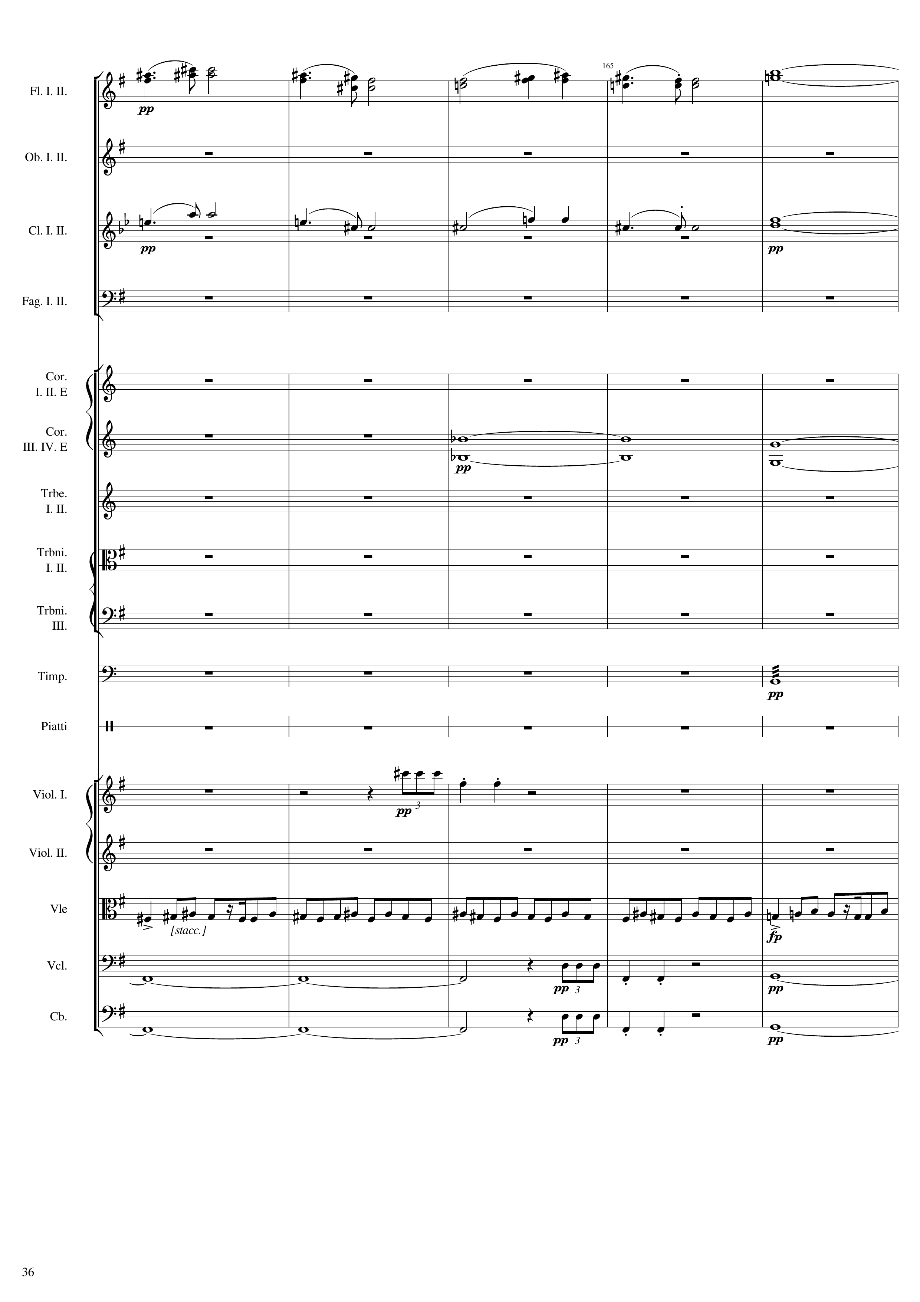
mel
harm
mel
harm
harm
rhythm
rhythm
mel+rhythm
harm
rhythm
harm
harm
rhythm
harm
Notes:
644-664
38:14

Slide 37
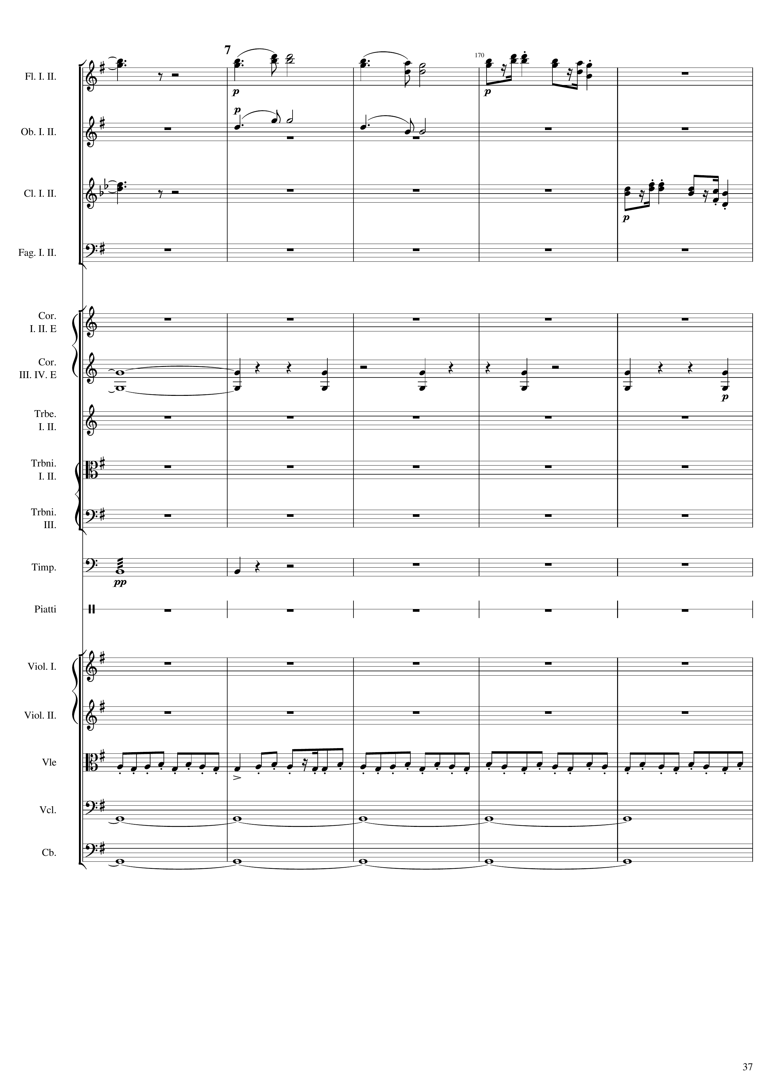
harm
mel
mel
harm
mel
harm
rhythm
rhythm
mel+rhythm
harm
harm
Notes:
664-684
38:23

Slide 38
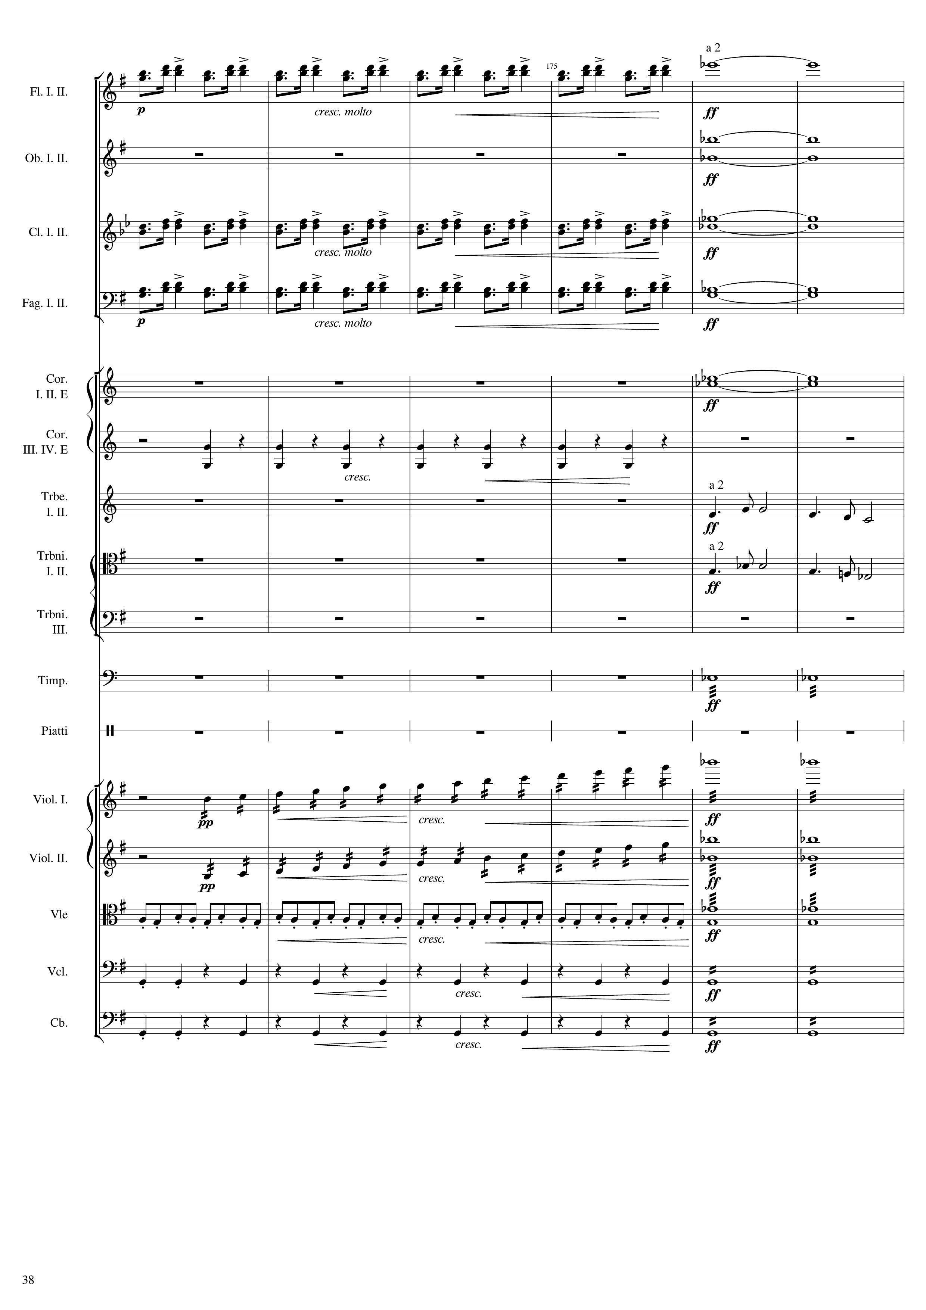
rhythm
harm
harm
rhythm
harm
rhythm
harm
harm
rhythm
mel
mel
rhythm
mel
rhythm+harm
mel
rhythm+harm
mel+rhythm
rhythm+harm
rhythm
rhythm+harm
rhythm
rhythm+harm
Notes:
684-708
38:32

Slide 39
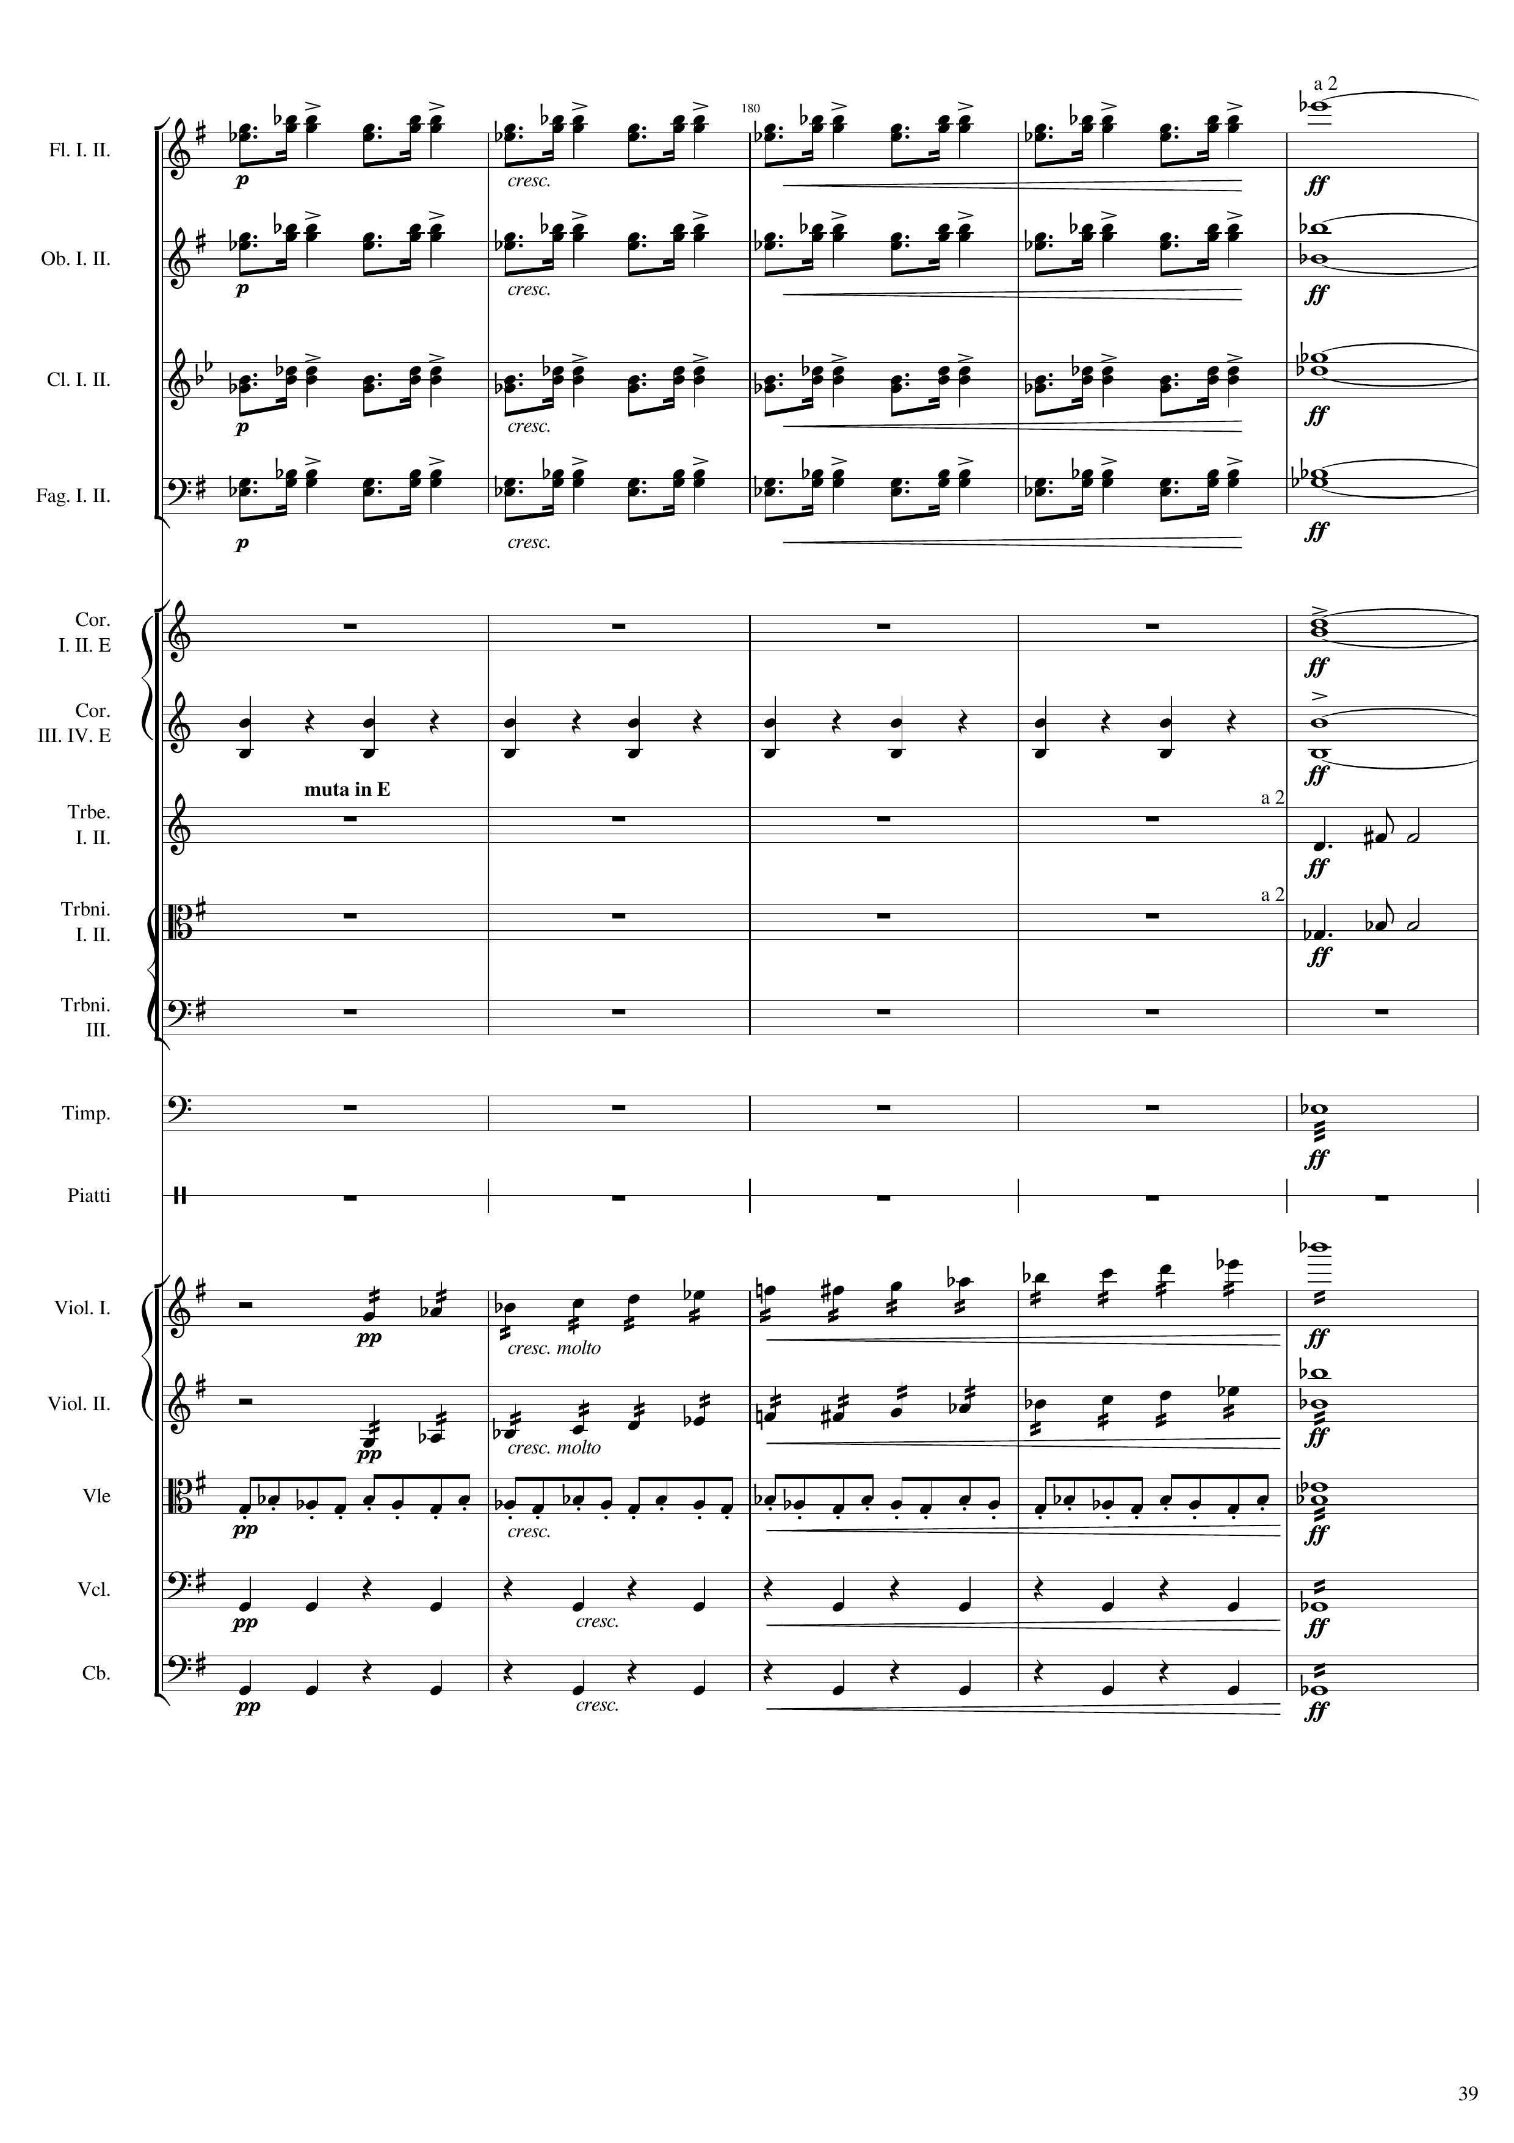
rhythm
harm
rhythm
harm
rhythm
harm
rhythm
harm
harm
rhythm
harm
mel
mel
rhythm
mel
rhythm+harm
mel
rhythm+harm
mel+rhythm
rhythm+harm
rhythm
rhythm+harm
rhythm
rhythm+harm
Notes:
708-728
38:43

Slide 40
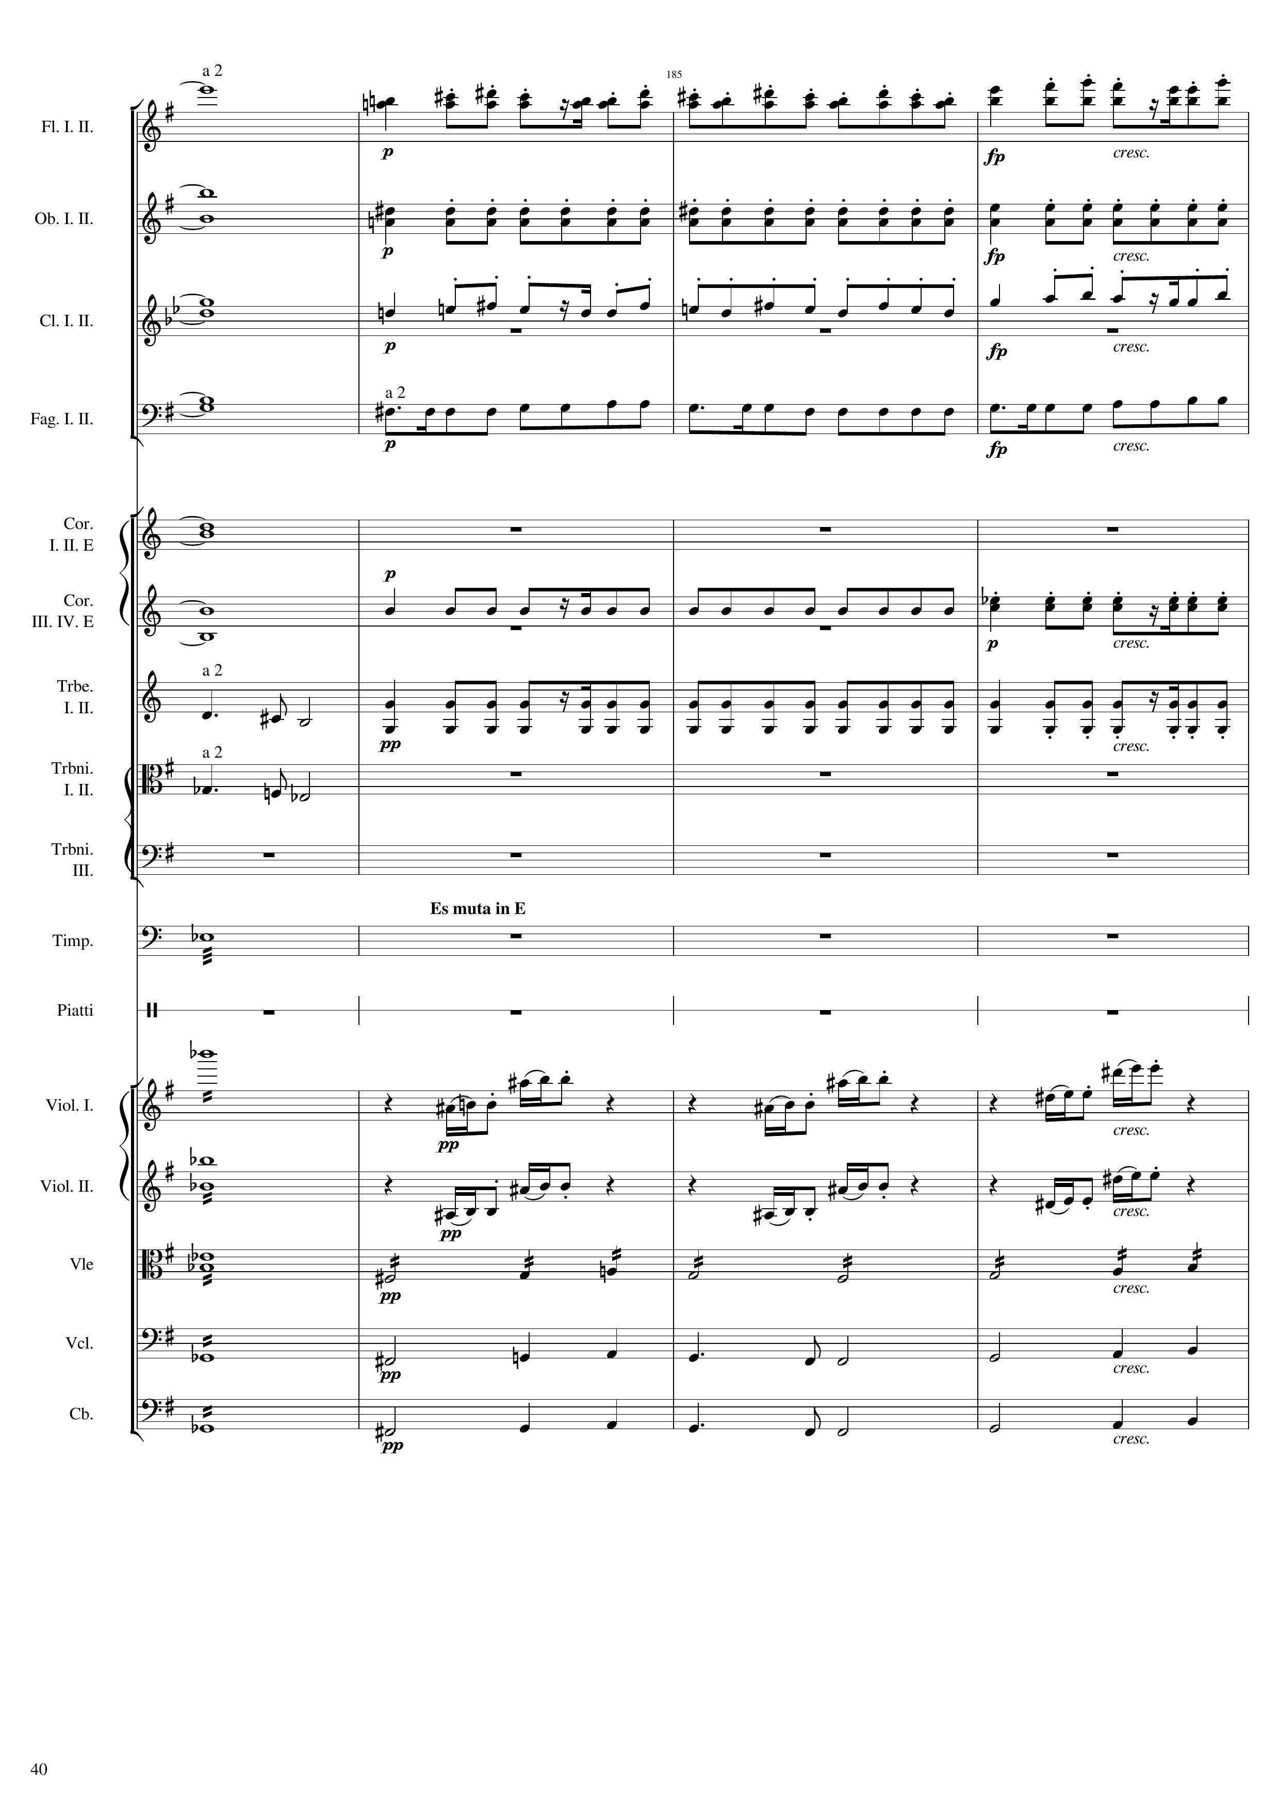
harm
mel+rhythm
harm
rhythm
harm
mel+rhythm
harm
rhythm
harm
harm
rhythm
mel
rhythm
mel
rhythm
rhythm+harm
mel
rhythm+harm
mel
rhythm+harm
mel+rhythm
rhythm+harm
mel
rhythm+harm
mel
Notes:
728-744
38:52

Slide 41
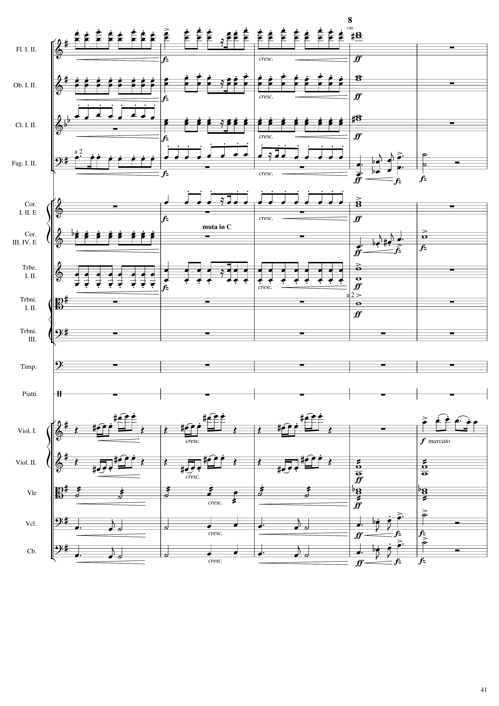
mel+rhythm
harm
rhythm
rhythm
mel+rhythm
harm
rhythm
mel+rhythm
rhythm
harm
rhythm
mel
c
rhythm
harm
rhythm
mel
c
rhythm
harm
harm
mel
mel
c
mel
rhythm
mel+rhythm
rhythm
mel
mel
c
mel
mel
c
Notes:
744-764
38:59

Slide 42
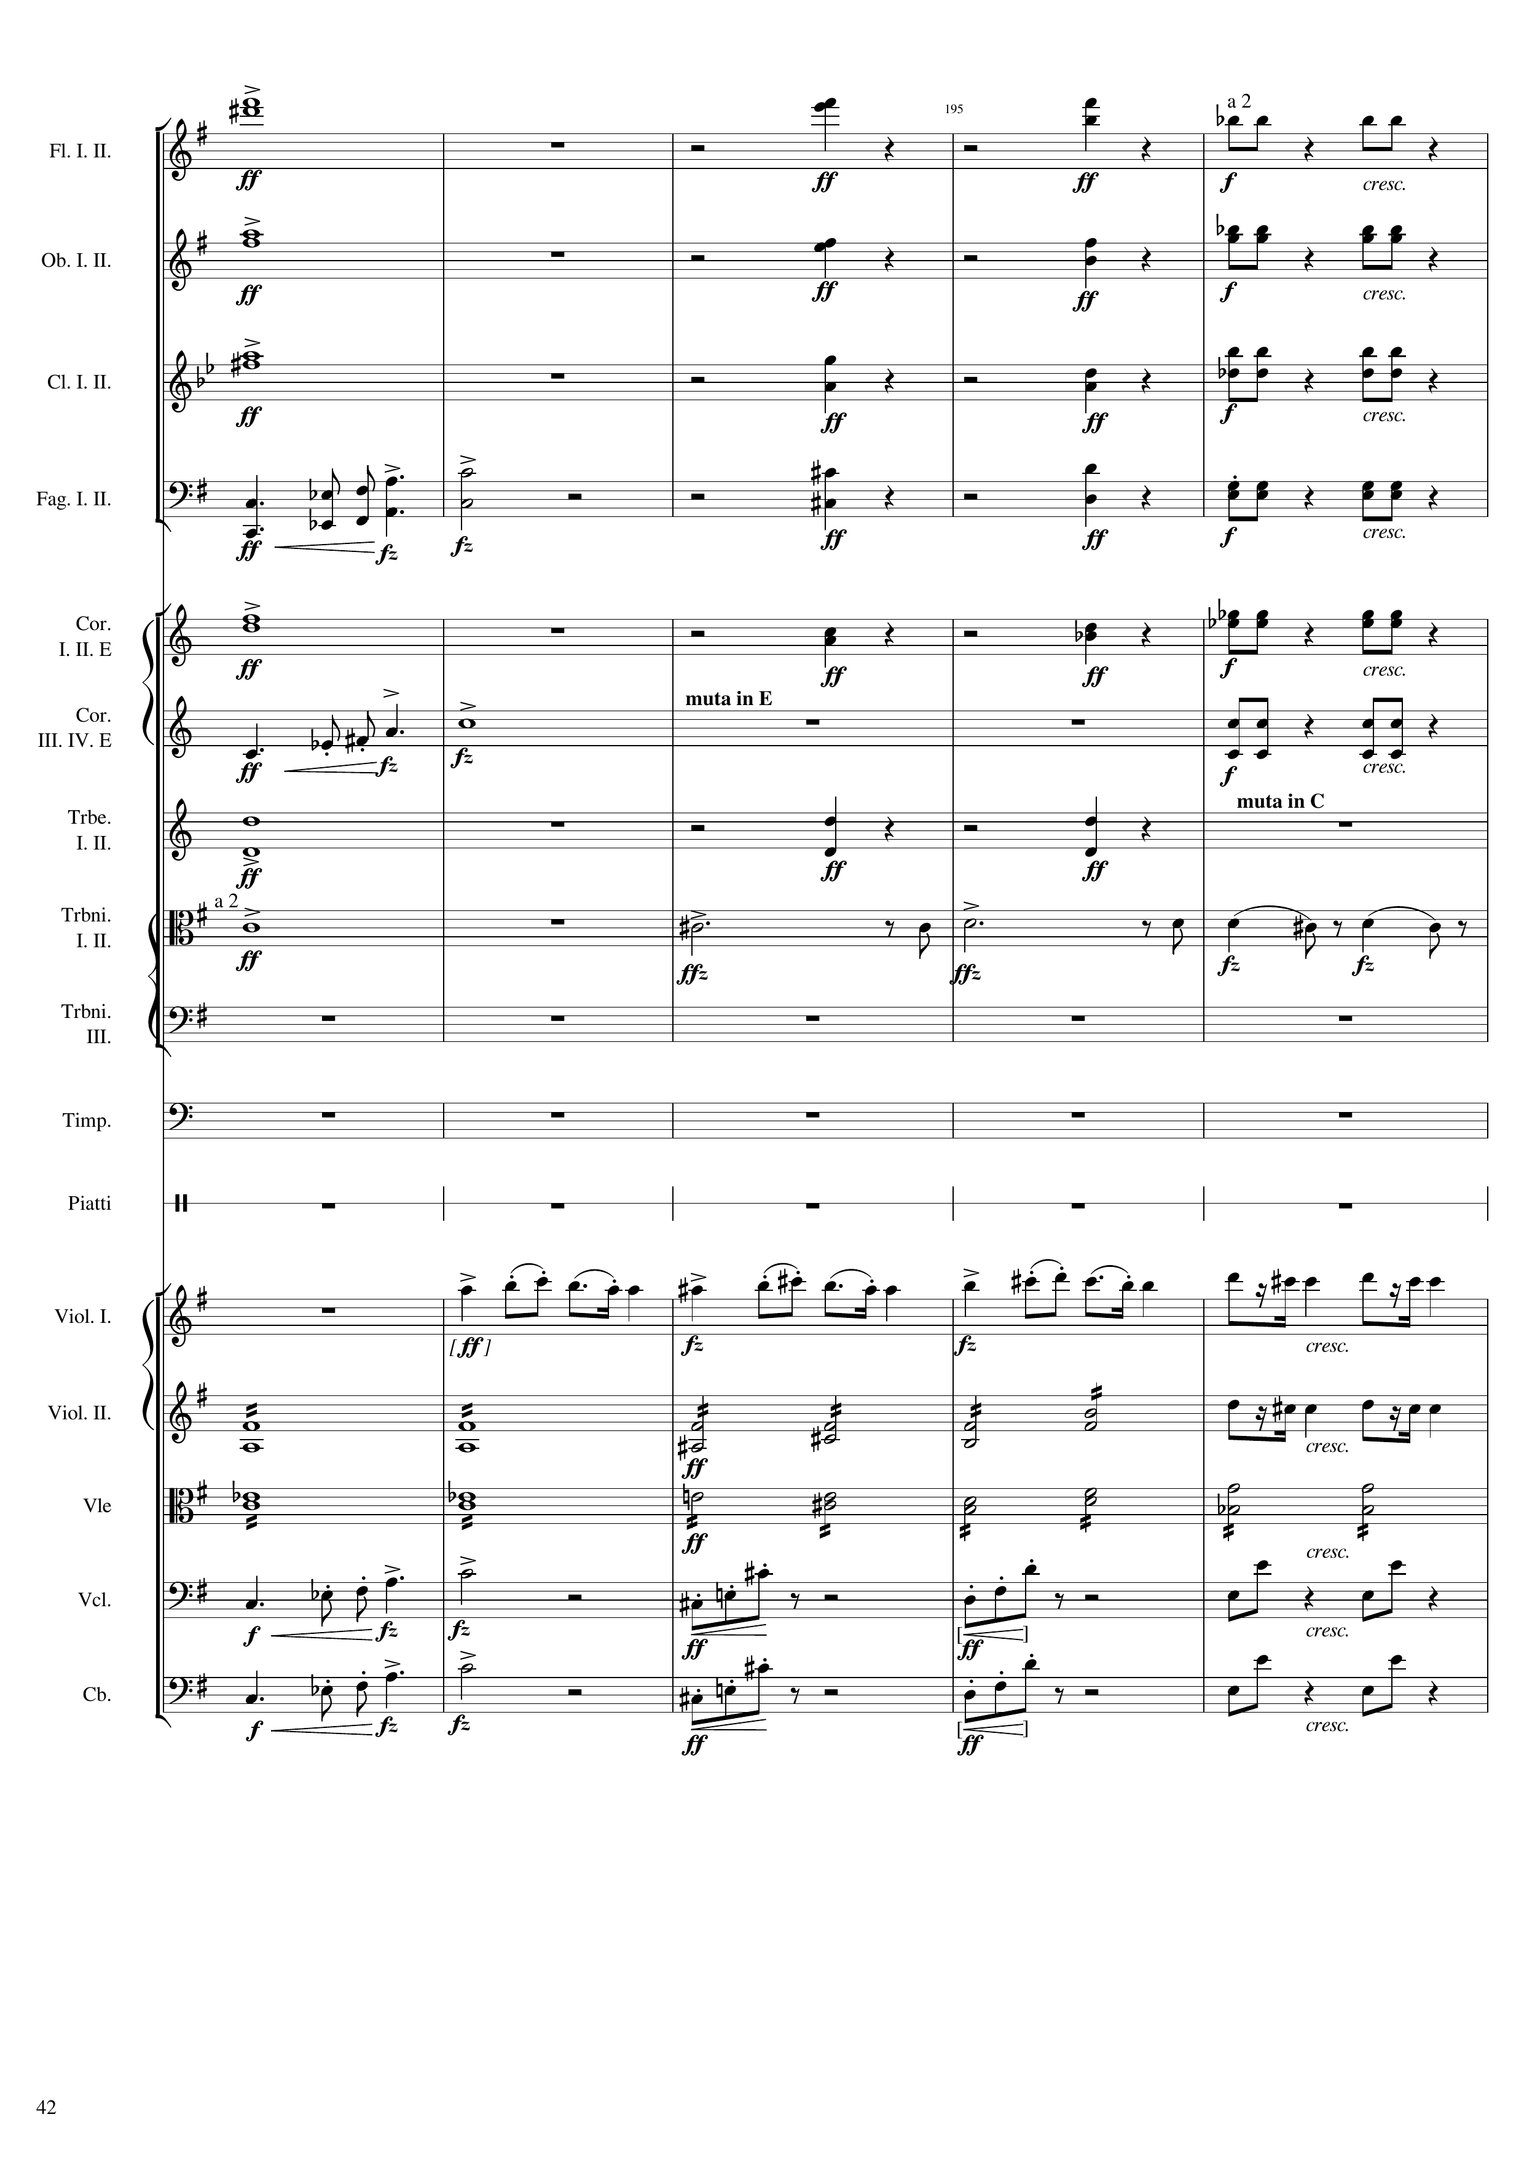
harm
rhythm+harm
rhythm+harm
harm
rhythm+harm
rhythm+harm
harm
rhythm+harm
rhythm+harm
mel
c
rhythm+harm
rhythm+harm
harm
rhythm+harm
rhythm+harm
mel
c
rhythm+harm
harm
rhythm+harm
harm
rhythm+harm
mel
c
mel
c
rhythm
rhythm+harm
mel
c
rhythm
rhythm+harm
rhythm+harm
mel
c
rhythm
rhythm+harm
mel
c
rhythm
rhythm+harm
Notes:
764-784
39:07

Slide 43
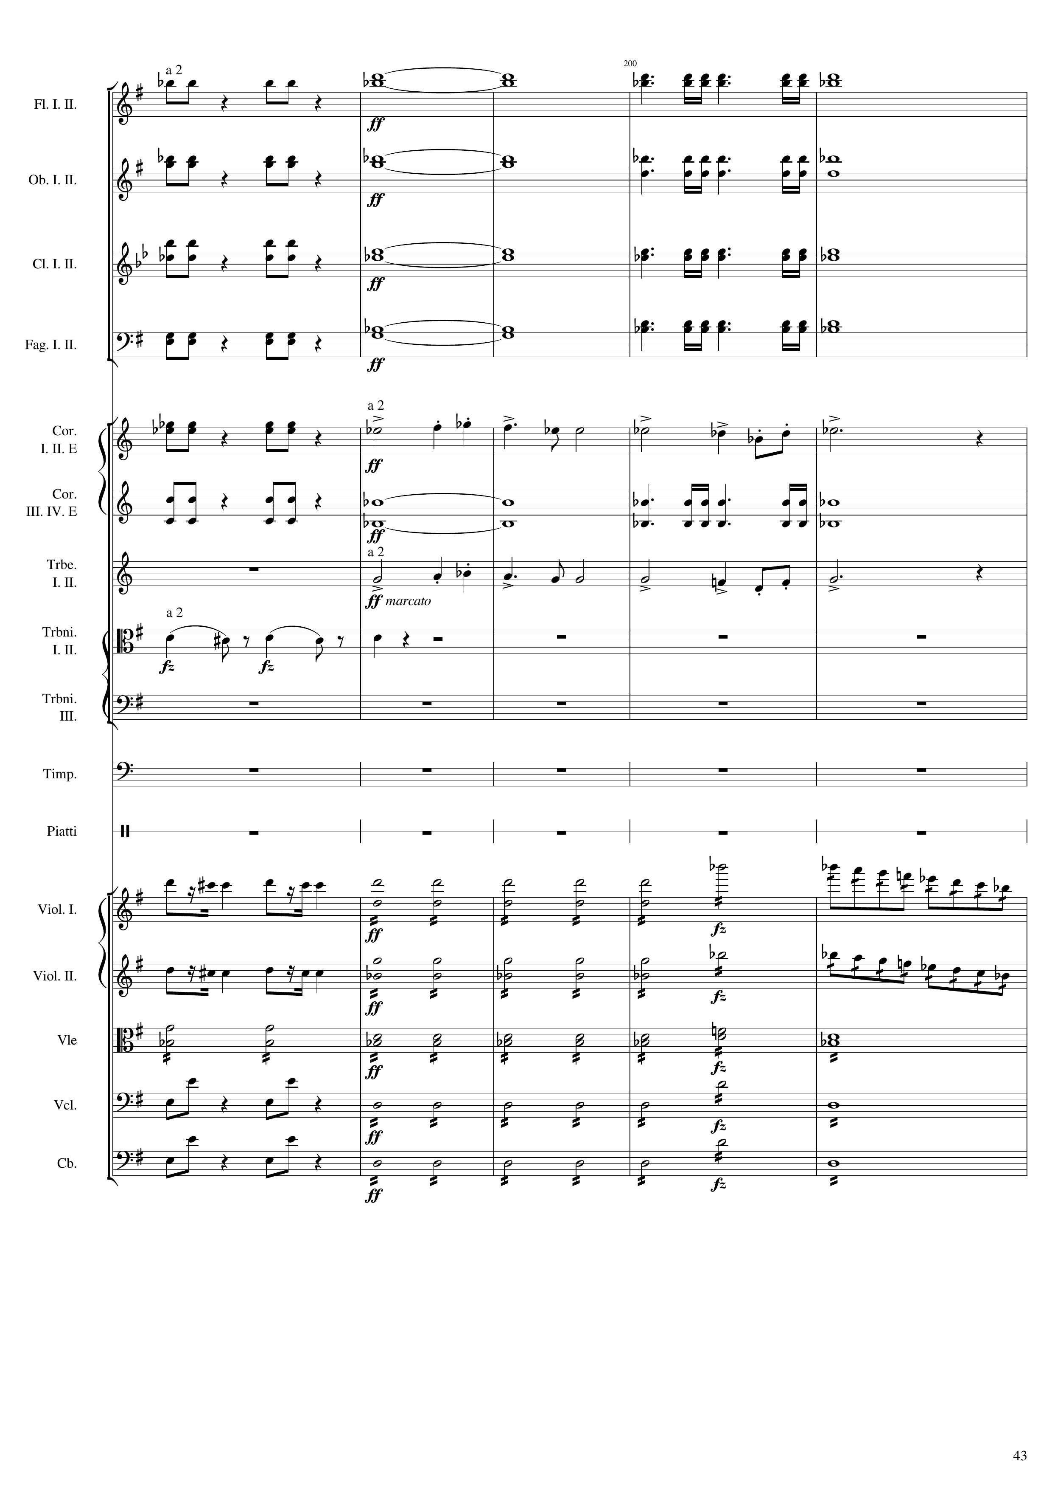
rhythm+harm
harm
rhythm
rhythm+harm
harm
rhythm
rhythm+harm
harm
rhythm
rhythm+harm
harm
rhythm
rhythm+harm
mel
c
rhythm+harm
harm
rhythm
mel
c
mel
c
mel
c
rhythm
mel+rhythm
mel
c
rhythm
mel+rhythm
rhythm+harm
rhythm
rhythm
rhythm+harm
rhythm
rhythm
rhythm+harm
rhythm
rhythm
Notes:
784-804
39:16

Slide 44
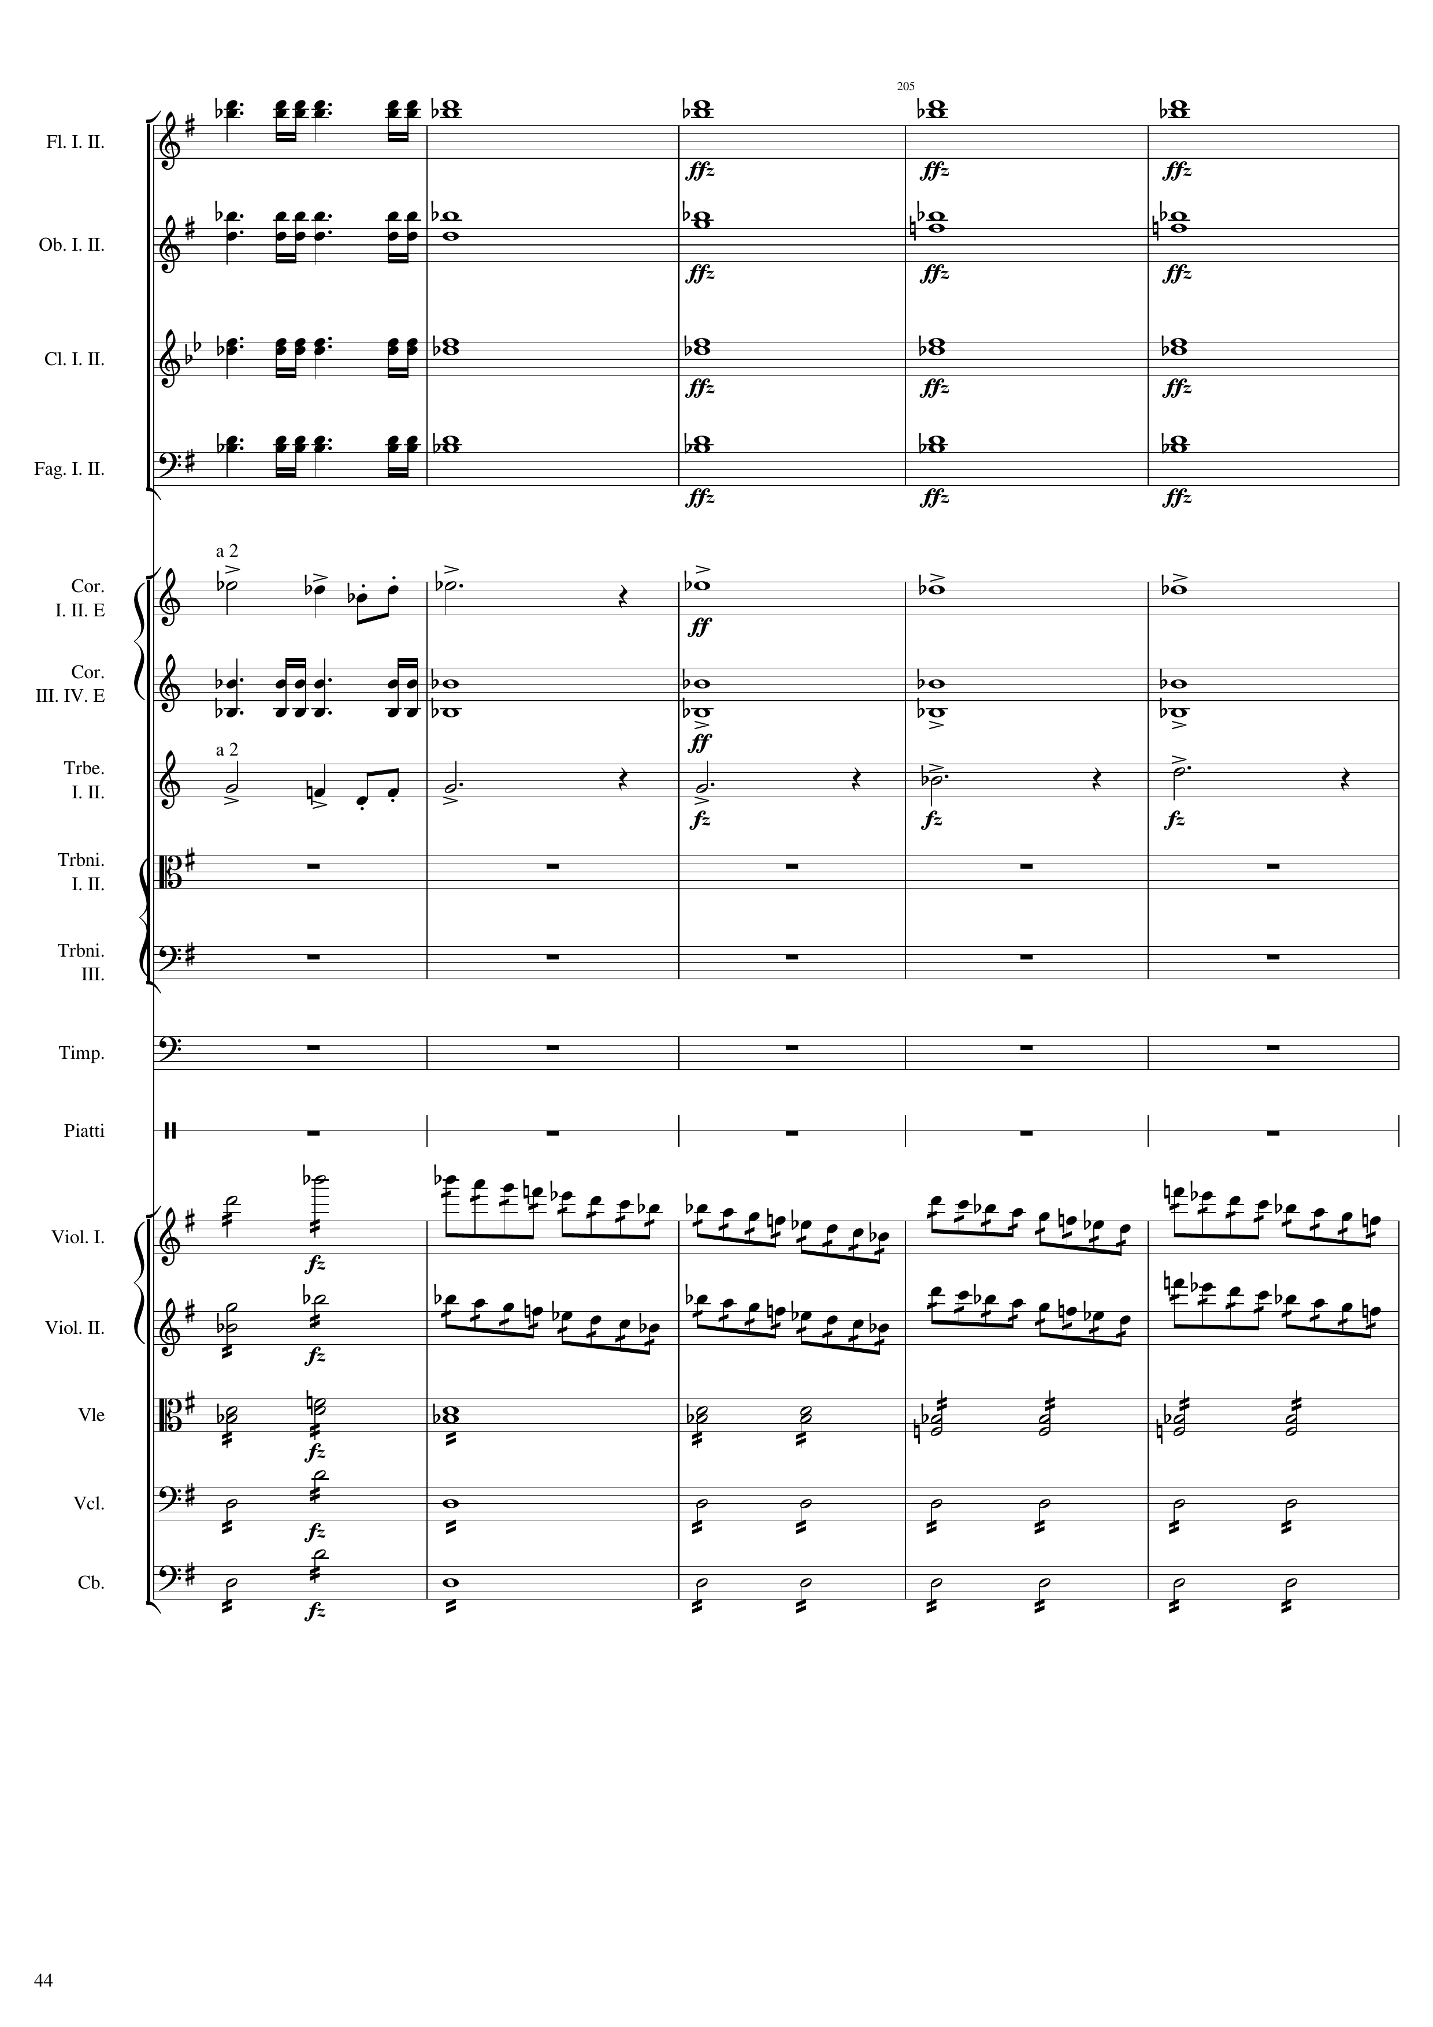
rhythm
harm
rhythm
harm
rhythm
harm
rhythm
harm
mel
c
harm
rhythm
harm
mel
c
harm
mel+rhythm
mel+rhythm
rhythm
rhythm
rhythm
Notes:
804-824
39:25

Slide 45
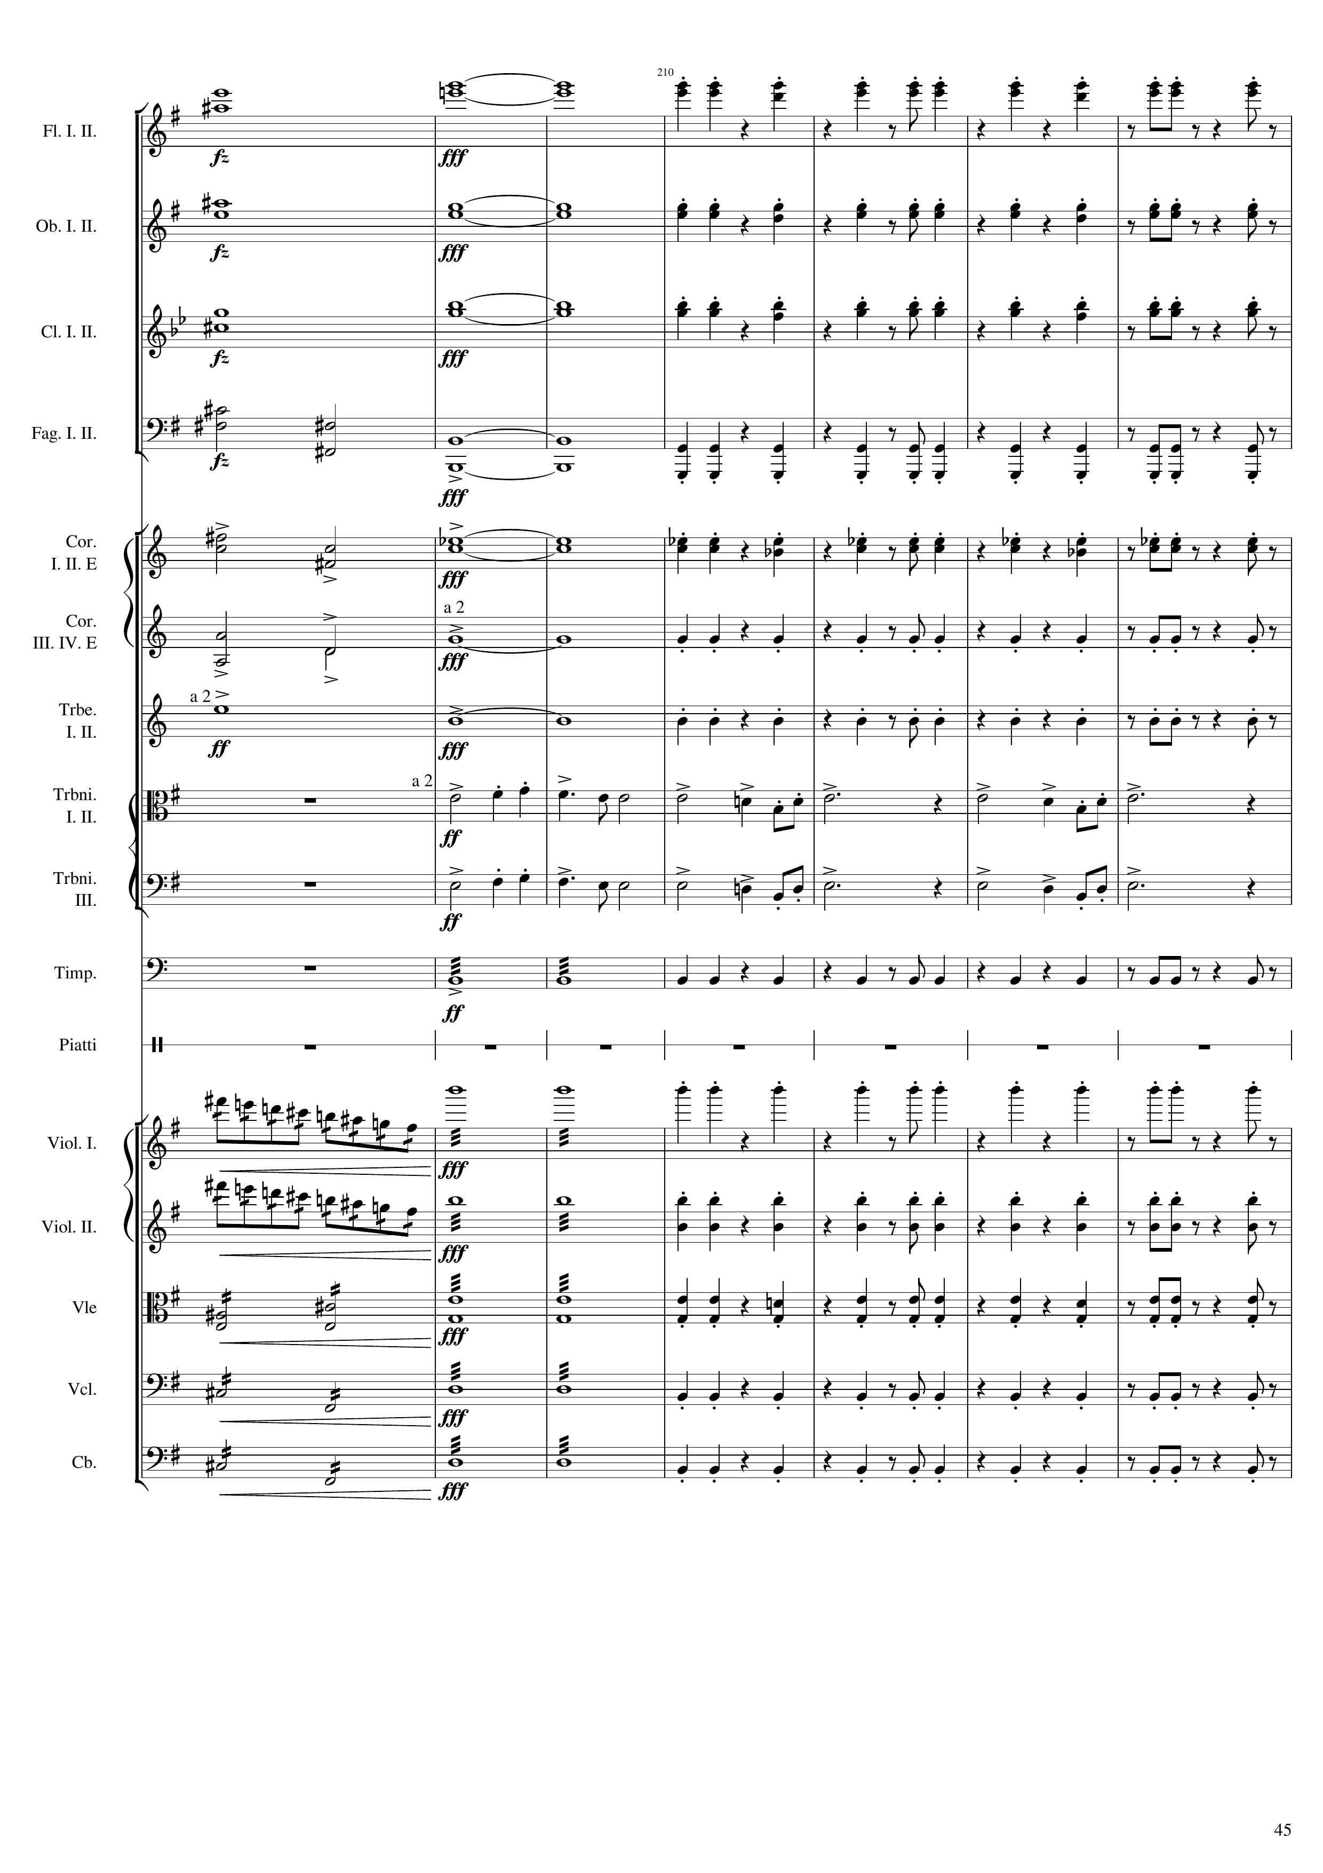
harm
harm
rhythm+harm
harm
harm
rhythm+harm
harm
harm
rhythm+harm
harm
harm
rhythm+harm
harm
harm
rhythm+harm
harm
harm
rhythm+harm
harm
harm
rhythm+harm
mel
c
mel
c
rhythm
rhythm+harm
mel+rhythm
rhythm
rhythm+harm
mel+rhythm
rhythm
rhythm+harm
rhythm
rhythm
rhythm+harm
rhythm
rhythm
rhythm+harm
rhythm
rhythm
rhythm+harm
Notes:
824-852
39:34

Slide 46
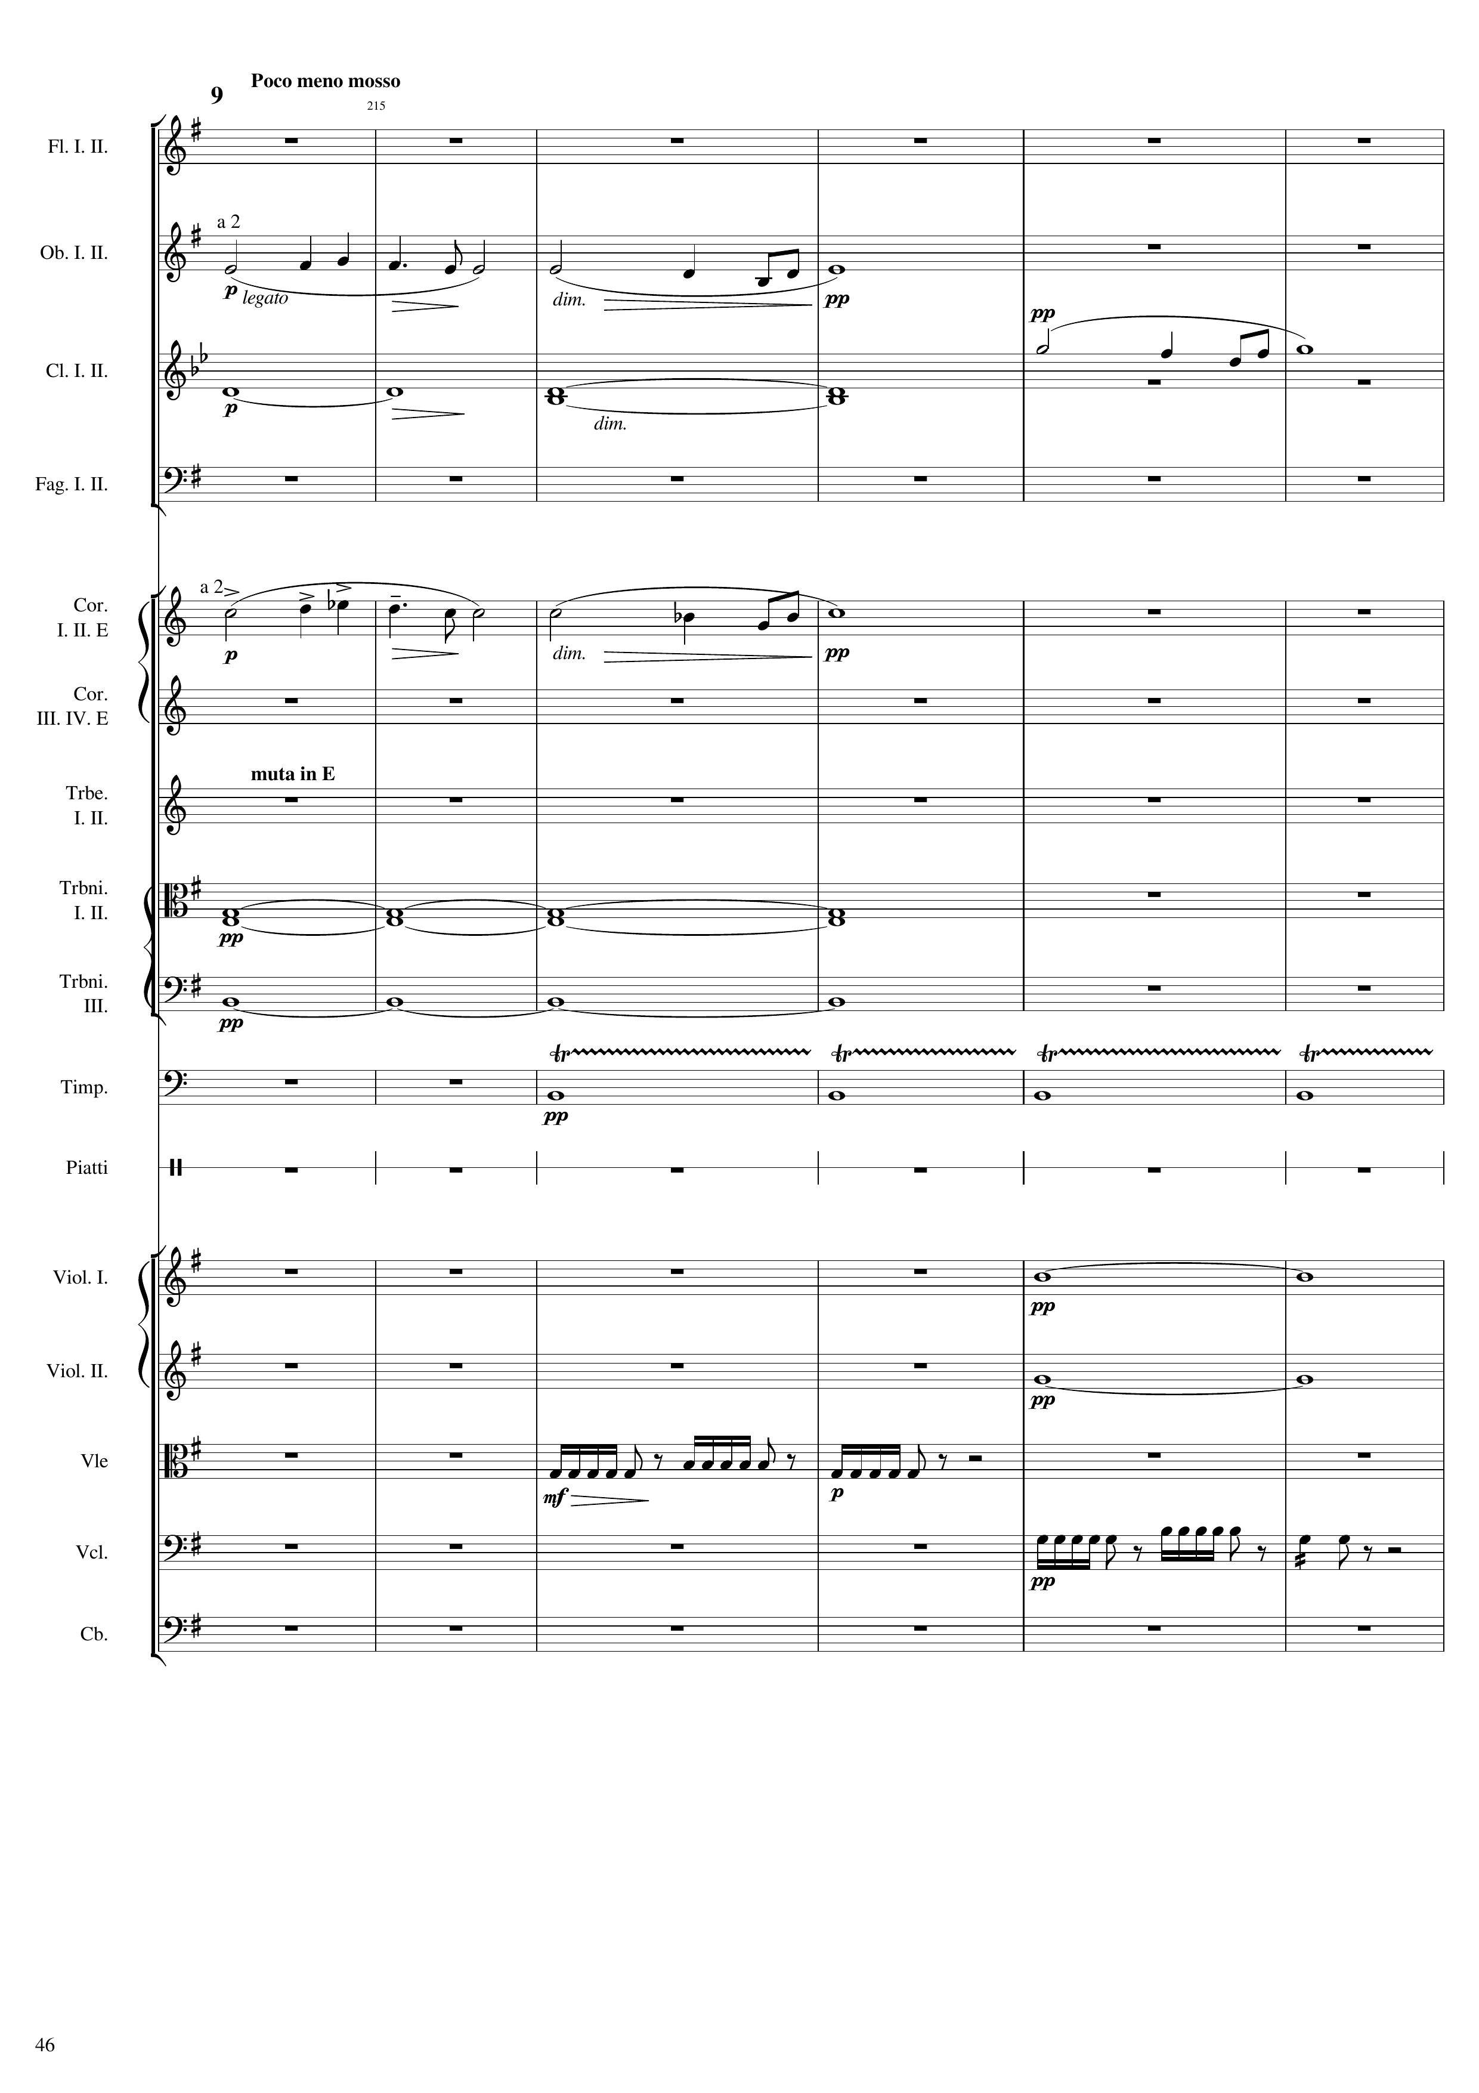
mel
c
harm
mel
c
mel
c
harm
harm
rhythm
harm
harm
rhythm
rhythm
Notes:
852-876
39:48

Slide 47
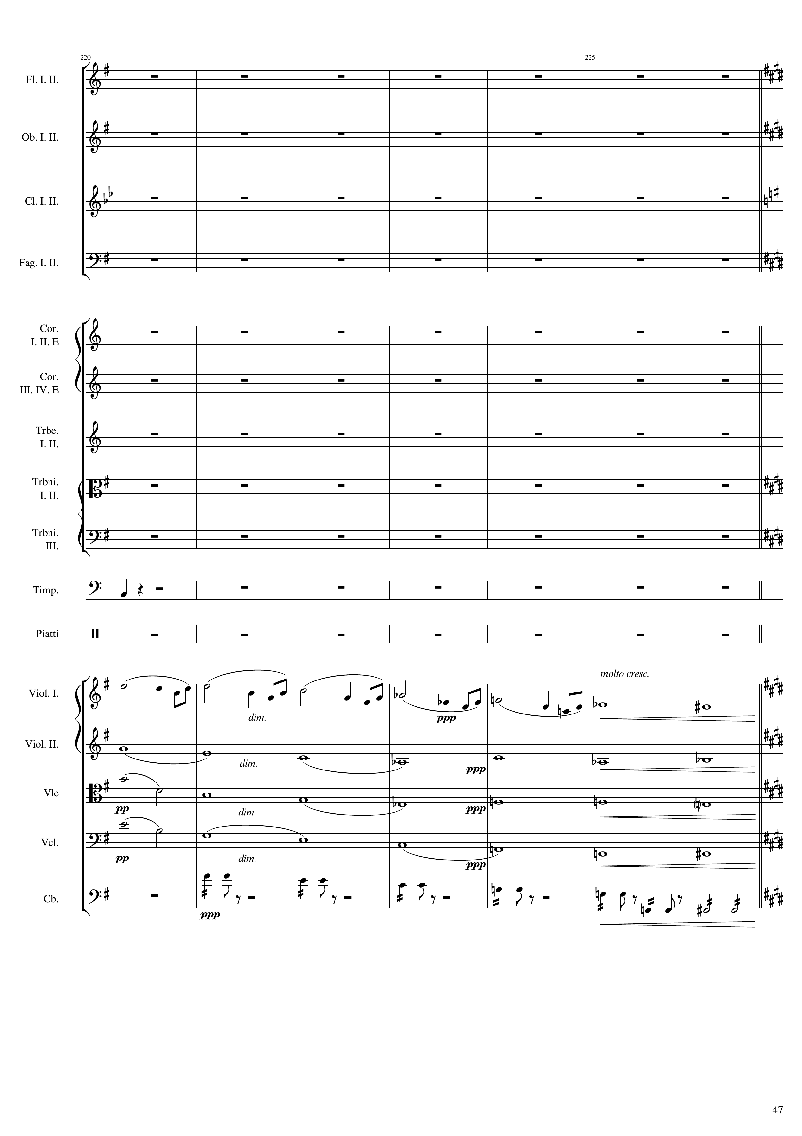
rhythm
mel
c
harm
harm
harm
harm
harm
harm
harm
rhythm+harm
Notes:
876-904
40:05

Slide 48
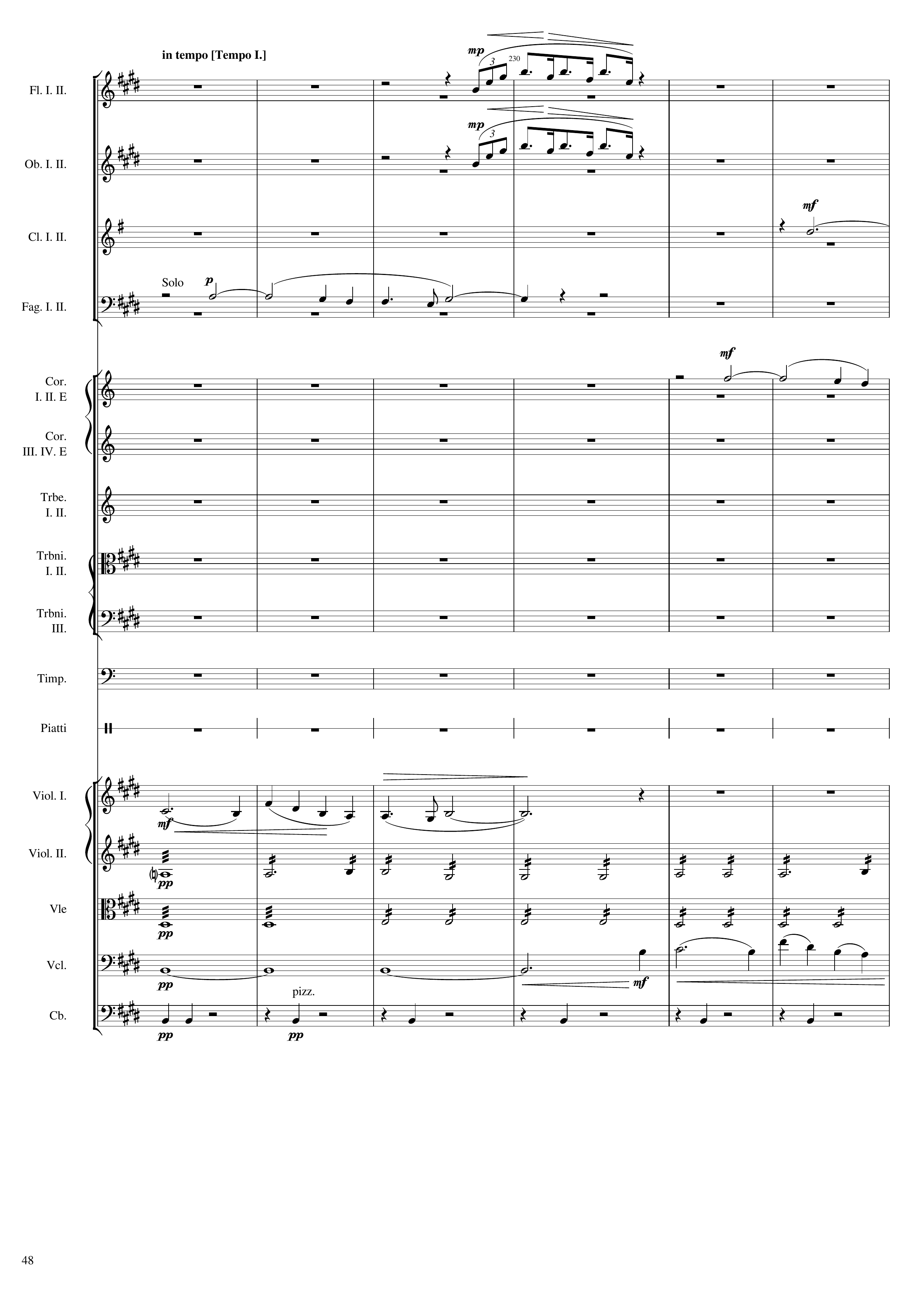
227th bar
904
mel
mel
mel
mel
mel
mel
harm
harm
harm
mel
rhythm

Slide 49
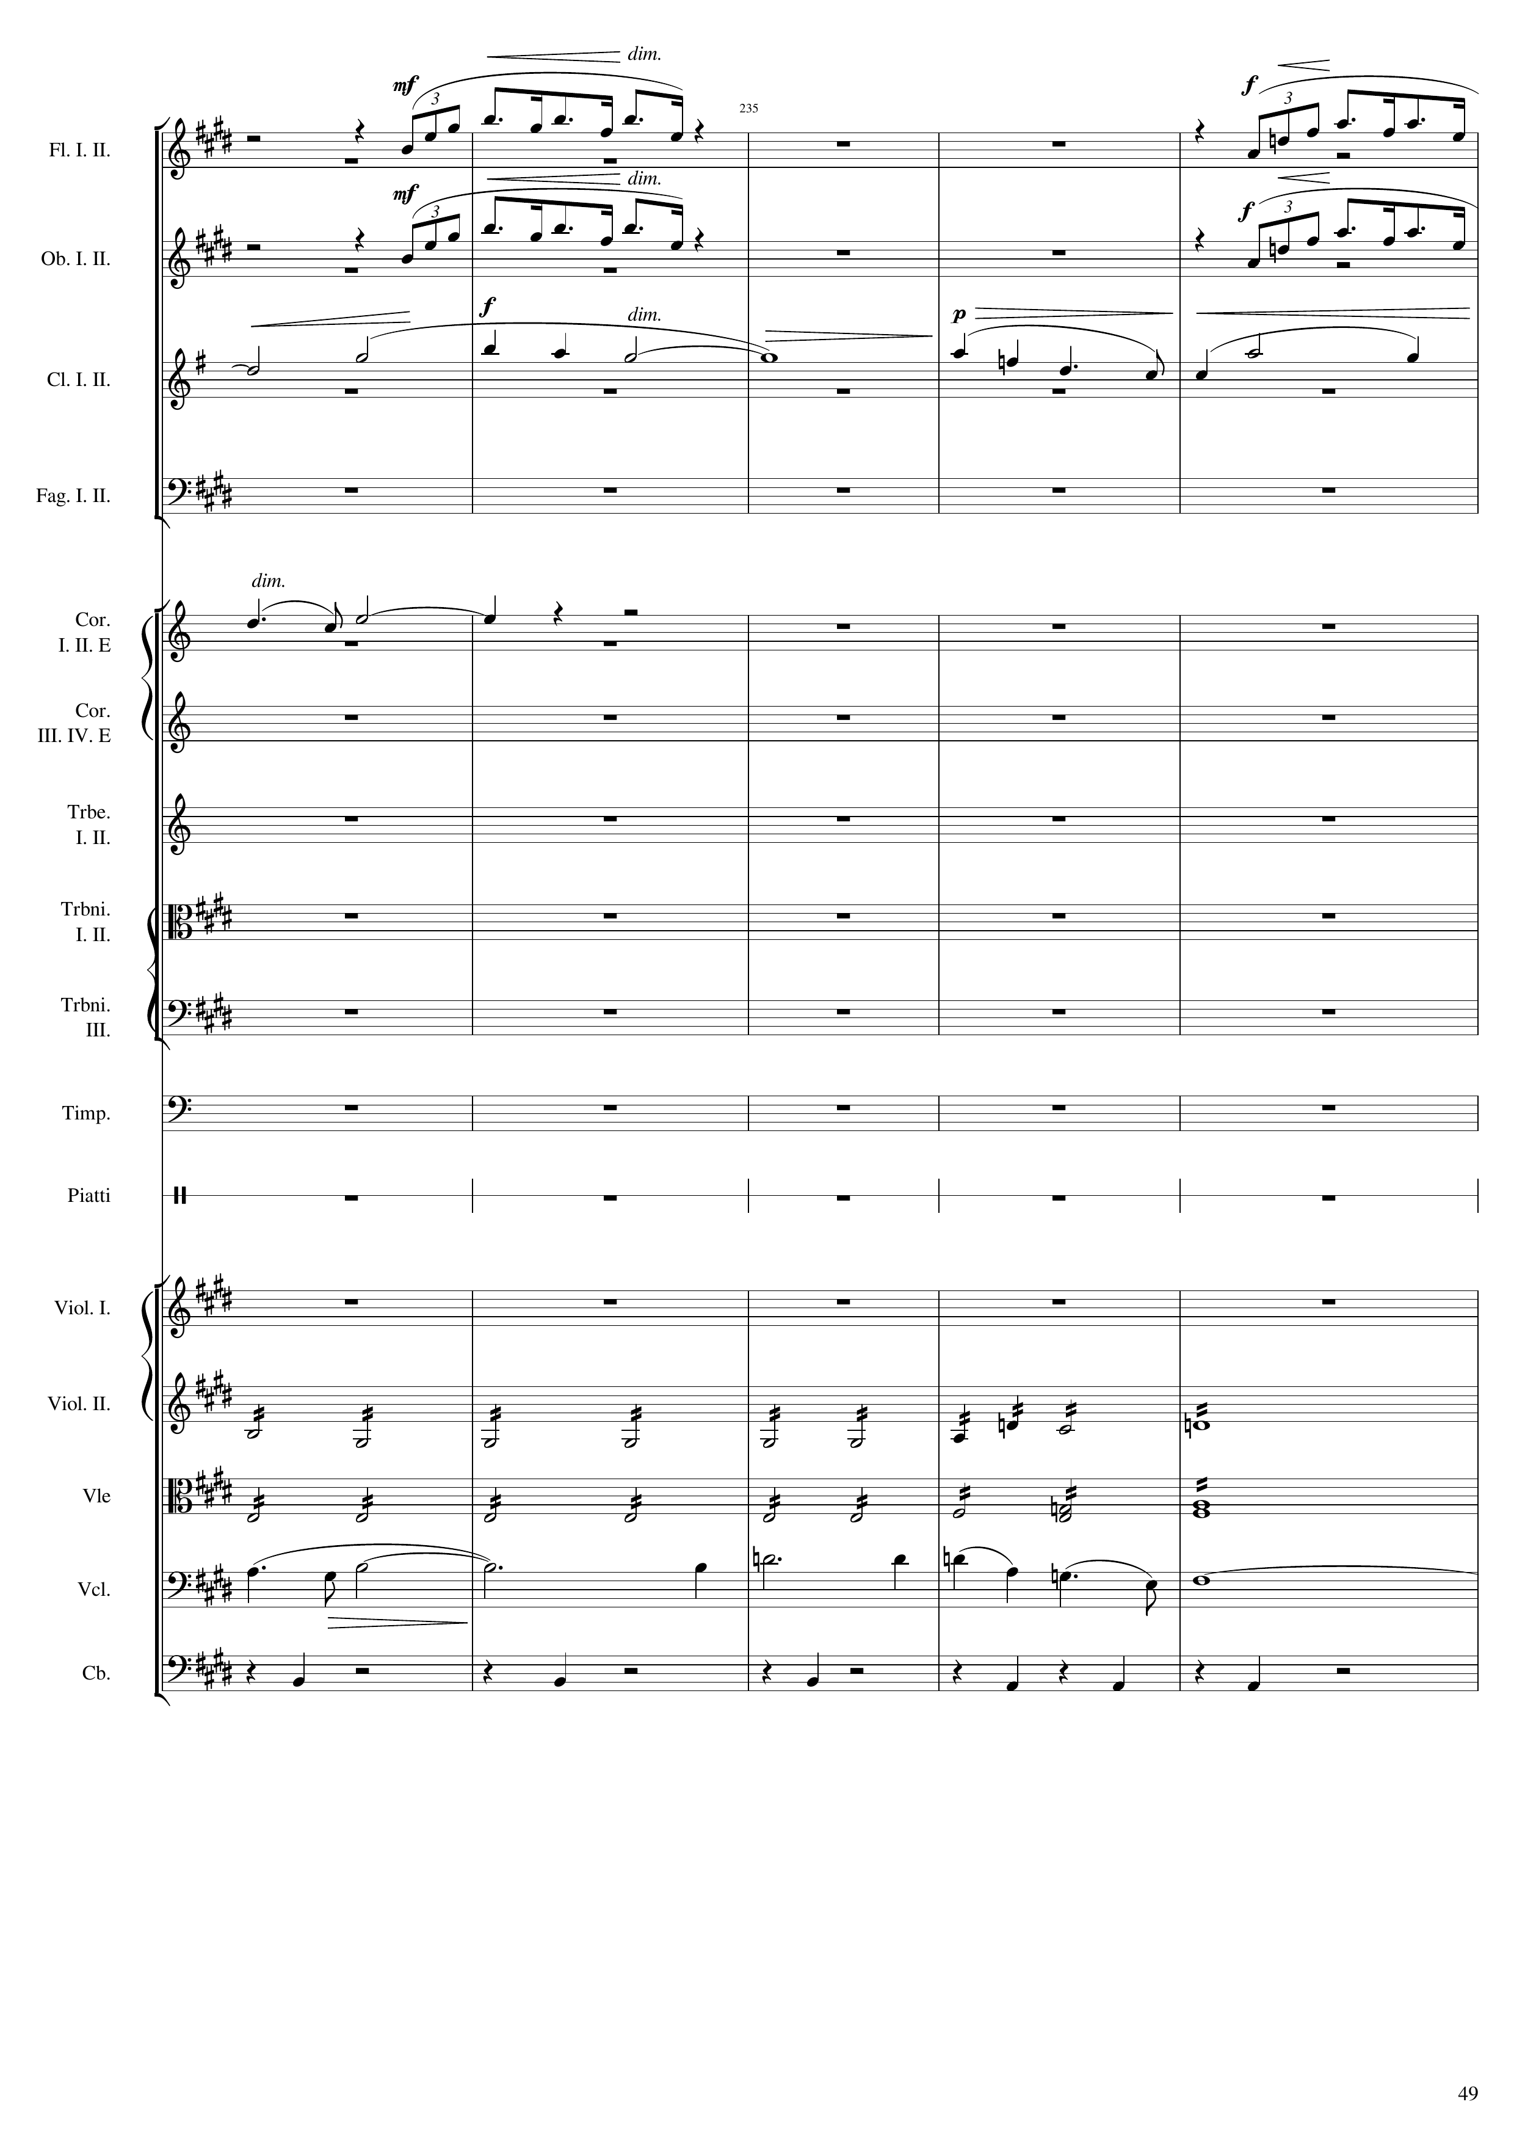
932
mel
mel
mel
mel
mel
mel
harm
harm
mel
rhythm

Slide 50
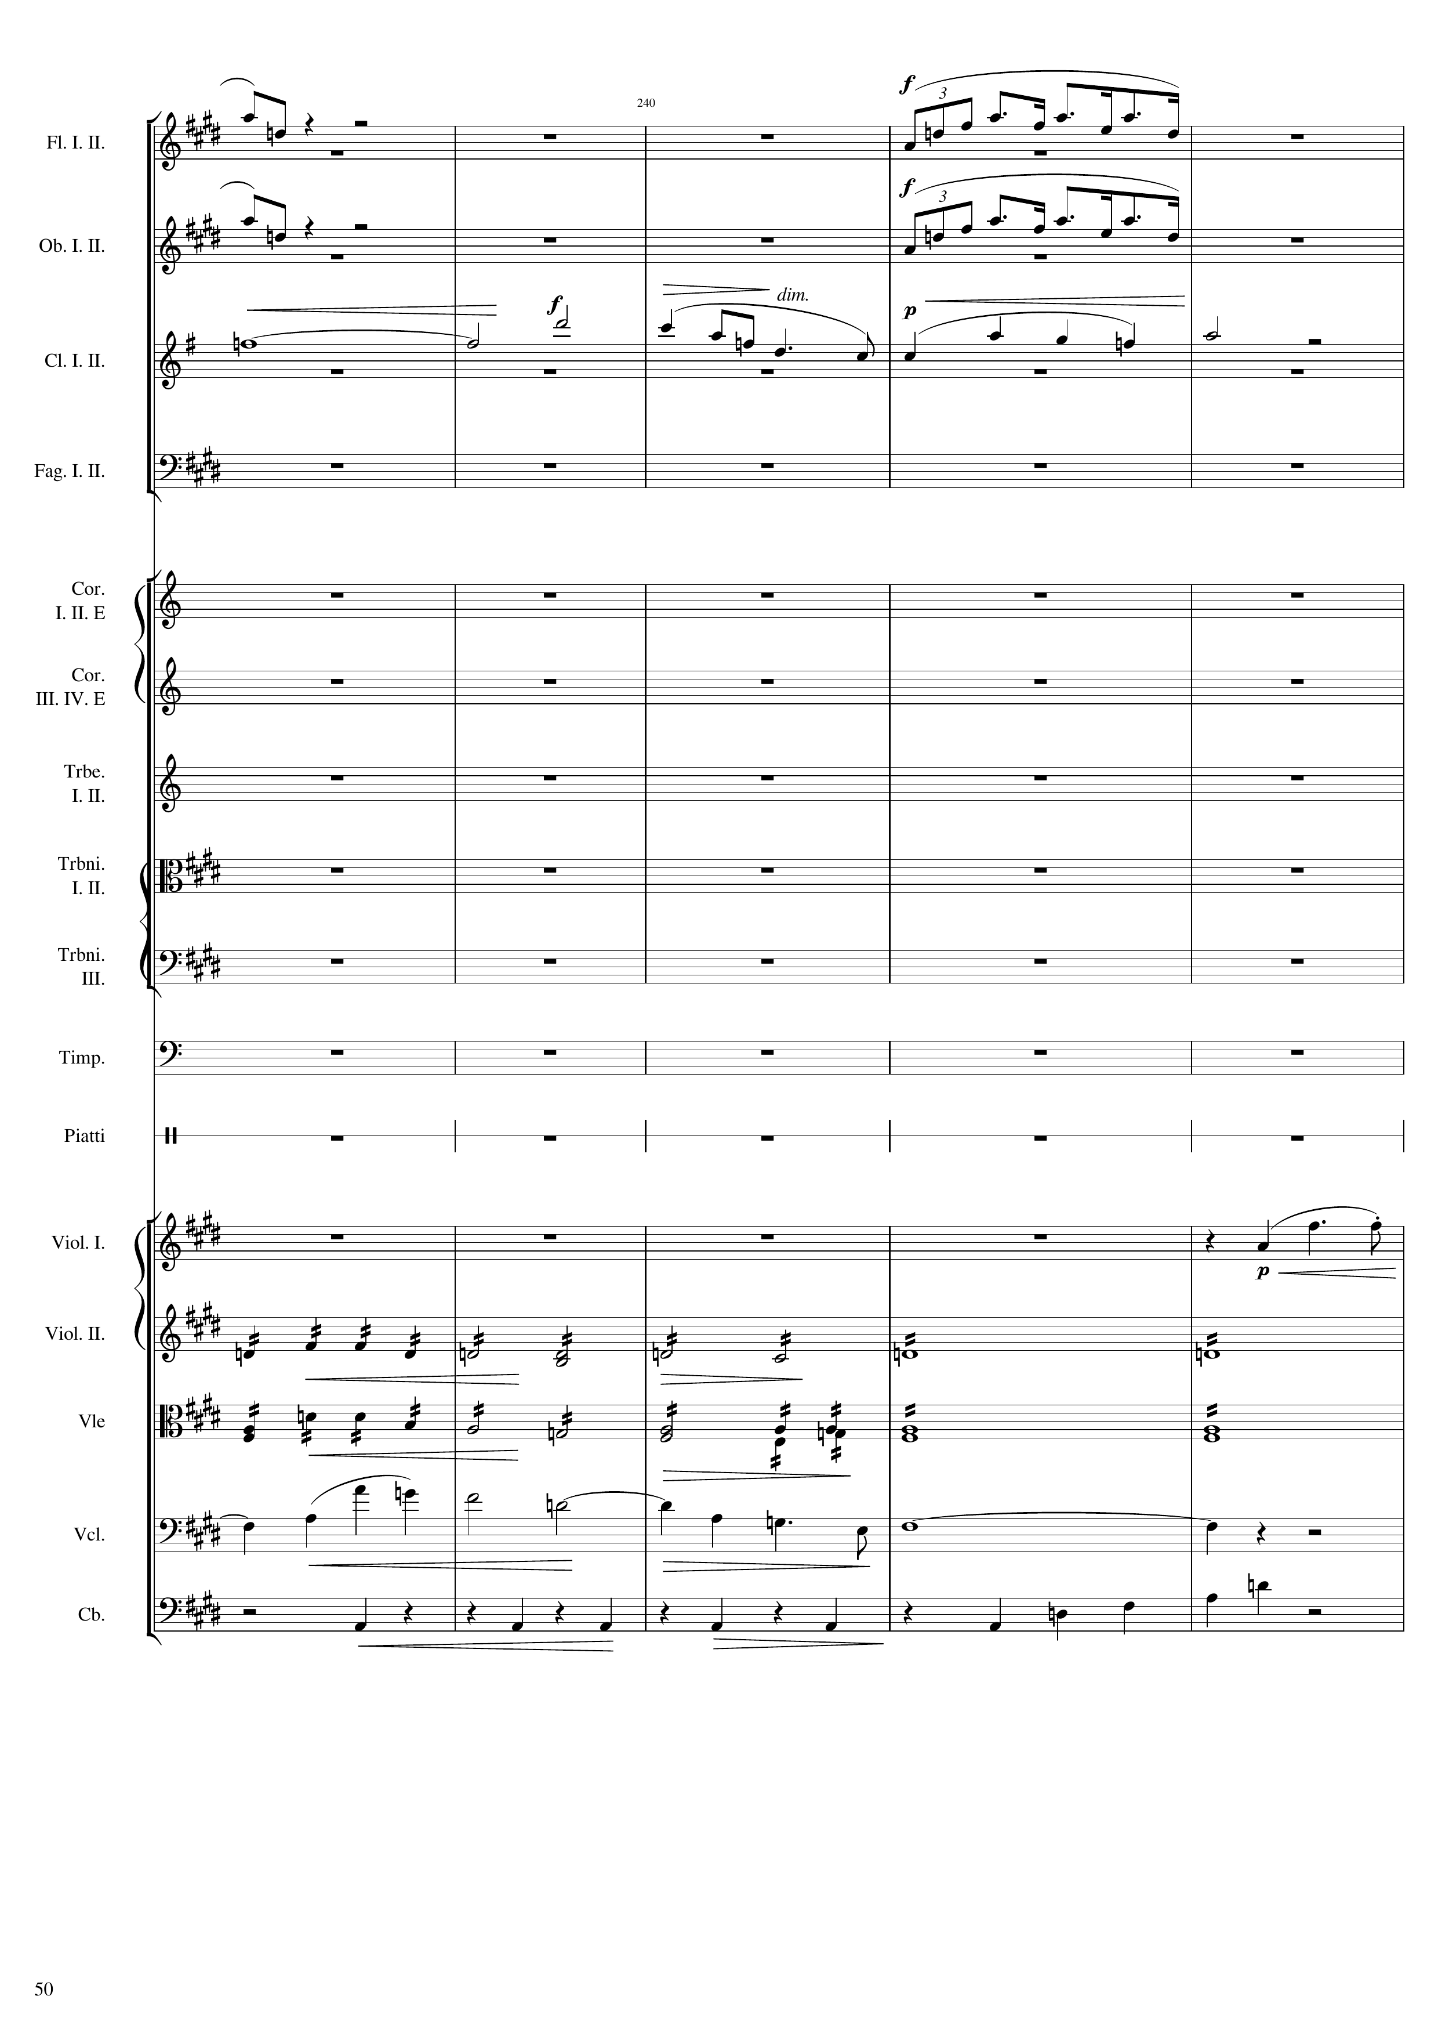
mel
mel
mel
mel
mel
mel
harm
harm
mel
rhythm

Slide 51

968
mel
mel
harm
mel
rhythm+harm
rhythm+harm
mel
mel

Slide 52

mel
mel
harm
harm
harm
rhythm
mel
rhythm+harm
rhythm+harm
mel
mel
rhythm+harm

Slide 53

1000
mel
harm
mel
harm
rhythm
mel
rhythm+harm
harm
rhythm
rhythm+harm
harm

Slide 54

mel
harm
mel
harm
rhythm
rhythm
harm
rhythm+harm
harm

Slide 55

1032
mel
harm
mel
mel
harm
mel+rhythm
rhythm
rhythm
harm
rhythm
harm
rhythm+harm
harm
harm

Slide 56

mel
mel
mel+rhythm
rhythm
harm
harm
harm
harm

Slide 57

1048
rhythm
harm
rhythm
harm
harm
mel+rhythm
mel
harm
harm
rhythm+harm
rhythm+harm
harm

Slide 58

1064
harm
mel
harm
mel
harm
mel
mel
mel
mel
harm
mel+rhythm
harm
mel+rhythm
rhythm+harm
harm
harm

Slide 59

1080
mel
mel+rhythm
harm
rhythm
mel+rhythm
mel+rhythm
harm

Slide 60

1096
1112
harm
harm
harm
mel
harm
mel+rhythm
mel
harm
harm
mel
mel
rhythm
harm
harm
harm
mel
harm
mel
harm

Slide 61

1120
harm
rhythm
harm
rhythm
harm
rhythm
harm
rhythm
mel
harm
rhythm
rhythm
mel
mel
rhythm
harm
mel+rhythm
harm
mel+rhythm
harm
mel+rhythm
harm
mel+rhythm
harm
rhythm+harm

Slide 62

1144
rhythm
rhythm
rhythm
rhythm
mel+rhythm
mel
rhythm
rhythm
rhythm
mel
mel
rhythm
mel+rhythm
mel+rhythm
mel+rhythm
mel+rhythm
rhythm+harm
mel+rhythm

Slide 63

1152
rhythm
harm
rhythm
harm
rhythm
harm
mel+rhythm
harm
rhythm
harm
rhythm
harm
mel
rhythm
mel
harm
rhythm+harm
harm
rhythm
mel+rhythm
harm
mel+rhythm
mel+rhythm
harm
mel+rhythm
mel+rhythm
harm
mel+rhythm
harm
mel+rhythm
harm

Slide 64

1176
rhythm+harm
mel+rhythm
rhythm+harm
mel+rhythm
rhythm+harm
mel+rhythm
mel+rhythm
rhythm+harm
rhythm
rhythm+harm
rhythm+harm
rhythm
rhythm+harm
rhythm
rhythm
mel
mel+rhythm
mel
mel+rhythm
harm
rhythm+harm
mel+rhythm
harm
rhythm
harm
rhythm

Slide 65

1192
mel+rhythm
rhythm+harm
mel+rhythm
rhythm+harm
mel+rhythm
rhythm+harm
rhythm
rhythm+harm
rhythm+harm
rhythm+harm
rhythm+harm
rhythm+harm
rhythm
rhythm+harm
rhythm+harm
rhythm+harm
rhythm
rhythm+harm
rhythm
mel+rhythm
mel+rhythm
mel+rhythm
rhythm+harm
mel+rhythm
rhythm+harm
mel+rhythm
rhythm+harm
rhythm
rhythm+harm
rhythm
rhythm+harm

Slide 66

1216
rhythm+harm
harm
rhythm+harm
harm
rhythm+harm
harm
rhythm+harm
harm
rhythm+harm
harm
rhythm+harm
harm
rhythm+harm
harm
rhythm+harm
harm
rhythm+harm
harm
rhythm
rhythm+harm
harm
rhythm+harm
harm
rhythm+harm
harm
rhythm+harm
rhythm
rhythm+harm
rhythm

Slide 67

harm
harm
harm
harm
harm
harm
harm
harm
harm
rhythm
harm
rhythm+harm
harm
rhythm+harm
harm
rhythm+harm
rhythm
rhythm

Slide 68

1248
harm
harm
mel
harm
rhythm
rhythm+harm
rhythm+harm
rhythm+harm
rhythm
rhythm
harm

Slide 69

1256
rhythm
mel
rhythm
rhythm
rhythm
rhythm
harm

Slide 70

1280
mel
harm
mel
harm
harm
rhythm
rhythm
harm

Slide 71

1304
mel
mel
rhythm+harm
harm
mel
rhythm+harm
mel
rhythm+harm
mel
rhythm+harm
rhythm+harm
rhythm+harm
harm
rhythm+harm
harm
rhythm+harm
rhythm
rhythm
mel+rhythm
mel
mel
mel+rhythm
mel
rhythm+harm
mel+rhythm
mel
rhythm+harm
mel+rhythm
mel
rhythm+harm
rhythm+harm

Slide 72

1320
mel
harm
harm
harm
mel
harm
harm
harm
mel
harm
mel
mel
harm
mel
harm
rhythm
harm
harm
harm
mel
harm
mel
harm

Slide 73

1344
1356
mel+rhythm
rhythm
rhythm
rhythm
mel+rhythm
rhythm
rhythm
mel+rhythm
rhythm
rhythm
rhythm
rhythm
mel+rhythm
rhythm
mel+rhythm
mel+rhythm
rhythm
mel+rhythm
rhythm
rhythm
rhythm
rhythm
rhythm
rhythm
mel+rhythm
mel+rhythm
mel+rhythm
mel+rhythm
rhythm
mel+rhythm

Slide 74

1372
1388
rhythm
rhythm
rhythm
rhythm
rhythm
rhythm
mel+rhythm
rhythm
rhythm
rhythm
rhythm
rhythm
rhythm
rhythm
mel+rhythm
rhythm
mel+rhythm
rhythm
rhythm
rhythm
rhythm
rhythm
rhythm
rhythm+harm
mel+rhythm
rhythm+harm
mel+rhythm
rhythm
mel+rhythm
rhythm

